Slide 1

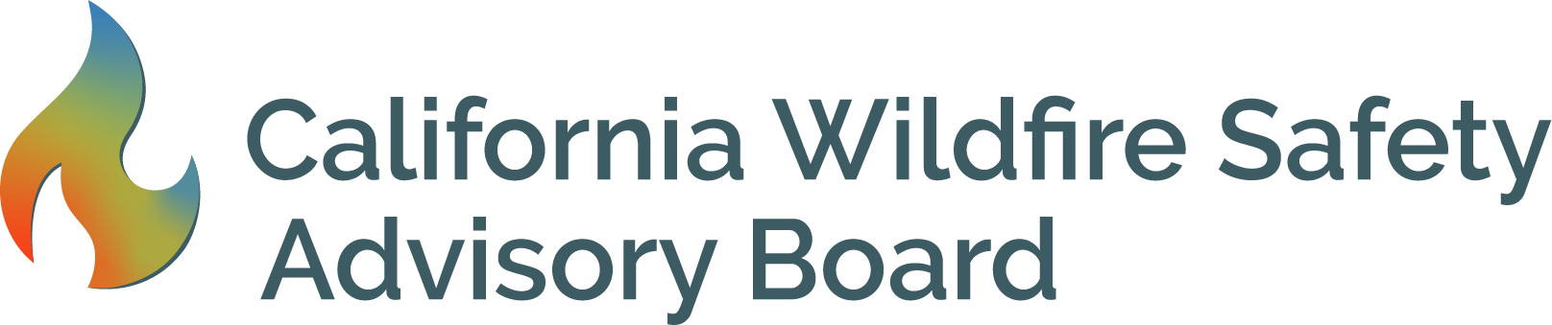
Wildfire Safety Advisory Board
Quarterly Meeting
December 7, 2021, 1:00 pm – 4:00 pm
Live Broadcast Online via Zoom.

Slide 2
Participation Information
Please choose one participation option. Using more than one technical option may create feedback.
Zoom: https://us06web.zoom.us/j/85054075344
Phone: Oral comments possible through Zoom by computer or phone.
  Number: 1-866-390-1828, passcode: 787909
  For public comment portion of the meeting: Dial #2 (pound sign two) to be placed in a queue.
Email: Written comments may be sent by mail or email to WSAB@energysafety.ca.gov.
Tech Issues: If there are technical issues, support staff is available to help. Please e-mail WSAB@energysafety.ca.gov or call Tim Tutt at 916 203-2075

Slide 3
About the Wildfire Safety Board
Members:
  Jessica Block, Chair
  Diane Fellman, Vice Chair
  Ralph M. Armstrong Jr., Board Member
  John Mader, Board Member
  Christopher Porter, Board Member
  Alexandra Syphard, Board Member
More information about the Board and its Members can be found here: https://www.energysafety.ca.gov/WSAB/.

Slide 4
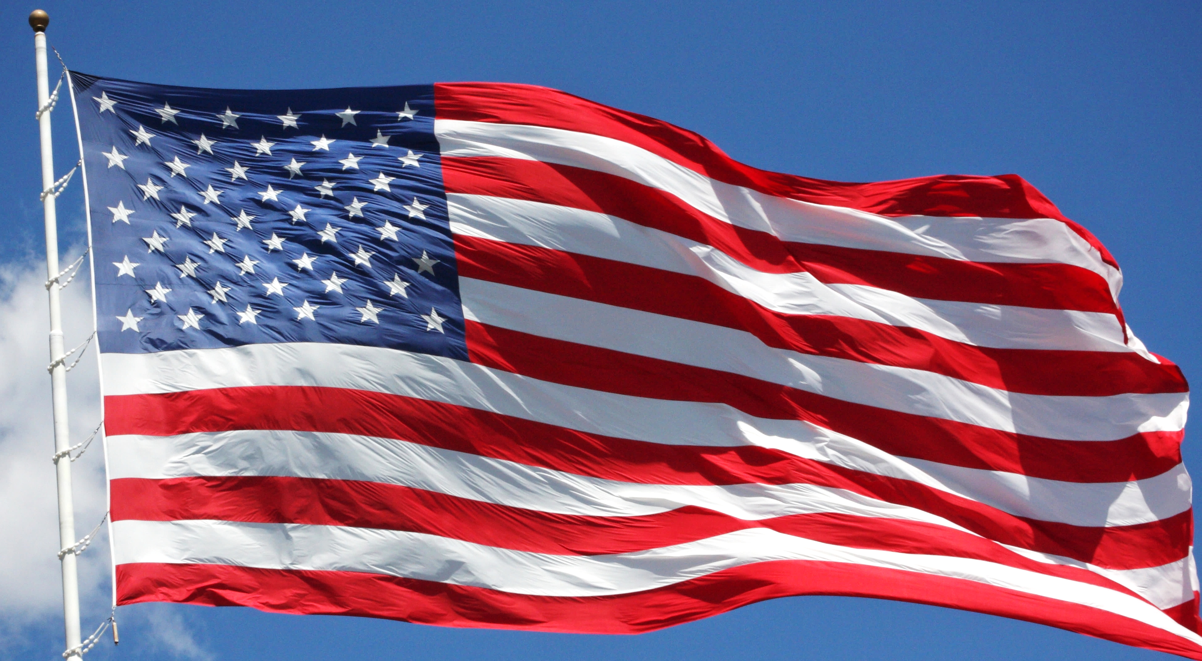
Pledge of Allegiance

Slide 5
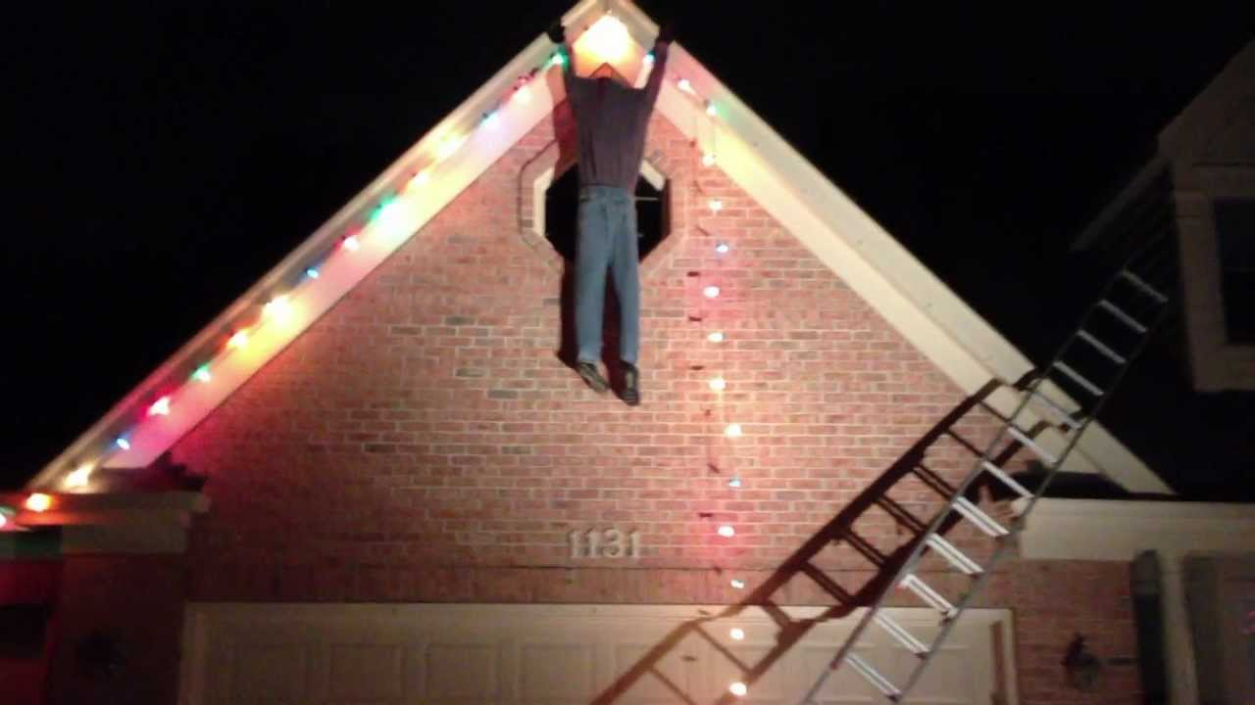
Safety Moment

Slide 6
Finding Meeting Materials
Meeting Materials Available:
www.energysafety.ca.gov/wsab
Notice (Agenda)
Draft Recommendations
Revised Recommendations
Board Meeting Presentation
Public Comments Available:
www.energysafety.ca.gov/wsab/publiccomment

Slide 7

Agenda
1) Opening Public Comment
2) July 27, 2021 Meeting Minutes
3) Office of Energy Infrastructure Safety Presentation
4) Irvine Ranch Conservancy Presentation
5) Publicly Owned Utilities Updates
6) Board Discussion
7) Adjourn Meeting

Slide 8
1) Opening Public Comment
Participation Options:
Please begin your comment by stating your name and organization (if applicable).
Phone: Number: 1-866-390-1828, passcode: 787909
  Dial # 2 (pound sign two) to be placed in a queue by the operator.
Email: Written comments may be sent email to WSAB@energysafety.ca.gov. Staff will read these comments out loud during the meeting if 3 minutes or less.
Tech Issues: If there are technical issues, support staff is available to help. Please e-mail WSAB@energysafety.ca.gov or call Tim Tutt at 916 203-2075

Slide 9

2) Vote on Minutes from July 27, 2021 Meeting
Discussion
&
Vote

Slide 10
3) Office of Energy Infrastructure Safety Presentation
Melissa Semcer
Deputy Director
Office of Energy Infrastructure Safety
Natural Resources Agency

Slide 11
4) Irvine Ranch Conservancy Presentation
Michael O’Connell
President and CEO
Irvine Ranch Conservancy

Slide 12
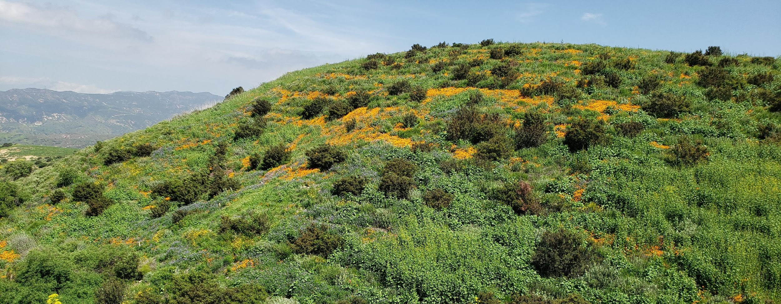

Wildfire Risk Reduction in the South Coast
Michael O’Connell, President & CEO

Slide 13
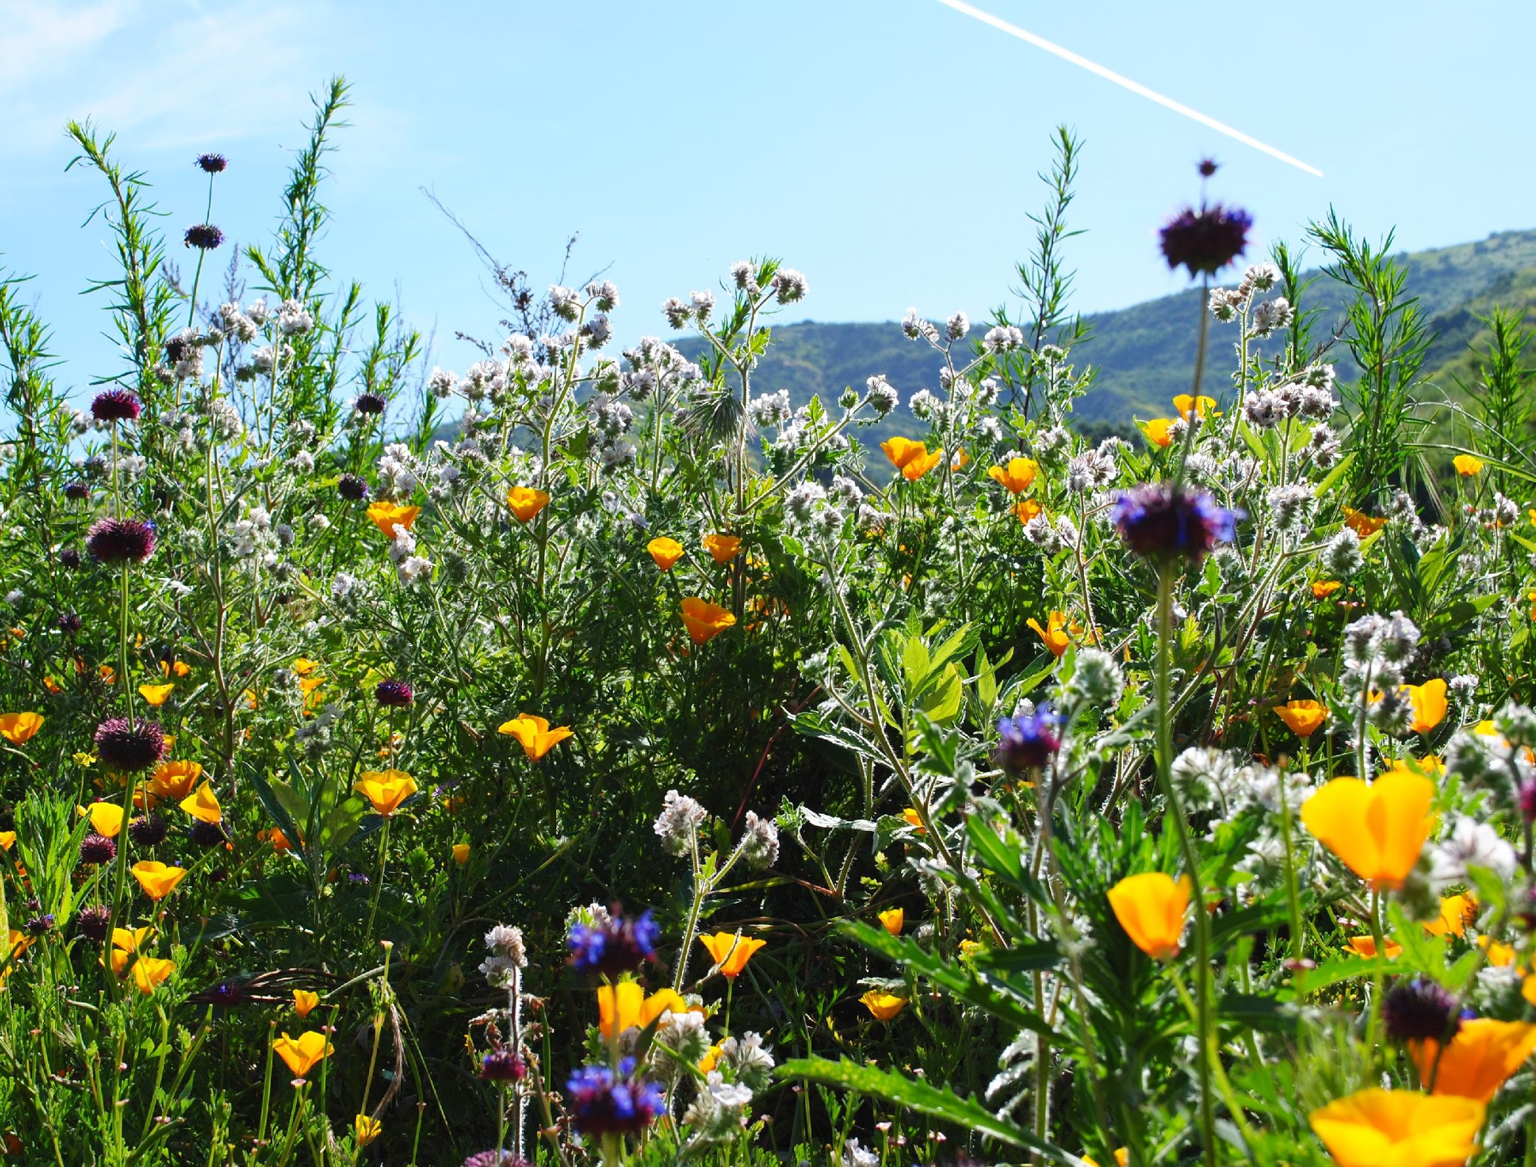
Irvine Ranch Conservancy
501(c)3 Non-Profit
Manage 30,000 Acres of Public Land in Partnership with OC Parks, Irvine and Newport Beach
Conduct Habitat Restoration and Enhancement on 1,500+ acres with Mitigation Funding
Build and Maintain 160 Miles of Trails and Visitor Infrastructure
525 Volunteers Annually Give 50,000 hours and Provide 2,900 Public Programs

Slide 14
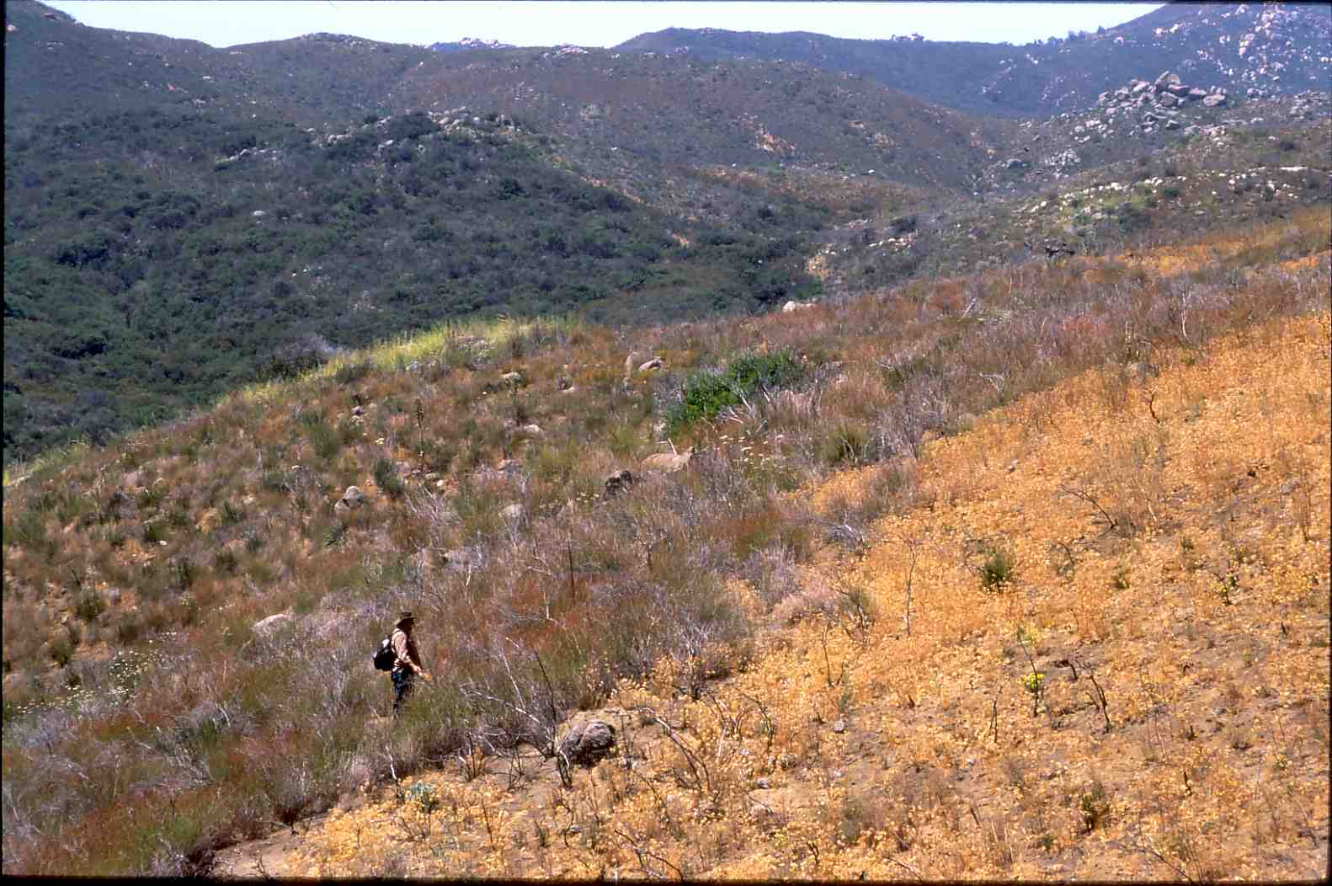
Wildfire in the South Coast
Shrublands - Different Fire Regime than Forests
Wind-Dominated vs. Fuel-Dominated
Region Has Had Too Much Fire
Natural Fire Return Interval = 70-150 yrs
Current Return = 7-10 yrs
Increasingly Catastrophic Fires
Laguna Fire 1970
Viejas Fire 2001
Cedar Fire 2003

Slide 15
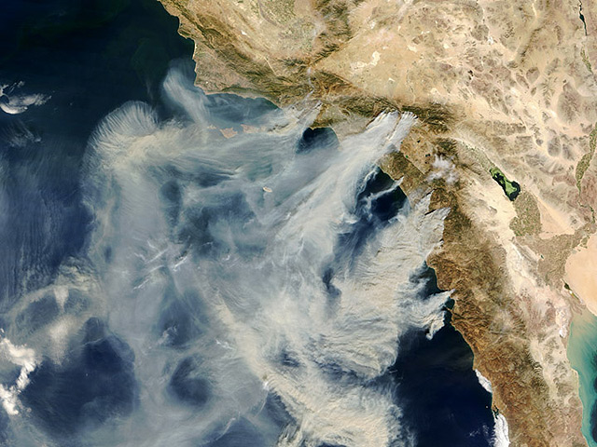
Wildfire in the South Coast
90% of Acres/Property Damage in Only 10% of Fires = Leverage
Almost 100% Human-Caused
Driven by Strong Seasonal Winds – 18 to 24 days/year
Embers Spread up to 5 Miles
Nearly Impossible to Suppress with Conventional Methods

Slide 16
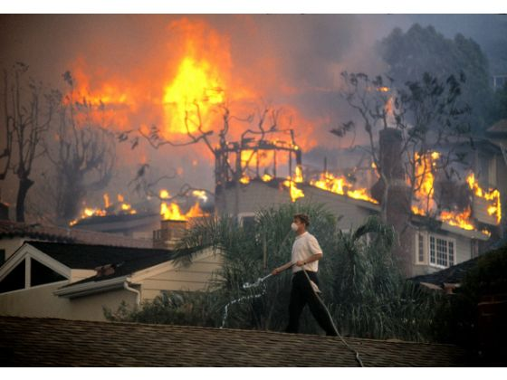
Communities at Risk
In Orange County Alone:
90,000 People Evacuated in 2020
Almost Entire County Vulnerable
Thousands of Aging Structures at High Risk from Embers
Smoke and Health Hazards for Entire Region
Hundreds of Fuel Mod Zones Requiring Maintenance

Slide 17
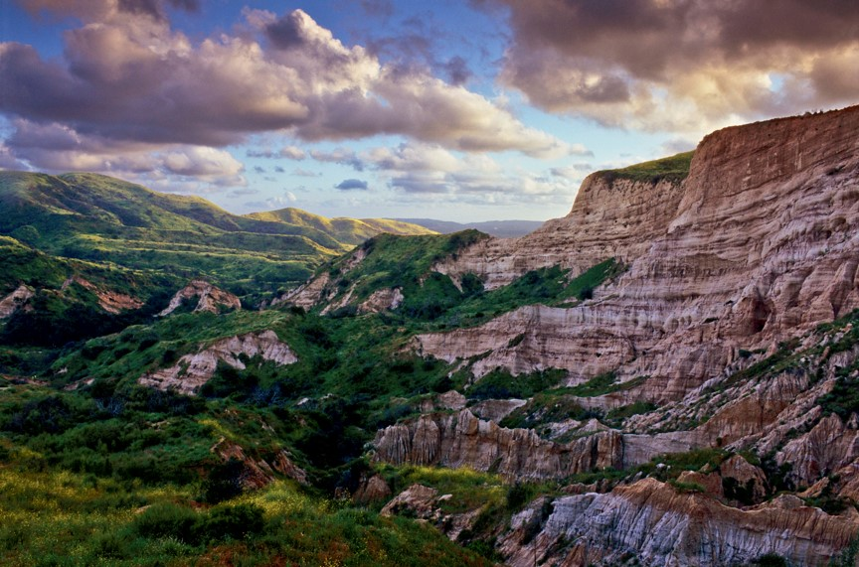
Investments in Land Protection Threatened
In Orange County Alone:
60,000 Acres Protected Since 1980
$100+ Million in Public and Private Funds Spent
120+ Rare Species and Natural Communities
Critical Urban Wildlands for Nature and People

Slide 18
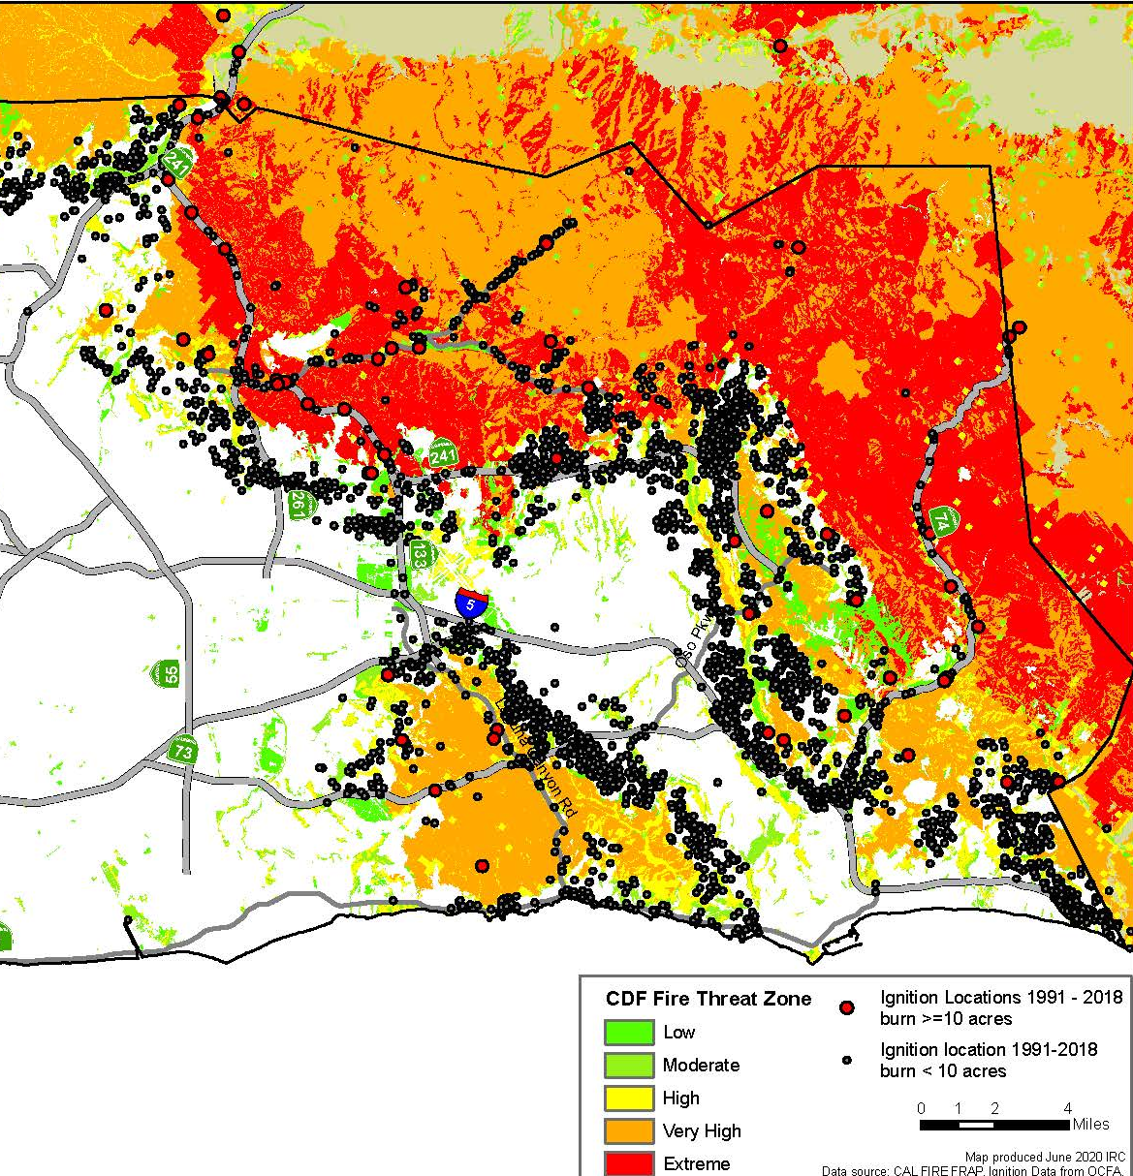
Unconventional Responses Needed
Ignition Prevention (93% Start on Roadways and Powerlines)
Structure Resilience –Defensible Space & Embers
Strategic Fuel Modification Zones
Landscape-Scale Fuel Treatment Makes the Problem Worse

Slide 19
























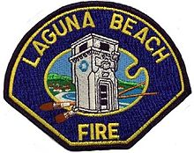


COAST Fire Prevention Working Group
Recognition that Wildfire is a Shared Problem
Shared Response to Wildland Fire Prevention and Risk Reduction
Convened by OCFA in 2014
Developed Orange County CWPP
Established AlertWildfire Cameras
Identified New Coastal Weather Zone
Coordinate Ignition Prevention and Risk Reduction Programs
Expanding through Regional Forest and Fire Capacity Program (RFFC)
Notes:
More than 24 Member Agencies

Slide 20
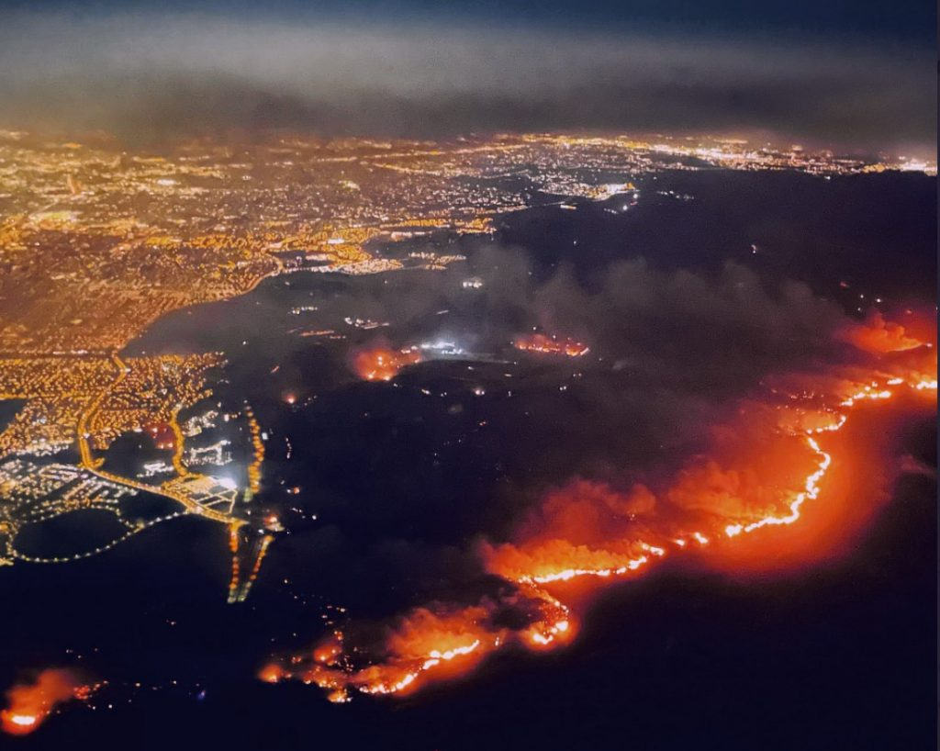
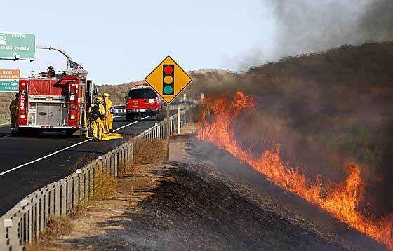
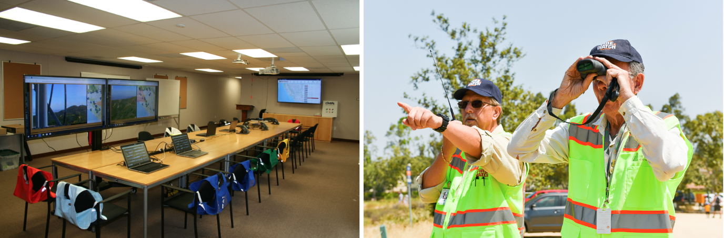
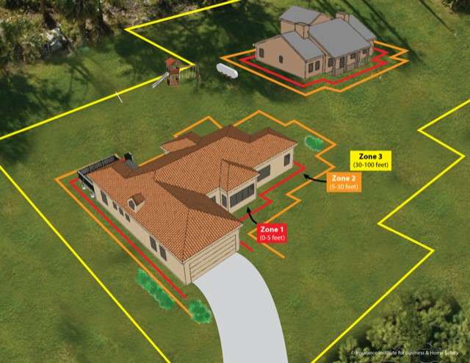


Urgent Risk Reduction Priorities
Santa Ana Wind Events (Red Flag Warnings)
Ignition Prevention on Primary Roadways & Utility Infrastructure
Arson Deterrence
Structure Hardening place holder
Strategic Fuel Mod Zones

Slide 21
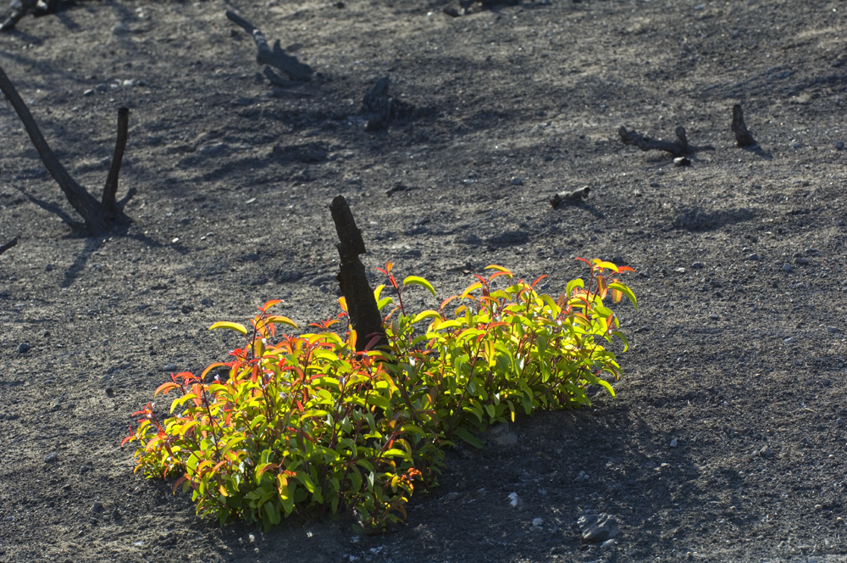

Partnership - Innovation - Excellence

Slide 22

Stretch Break
Notes:
Initially, utilities wanted ultra-flexibility in the form of a “Clean Energy Standard”– set a carbon reduction goal for utilities, and allow choice among EE, RE, ET investments to achieve.
In some ways, I’m glad that this solution was not adopted – it looks painful.
However, significant flexibility was added to the bill resulting in general utility support for the final version.
I’ll give you a couple of examples…..

Slide 23

5) Publicly Owned Utilities Updates
Barry Moline, Executive Director
CA Municipal Utilities Association
b. Board Member Chris Porter

Slide 24
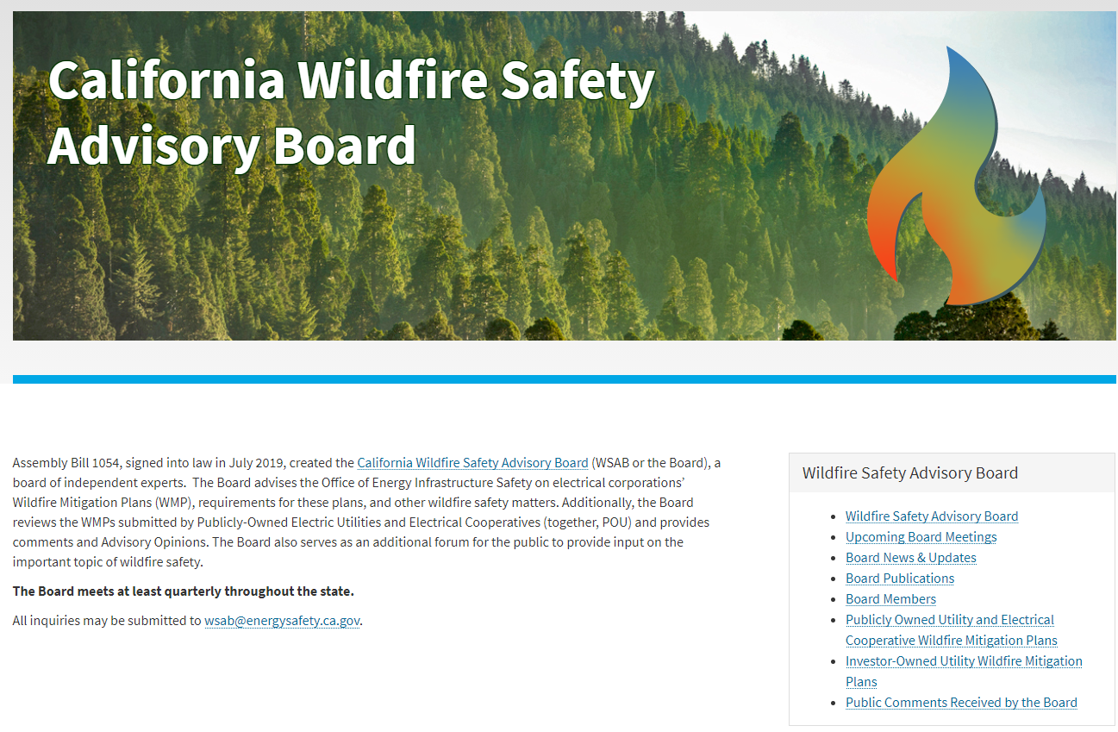
Announcements: Transition Updates
Wildfire Safety Advisory Board Website:
www.energysafety.ca.gov/who-we-are/wildfire-safety-advisory-board/
6) Board Discussion

Slide 25

7) Adjourn Board Meeting
For more information:
www.energysafety.ca.gov/wsab
WSAB@energysafety.ca.gov

