Slide 1

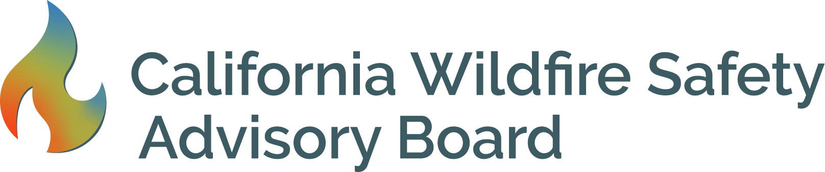
Wildfire Safety Advisory Board Meeting
June 24, 2020, 1-4 pm
Online via Webcast
and Telephone.

Slide 2
Participation Information
Please choose one participation option. Using more than one technical option may create feedback.
Webcast: www.adminmonitor.com/ca/cpuc
Phone: Oral comments possible with assistance of an operator.
  Number: 1-800-857-1917, passcode: 17 67 567
  For public comment portion of the meeting: Dial * 1 (star one) to be placed in a queue by the operator.
Email: Written comments may be sent by mail or email to WildfireSafetyAdvisoryBoard@cpuc.ca.gov.
Public Advisor: If there are technical issues, the Public Advisor can help. Email public.advisor@cpuc.ca.gov, or call (866) 849-8390.

Slide 3
About the Wildfire Safety Board
Members:
  Marcie Edwards, Chair
  Diane Fellman, Vice Chair
  Ralph M. Armstrong Jr., Board Member
  Jessica Block, Board Member
  John Mader, Board Member
  Christopher Porter, Board Member
  Alexandra Syphard, Board Member
More information about the Board and its Members can be found here: https://www.cpuc.ca.gov/WSAB/.

Slide 4
Acknowledgement
The persistence of systemic racism impacts all corners of our society. Communities of color are disproportionally affected by wildfires, wildfire risks, and pollution. Wildfire risk mitigation touches the lives of our most vulnerable communities, including individuals who are elderly, disadvantaged, have medical issues or disabilities, and those who cannot participate in the development of new processes and programs for themselves. While our primary role is to provide guidance to the state’s electric utilities on wildfire mitigation, we must examine our policies and programs with an eye towards equity, diversity, and celebrating the humanity that belongs to each of us.

Slide 5

Pledge of Allegiance

Slide 6
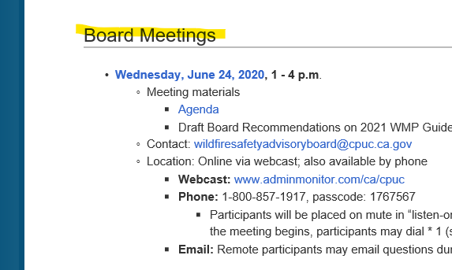
Finding Meeting Materials
Please be aware of your surroundings!
Materials available:
Meeting Minutes from April 15
Agenda
Draft 2021 WMP, Performance Metrics, and Safety Culture
POU Presentation
PowerPoint Presentation
See website: www.cpuc.ca.gov/wsab

Slide 7
Agenda
[1] Opening Public Comment
[2] Adopt Minutes from April 15, 2020 Board Meeting
[3] Recommendations on the 2021 Wildfire Mitigation Plan Guidelines, Performance Metrics, and Safety Culture
  Public Comment
  Board Member Comments
  Discussion and Vote
[4] Stretch Break
[5] Discussion with Publicly Owned Utilities
  Public Comment
  Presentation by POU Representative
  Board Discussion
[6] Board Feedback on Wildfire Safety Division Strategy Document
  Public Comment
  Presentation by Director Thomas Jacobs
  Board Discussion
[7] Presentations by Wildfire Safety Division
  Status of 2020 WMP Review
  The Division’s Compliance Efforts
  Board Discussion

Slide 8
[1] Opening Public Comment
Participation Options:
Please begin your comment by stating your name and organization (if applicable).
Phone: Number: 1-800-857-1917, passcode: 17 67 567
  Dial * 1 (star one) to be placed in a queue by the operator.
Email: Written comments may be sent email to WildfireSafetyAdvisoryBoard@cpuc.ca.gov. Staff will read these comments out loud during the meeting.
Public Advisor: If there are technical issues, the Public Advisor can help. Email public.advisor@cpuc.ca.gov, or call (866) 849-8390.

Slide 9

[2] Vote on Minutes from April 15 Meeting
Discussion
Vote

Slide 10
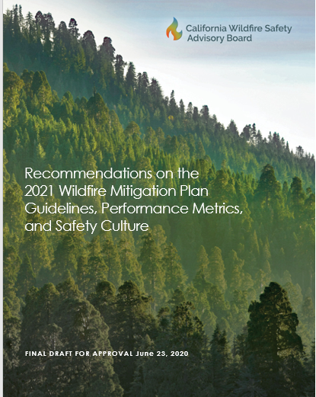
[3] Recommendations on the 2021 WMP Guidelines, Performance Metrics, and Safety Culture
  Public Comment
Participation Options:
Please begin your comment by stating your name and organization (if applicable).
Email: Written comments may be sent email to WildfireSafetyAdvisoryBoard@cpuc.ca.gov. Staff will read these comments out loud during the meeting.
Phone: Dial * 1 (star one) to be placed in a queue by the operator.
Public Advisor: If there are technical issues, the Public Advisor can help. Email public.advisor@cpuc.ca.gov, or call (866) 849-8390.

Slide 11
[3] Recommendations on the 2021 WMP Guidelines, Performance Metrics, and Safety Culture
  b. Board Member Comments
  c. Discussion
  d. Vote

Slide 12

[4] Stretch Break

Slide 13

Welcome Back
[5] Discussion with Publicly Owned Utilities
Participation Options:
Please begin your comment by stating your name and organization (if applicable).
Email: Written comments may be sent email to WildfireSafetyAdvisoryBoard@cpuc.ca.gov. Staff will read these comments out loud during the meeting.
Phone: Dial * 1 (star one) to be placed in a queue by the operator.
Public Advisor: If there are technical issues, the Public Advisor can help. Email public.advisor@cpuc.ca.gov, or call (866) 849-8390.

Slide 14

POU Wildfire Mitigation Plan Template: Development and Use
Barry Moline
Executive Director
June 24, 2020

Slide 15
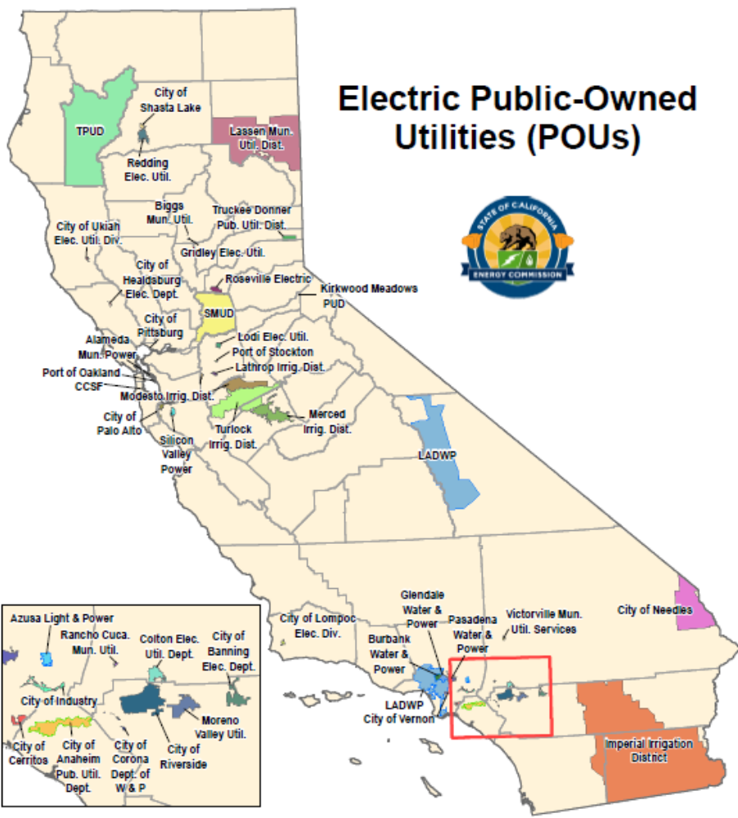
Publicly Owned Utilities
44 Publicly Owned Utilities (POUs)
  42 have facilities, submitting plans
  2 are wholesale/contract-only agencies
25% of CA electricity delivery
Completed Wildfire Management Plans by Jan. 1, 2020
  Approved by local governing boards
Currently submitting to WSAB by July 1

Slide 16
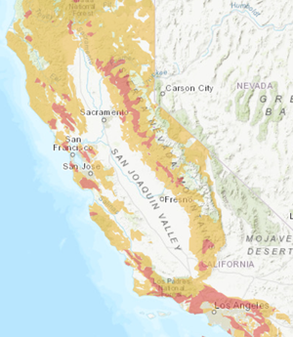
Historical Wildfire Engagement
POUs eager to continue engagement on mapping High Fire Threat District
  POUs obligated to identify where CPUC should expand HFTD based on new information or changes to the environment
Bottom line: POUs actively involved from the start, and will stay involved

Slide 17
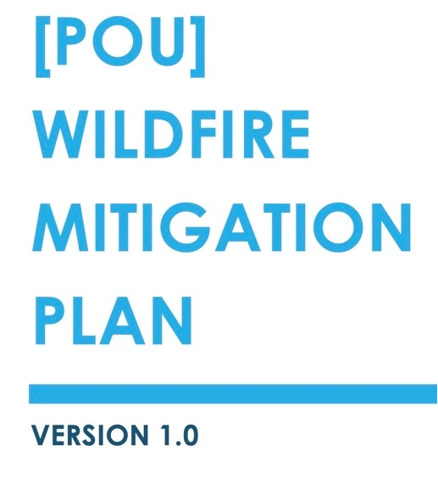
Template Development
CMUA Wildfire Working Group
  Utility Engineers
  Local Fire Officials
  Utility Directors
  Attorneys
  Relevant City Departments
  Electric and Water Agencies
Expanded in 2018 after fire mapping complete
  CPUC proceedings on wildfire, deenergization, sharing ideas and practices, WMPs

Slide 18
Template Development
Template created to assist CMUA members
  Reviewed various fire plans
    IOUs, federal requirements for hydro relicensing
    Statutory requirements
  Developed to reflect good practices
Encourages flexibility
  Some followed closely, others deviated, and some used elements as a “checklist” to make sure all statutory elements were covered
Notes:
The template was drafted to be flexibly adapted by our array of members to meet the requirements of their widely varying sizes and risk profiles.
While many POUs utilized this template as a guideline, not all used it as their model. [Examples? Sections not relevant were excluded; Draft independent wording to address individual programs…]
This is reflective of the fact that POUs are not homogenous; POUs not only vary greatly in size and resources, but are also located in a variety of geographic, climate and fire risk zones.

Slide 19
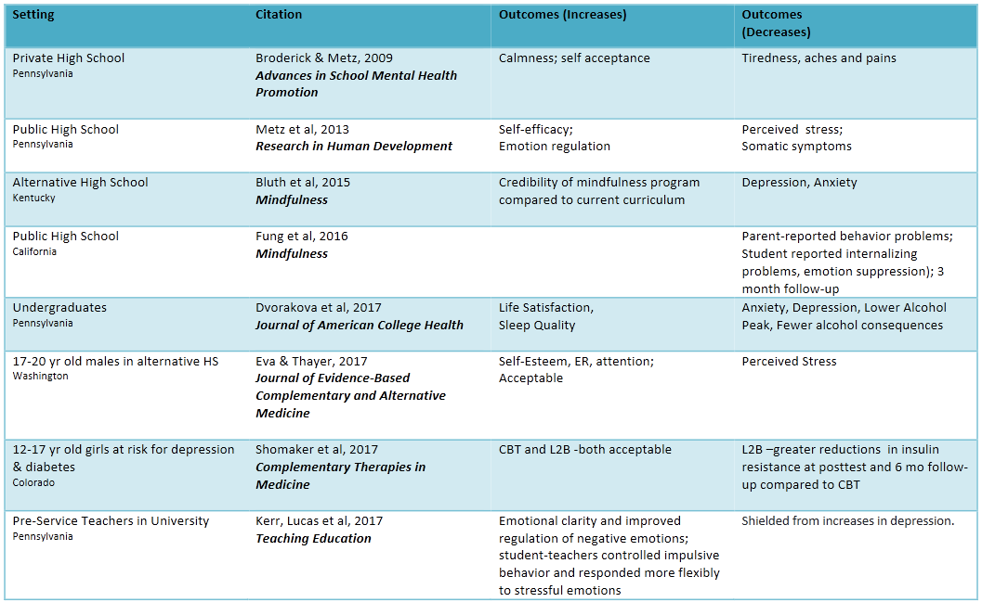
Future
POUs will continue collaborating with WSAB
  Facilitate information sharing
  WSAB review of POU WMPs
Would a WMP template be useful?
  Define Template
    Simple Outline? Document with narrative? Other format?
  Consider Timing – how would it fit into the process
    WMPs reviewed and updated annually
    Comprehensive review every three years
    Incorporate WSAB feedback into future WMPs and updates
  Consider Budgeting
    POUs budget to hire outside consultants, independent evaluator
    Planning allows utilities to properly budget
  Summary Table
    CMUA could facilitate creation of a summary table of WMP plan
    elements and coverage in individual WMPs

Slide 20
CMUA’s Mission & Vision
Mission
Vision
CMUA partners with community owned utilities to support reliable, sustainable, affordable services through advocacy, education and relationships.
^{CMUA is the}
^{leading voice}
^{for California utilities,}
^{enhancing our}
^{communities.}

Slide 21
Contact Info
Barry Moline, Executive Director
bmoline@cmua.org
(916) 326-5801

Slide 22
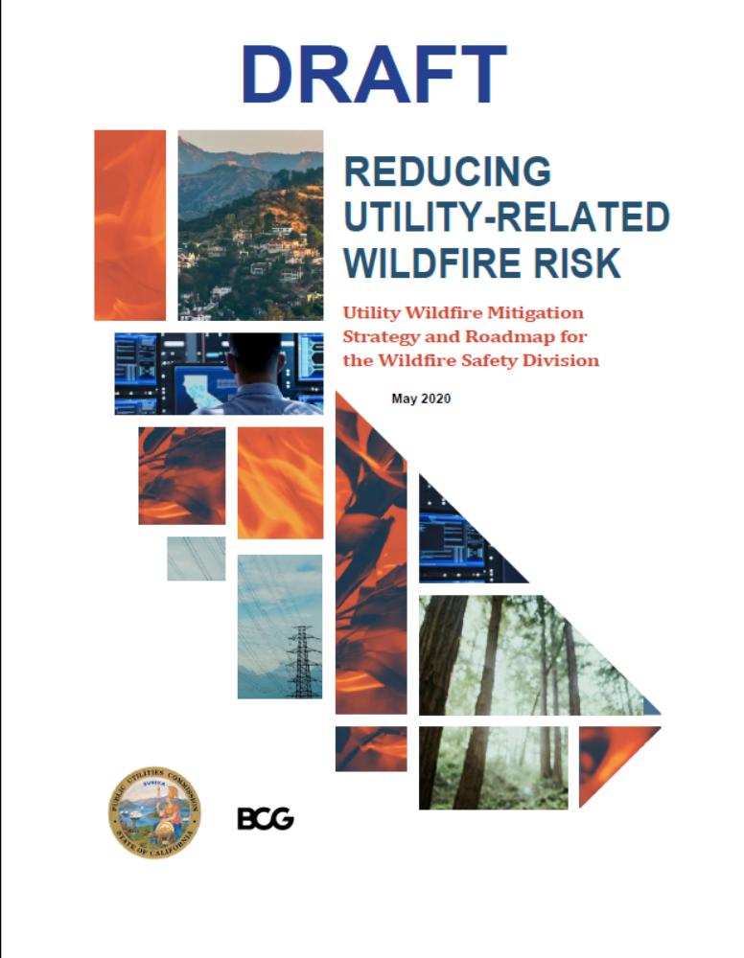
[6] Board Feedback on Wildfire Safety Division Strategy Document
  a. Public Comment
Participation Options:
Please begin your comment by stating your name and organization (if applicable).
Email: Written comments may be sent email to WildfireSafetyAdvisoryBoard@cpuc.ca.gov. Staff will read these comments out loud during the meeting.
Phone: Dial * 1 (star one) to be placed in a queue by the operator.
Public Advisor: If there are technical issues, the Public Advisor can help. Email public.advisor@cpuc.ca.gov, or call (866) 849-8390.

Slide 23
[6] Board Feedback on Wildfire Safety Division Strategy Document
  b. Presentation by Director Thomas Jacobs
  c. Board Discussion

Slide 24
Wildfire Mitigation Plan Update
Wildfire Safety Advisory Board
June 24, 2020

Slide 25
2020 Wildfire Mitigation Plans: Draft resolutions issued 5/7 propose approval with conditions for all utilities; WSD issued final approval Action Statements (6/10); CPUC ratified resolutions (6/11)
      Today
CPUC submission drafting
(December–February)
WMP review
(February–May)
Implementation and learning
(June–November)
Utilities draft wildfire mitigation plan (WMP), which includes
Wildfire Safety Division (WSD) reviews WMPs and assesses maturity via survey and WMPs
Deep and broad subject expertise required to review WMPs, including from CPUC SED, CAL FIRE, and a range of other experts
An approved WMP is required for
safety certification
Utilities implement mitigation plans and develop lessons learned that should be included in annual updates
WSD monitors for compliance with WMPs, and incorporates lessons learned into next year's guidelines
Utility plan to reduce
wildfire risk
Outcome and progress metrics
Utilities also complete a maturity survey
to assess capabilities for managing
wildfire risk

Slide 26
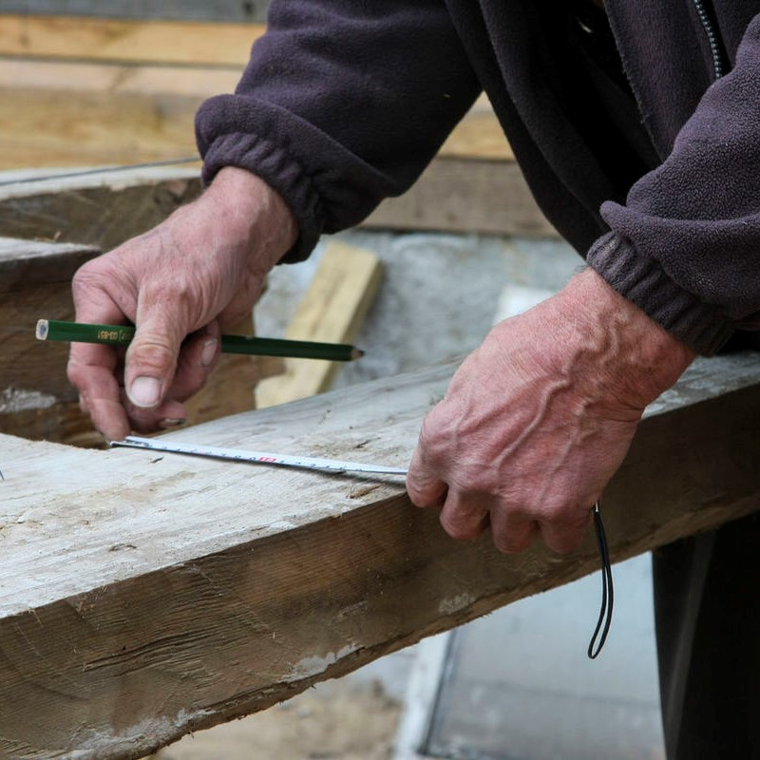


2020 WMP Guidelines Revised to Support Broader Vision
Improvements to be incorporated in 2021 and beyond
Guideline revisions had 3 objectives:
Increased standardization
Improved objectivity
Forward-looking focus
Standardize information collected on utility wildfire risk exposure and mitigation initiatives
Enable systematic and uniform review of qualitative information
Move utilities towards an effective long-term wildfire mitigation strategy, with systematic tracking of improvements against long term targets

Slide 27

WMP Evaluation Rubric
Four factors to consider
1. WMP comprehensively responds to guidelines and utility survey is complete
2. Initiatives in WMP are deemed technically feasible and effective in reducing wildfire risk
3. Initiatives in WMP are an efficient use
of resources
4. Sufficient forward-looking ambition for
maturity growth

Slide 28

Evaluation Team
Evaluation Team consisted of 27 members
  18 subject matter, writing and project management experts from across the CPUC
  9 subject matter experts from CAL FIRE

Slide 29
Evaluation Process Results
Approve
Approve with Conditions
Bear Valley- made no determination
Class A Deficiency: Aspect of a plan is lacking or flawed. Remedy: Provide a Remedial Compliance Plan in 45 days
Class B Deficiency: Insufficient Detail or justification provided in plan. Remedy: submit a resolution to deficiency in a Quarterly Report within 90 days
Class C Deficiency: Gaps in baseline or historical data. Remedy: Resolve by or within 2021 WMP Plan Update

Slide 30
2020 Wildfire Mitigation Plans: Common themes across 6 categories
Risk assessment and mapping
Grid hardening and asset management
PSPS
Little discussion of how models assess consequences of a given ignition and how outputs are leveraged for decision-making
Unclear from WMPs how significantly these initiatives reduce risk in terms of ignitions and PSPS events
Unclear from WMPs how VM and hardening work will quantifiably reduce scale / scope of PSPS by increasing wind threshold for initiating PSPS
Vegetation Management
Risk spend efficiency
Timelines
Labor constraints and recurring costs may impede planned efforts
Little to no analysis presented to show how “enhanced” programs reduce ignitions over detailed and patrol inspections
WMPs do not sufficiently demonstrate that they are allocating finite resources to initiatives that most effectively reduce wildfire and PSPS risk
Hard to assess utility compliance and progress if timelines and deployment plans are not described clearly

Slide 31
Guidance Resolution (WSD-002)
Guidance Resolution Deficiencies
  One Class A Deficiency: Lack of risk modeling to inform decision-making
  10 Class B Deficiencies
  One Class C Deficiency
Note: Additional Class A Deficiency common to 3 Large IOUs that require
demonstration of effectiveness of increased vegetation management clearances

Slide 32




PG&E, SCE and SDG&E Summary
7 Class A Deficiencies
  Aggregation of Initiatives
  Personnel shortages
  High incidence of conductor failure
  20 Class B Deficiencies
  2 Class C Deficiencies
PG&E’s Plan met minimum requirements, demonstrated an understanding of top ignition drivers and actions to address those drivers
Areas of Concern (selected):
  Unclear use of risk models to drive prioritization of mitigation activities to reduce wildfire risk and PSPS
3 Class A Deficiencies
  Near Misses
  Vegetation management clearances
  Advancement in vegetation management
  18 Class B Deficiencies
  1 Class C Deficiencies
SCE’s Plan met minimum requirements and presented activities to drive down wildfire risk
Areas of Concern (selected):
  Scale and scope of PSPS
  Large allocation of spend on covered conductor
1 Class A Deficiencies
  Vegetation management clearances
  14 Class B Deficiencies
  1 Class C Deficiencies
SDG&E’s Plan met minimum requirements, demonstrated understanding of risk, and presented initiatives to drive down wildfire risk
Areas of Concern (selected):
  Efficient use of resources
  Diminishing returns

Slide 33



Liberty, PacifiCorp and Bear Valley Summary
0 Class A Deficiencies
  4 Class B Deficiencies
  1 Class C Deficiencies
Liberty’s Plan met minimum requirements, initiatives addressed major risk drivers, good-faith effort to address risk given exemption to date from S-MAP and RAMP requirements.
Liberty expects to have a process for evaluating new initiatives’ performance by 2023
Areas of Concern (selected):
  Risk-informed decision-making to deploy initiatives
0 Class A Deficiencies
  5 Class B Deficiencies
  2 Class C Deficiencies
PacifiCorp's Plan met minimum requirements, initiatives addressed major risk drivers, good-faith effort to address risk given exemption to date from S-MAP and RAMP requirements.
PacifiCorp expects to have tools to quantitatively estimate ignition risk by 2023
Areas of Concern (selected):
  Continued development towards maturity
Wildfire Safety Division did not act on Bear Valley’s WMP.
Wildfire Safety Division issued statement extending evaluation time period.
Bear Valley submitted errata on May 22, 2020 that substantially altered the contents of their plan.
Overall plan spend decreased from 247 million to 46 million

Slide 34


Plans Approved Without Conditions
Horizon West undergrounding initiative
faces delays

Slide 35
End

Slide 36
Adjourn
For more information:
www.cpuc.ca.gov/wsab
WildfireSafetyAdvisoryBoard@cpuc.ca.gov

