Slide 1

2020
WILDFIRE MITIGATION
PLAN
JOHN JENKINS
Vice President, Electric System Operations

Slide 2

PUBLIC SAFETY POWER SHUTOFF (PSPS) LESSONS LEARNED
1
2019: Historic Year for PSPS in California
Impacted 27,700 SDG&E customers at peak
Zero ignitions of consequence associated with SDG&E equipment
Adapting and Acting
Website capabilities scaled up
Building trust with our local communities
Strong partnerships with non-profits will strengthen our community’s ability to minimize the impact of a PSPS event
Collaboration with public safety agencies
Strategic use of sectionalizing
Hardening efforts help the system withstand extreme weather conditions
SDG&E’s Goal
Reduce risk while mitigating the impacts of PSPS to customers
Last resort mitigation during extreme weather events to minimize public risk
2
3

Slide 3
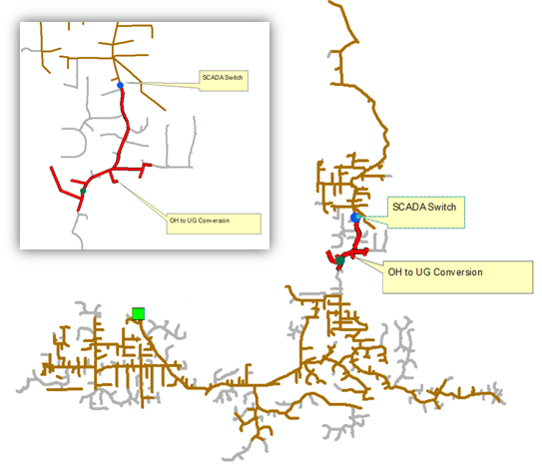
PUBLIC SAFETY POWER SHUTOFF MITIGATION
1
Increased Sectionalizing and Situational Awareness
240 remote sectionalizing devices and 190 weather stations (30s reads)
Increased precision - apply PSPS only to highest risk infrastructure
Reduces customer impact
PSPS Mitigation Engineering Team
Dedicated team of experts to assess the company’s infrastructure in high wildfire risk areas
Segment-by-segment circuit analysis
Portfolio of mitigations
PSPS Mitigation Goals
Short-term: Mitigate PSPS impacts through critical infrastructure support
Long-term: Segment-by-segment review to mitigate PSPS to the greatest number of customers, and customers who experience the greatest frequency of PSPS
Enhanced strategies to mitigate the customer impacts of PSPS
2
3

Slide 4
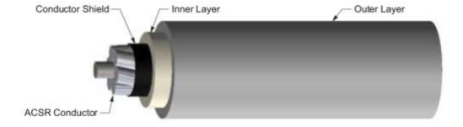
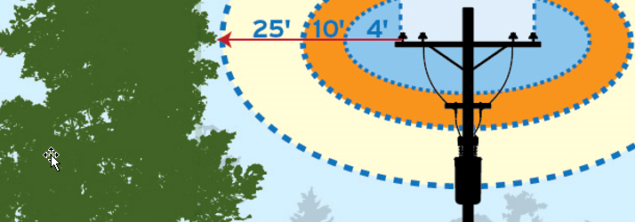
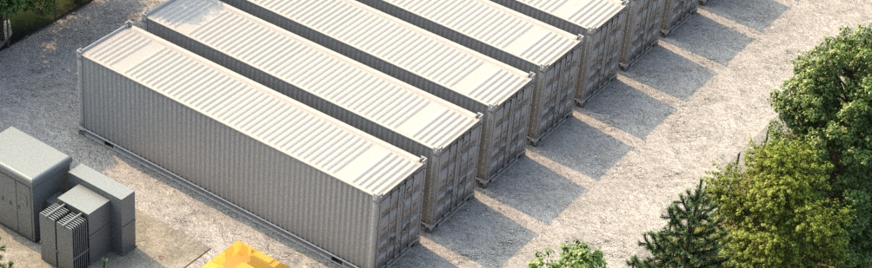
MAJOR PROGRAMS SUPPORTING PSPS MITIGATION
Mitigation​ | 2020 Scope | WMP Term Goal
Strategic Undergrounding | 25 miles | 135 miles
OH Hardening – includes Covered Conductor | 103 mile | 145 miles
PSPS Enhancements – Sectionalizing Devices | 10 switches | 30 switches
Advanced Protection | 6 substations enabled | 20 substations enabled
Enhanced Inspections Patrols and Trimming | 17,000 @ 25’ clearance | 51,000 @ 25’ clearance
Fuels Management Program | 500 poles | 1,500 poles
Micro Grids | 3 microgrids | 7 microgrids
Customer Resiliency Programs | 1,250 generators | 4,630 generators
 | 4 generators leased | 12 generators leased
Whole House Generators | 300 generators | 900 generators
The PSPS Mitigation Engineering Team utilizes a portfolio of initiatives
3-layer Covered Conductor

Slide 5
2020 WILDFIRE MITIGATION PLAN SUMMARY
SDG&E’s 2020 Wildfire Mitigation Plan (WMP) includes 65 activities to mitigate wildfire risks. Activities are divided into 10 categories:
1
Risk Assessment and Mapping
Situational Awareness and Forecasting
Grid Design and System Hardening
Asset Management and Inspections
Vegetation Management and Inspections
6
Grid Operations and Protocols
Data Governance
Resource Allocation Methodology
Emergency Planning and Preparedness
Stakeholder Partnerships and Community Engagement
2
7
3
8
4
9
5
10

Slide 6
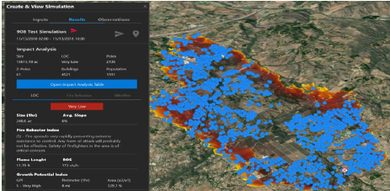
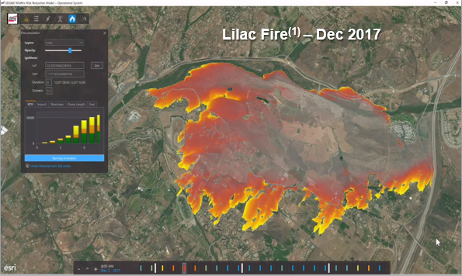
1. RISK ASSESSMENT & MAPPING
1
Enhancements to Operational Wildfire Risk Reduction Model (WRRM-Ops)
Single visual and configurable live map
New features and integrations
High-Performance Computing
Replace supercomputers in 2022
Work closely with San Diego Supercomputing Center
Advancement of risk models to support short and long-term decisions
2

Slide 7
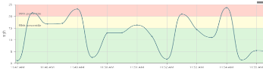
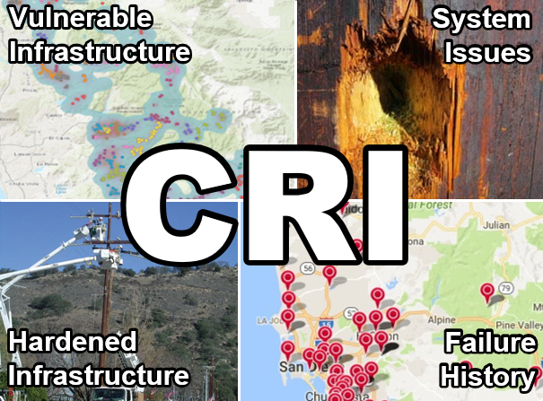
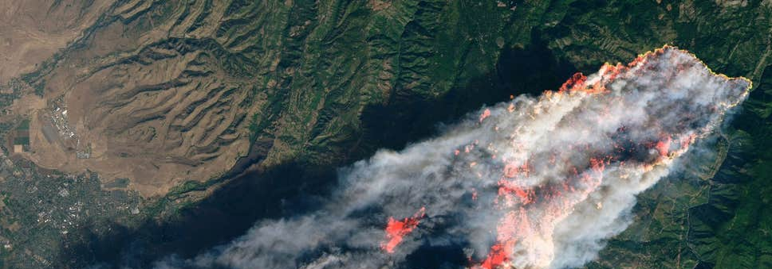
2. SITUATIONAL AWARENESS & FORECASTING
1
Advanced Weather Stations
Grow weather network to 225 stations
Expand network into high-impact wildland urban interfaces
Circuit Risk Index (CRI)
Will be integrated into the PSPS Situational Awareness Dashboard
Quantify risk into a single metric
Fire Science & Innovation Lab
Collaboration of academia, government, and the community
Create forward looking solutions
Advanced Fire Detection Capabilities
Cameras and ignition detection software
Satellite wildfire alert system
Capabilities support informed operational decision-making
2
3
4

Slide 8
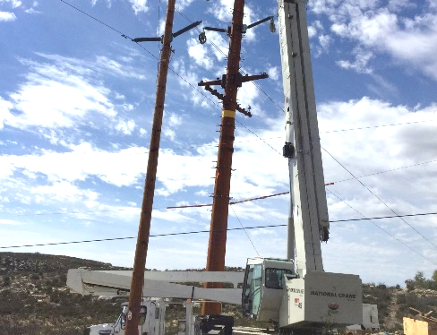
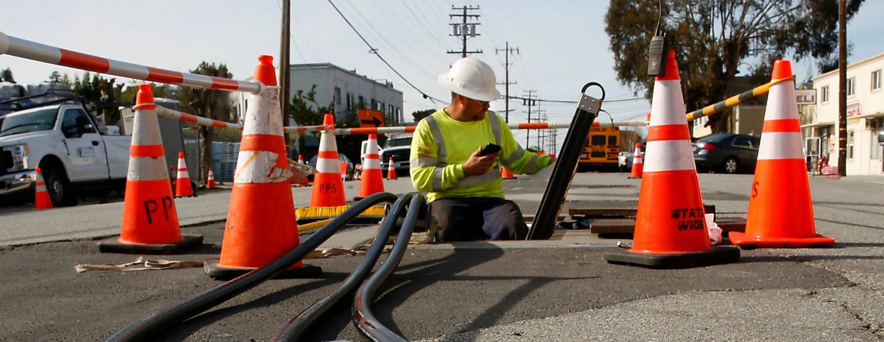
3. GRID DESIGN & SYSTEM HARDENING
1
Strategic Undergrounding
Install additional 135 miles of underground circuits over the next 3 years
Overhead Hardening
102 miles of high-risk distribution assets to be hardened in 2020
Covered conductor use to increase in 2021 and 2022
High-Risk Equipment Replacement
SCADA capacitors, expulsion fuses, hotline clamps, and lightning arrestors
Additional Generator Grant Programs
Two new programs: Expanded and Whole House
Advanced Protection
Plans to enable advanced protection for entire high fire threat district (HFTD)
Private LTE network to provide connectivity to support WMP programs
2
Reduce wildfire risk factors and PSPS customer impacts
3
4
5

Slide 9
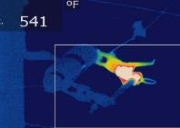
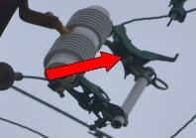
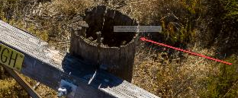
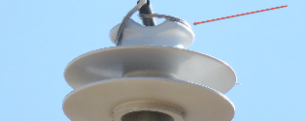
4. ASSET MANAGEMENT & INSPECTIONS
1
Maintenance Inspections
Corrective Maintenance Program – Transmission and Distribution
HFTD Tier 3
Substation
Infrared Inspections
Early detection of potential issues on electrical connections
Distribution pilot in 2020 prior to fire season
Drone Assessments
All Distribution HFTD Tier 3 by end of 2020, and HFTD Tier 2 by end of 2022
Pre-PSPS Event HFTD Patrols
Transmission Infrared
Distribution
Vegetation Management
Adding new inspections to identify system issues not visible to the naked eye
2
3
12kV Cutout, 485°F above ambient
4

Slide 10
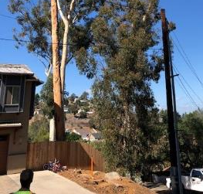
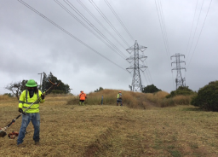
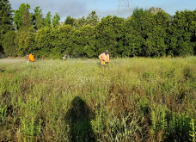
5. VEGETATION MANAGEMENT & INSPECTIONS
1
Fuels Management
Aligned priorities with fire agencies and local fire safe councils
Expand community partnerships and collaboration with governmental sectors
LiDAR Inspections
Augments and enhances the inspection activity
Piloting mobile phone app that utilizes LiDAR data within routine tree inspection activity
Enhanced Trim
Trimming five species of trees to a 25-foot clearance
Targeting approximately 81,000 trees within the HFTD
Enhancing and expanding vegetation management
2
3

Slide 11
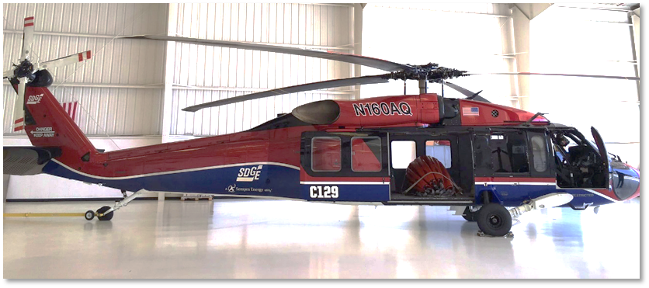
6. GRID OPERATIONS
& PROTOCOLS
1
Special Work Procedures
Operating conditions dictate the types of work that we perform under normal, elevated, extreme or red flag warning (RFW) conditions today
Recloser Protocols
Enabling of sensitive settings for automated reclosers
PSPS Protocols
Hardened transmission
Segment-by-segment assessment
Wind speeds (95th and 99th percentile)
Upgrade to our customer notification system
Fire Suppression
Wildfire infrastructure protection teams, aviation firefighting program, and industrial fire brigade
In elevated or extreme conditions, SDG&E implements operating protocols to help reduce risk of ignitions
2
3
4

Slide 12




7. DATA GOVERNANCE
1
Centralized Data Repository
Integration of data throughout the asset life cycle
Asset Health Index
Score and track the condition and performance of an asset
Ignition Management Program
Root cause analyses on ignitions
Detect patterns or correlations
Centralizing data for enhanced access and analytics, and to identify opportunities for automation
2
3

Slide 13

8. RESOURCE ALLOCATION METHODOLOGY
1
Risk-informed planning process
Enterprise Risk Management
Capital Planning Process
Decision support tools
Enterprise tools for funding allocation building on methodology developed in the Safety Model Assessment Proceeding (S-MAP)
Utilization of more granular tools
Other supporting initiatives
Wildfire Mitigation Personnel
PSPS Mitigation Engineering Team
Risk-informed resource allocation will continue to evolve and build on newly developed methodologies
2
3
Risk
Cost

Slide 14
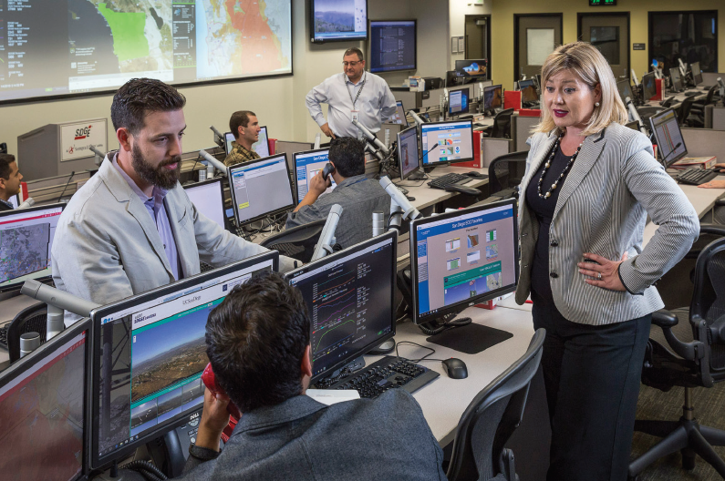
9. EMERGENCY PLANNING & PREPAREDNESS
1
Emergency Operations Center (EOC) Upgrades
Expansion and update of the EOC facility
Enhance planning, coordination, program development and communications
Emergency Management Operations
Emergency management response in alignment with national emergency response standards (FEMA)
After-Action Review program
Customer Support During Emergencies
Customer communications and protections
Coordination with Public Safety Partners
Year-round partnership engagement
Help protect the safety of SDG&E’s customers, its personnel and the communities it serves
2
3
4

Slide 15

10. STAKEHOLDER PARTNERSHIP & COMMUNITY
ENGAGEMENT
1
Community Outreach
Support nonprofit organizations whose programs promote
emergency preparedness and safety
Continue to host open houses and fair events
Best Practice Sharing
Knowledge sharing tours of the EOC and weather center
Best practice sharing with other utilities and countries
Several events planned for 2020
Cooperation with First Responders
Fire Coordination is a direct link between SDG&E and First Responders
Year-round engagement
Work alongside community partners to support our customers
2
3
SDG&E’s 30-minute documentary titled “Everything in our Power” provides behind-the-scenes insight into our wildfire safety efforts.

Slide 16
2020 WMP CONCLUSION
SDG&E’s 2020 WMP includes 65 activities to reduce wildfire risk while mitigating the impacts of PSPS to customers
1
Lessons learned from 2019
Situational awareness improved by advanced weather stations and artificial intelligence
System hardening is leveraging increased undergrounding
New LTE communication network will enhance system protection
Enhanced strategies to mitigate the customer impacts of PSPS
Increased collaboration with community partners
2
3
4
5
6

