Slide 1
PacifiCorp’s California Wildfire Mitigation Plan
February 2020
Notes:
Choose from three different title slide designs by selecting “New Slide.” These slides are suitable for business and community presentations.

Slide 2
Overview
PacifiCorp’s service territory summary
Key objectives of the WMP
2019 WMP Plan Progress
2020 WMP Elements
Template Inputs to PacifiCorp’s 2020 WMP
Public Safety Power Shutoff plans and development
Conclusion
Notes:
Choose from different slide layouts by selecting “New Slide”

Slide 3
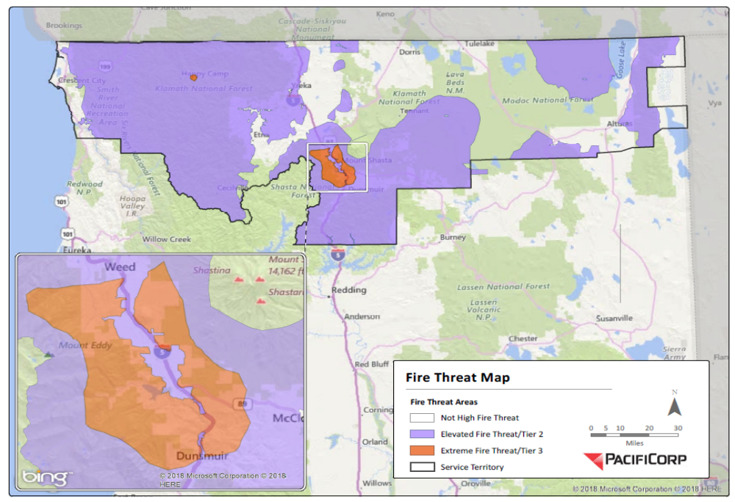
PacifiCorp’s California Service Territory
PacifiCorp provides
electricity to approximately
45,000 customers via
63 substations and
2,520 miles of
distribution lines and about 800 miles of transmission lines
across nearly
11,000 square miles
Of which just under half is classified as HFTD

Slide 4
Key objectives of PacifiCorp’s plan
Greater Resilience/Fewer Fault Events
Rapid Fault Response
Prompt & Strategic Operations
Initiatives included
Asset Hardening
Inspect/Correct Programs
Vegetation Management
Risk-Informed Device Management
Advanced Protection & Control Strategies
Remotely Operable Electrical Devices
Situational Awareness
Operational Response
Notes:
Choose from different slide layouts by selecting “New Slide”

Slide 5
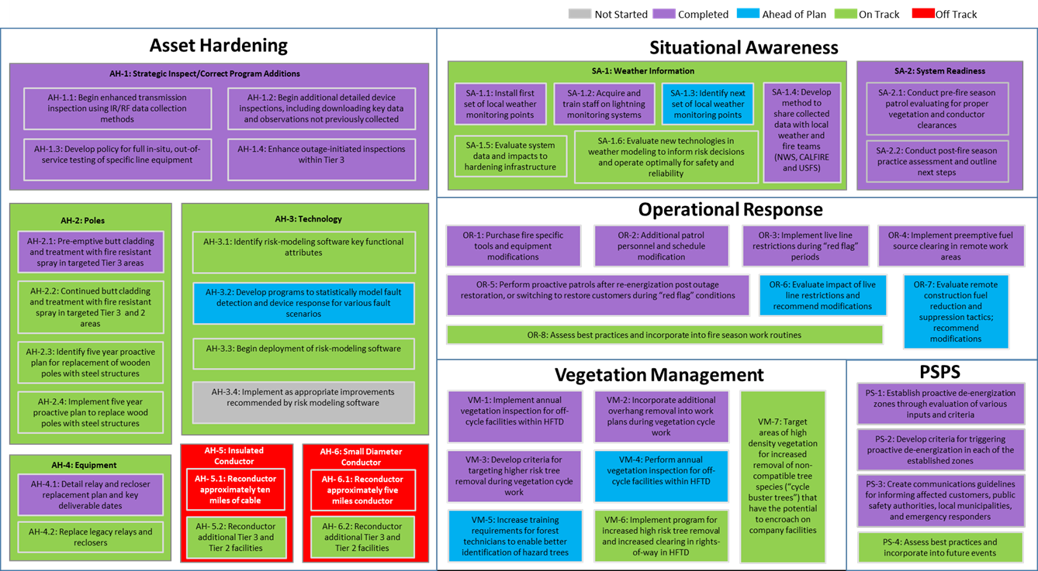
PacifiCorp’s Wildfire Mitigation Plan Elements
2019 Progress

Slide 6
PacifiCorp’s 2020 Wildfire Mitigation Plan Elements (1/3)
Strategy | Immediate (before next fire season) | Near Term (before next annual Plan) | Long Term (within next five years)
Grid Design & System Hardening | Augment existing program tracking methods to incorporate new requirements as indicated in the 2020 WMP and implement a new, robust program tracking system for system hardening projects Prioritize programs needed before the next fire season and annual update and ensure inclusion in the CY2020 execution plan; Final installation and commissioning of 25 field reclosers located within the PSPS candidate zones Install RF network to enable remote operation of fire season settings on newly installed field reclosers Complete 12 transmission and distribution substation relays with advanced protection and control capabilities | Complete full detailed scope for specific programs in years CY2021 and CY2022; Identify, scope, and begin all projects in some discipline related to the wildfire mitigation program through CY2023; Complete CY2020 scope of work pending resource constraints Establish a system of audit with documentation through each phase of the project with checks and balances identified for quality assurance | Complete CY2020 – CY2022 system hardening program scope Evaluate the use of additional new technologies as it relates to grid design and system hardening programs
Asset Management & Inspections | Complete the CY2020 planned inspections within the HFTD Complete remaining scope of IR inspections of transmission lines pilot project to include IR capture at winter peak loading Determine LiDAR pilot project expansion | Complete the CY2020 planned inspections within California Collaborate with industry utilities regarding line equipment maintenance programs to complement compliance-based programs Establish long term strategy regarding the use of IR or LiDAR for equipment based inspections and maintenance | Complete annual scope of planned inspections in CY2020-CY2022 within California Evaluate potential incorporation of risk assessment software solutions to inform asset management and inspections programs and augment existing risk based decision making framework Memorialize findings regarding evaluation of potential line equipment maintenance programs and incorporate, where appropriate, new programs into the long term asset management strategy
Asset Hardening | Identify risk-modeling software key functional attributes | Develop implementation plan for risk-modeling software | Utilize risk-modeling software to improve risk portfolio

Slide 7
PacifiCorp’s 2020 Wildfire Mitigation Plan Elements (2/3)
Strategy | Immediate (before 2020 fire season) | Near Term (before next annual Plan) | Long Term (within next three years)
Situational Awareness | Calibrate existing 10 weather stations to ensure in working condition and able for use in PSPS evaluations during the 2020 fire season Perform verification and validation of forecast vs actual fire weather data from 2019 to improve forwarding looking forecast | Install 10 additional weather stations Continue improvement of real time weather monitoring capability; Evaluate use and potential viability of RAWS-quality weather stations to augment the company’s micro-station installations; Perform a probabilistic arc energy analysis on all circuits within the HFTD Perform a probabilistic arc energy analysis on all small diameter circuits outside of the HFTD Collaborate to pilot distribution fault anticipation (DFA) technology | Complete installation of all weather stations Continue improvement of real time weather monitoring capability; Install any viable RAWS-quality weather stations to augment the company’s micro-station installations Complete recommendations per probabilistic arc energy analysis on all circuits within the HFTD Complete recommendations per probabilistic arc energy analysis on all small diameter circuits outside of the HFTD Evaluate benefits of distribution fault anticipation (DFA) technology
Grid Operations & Protocols | Review existing operating protocols and ensure preparedness Develop a plan and schedule to leverage new high impedance fault detection capabilities and data analytics to inform operating procedures and protocols | Review existing operating protocols and ensure preparedness Leverage RF network where available to facilitate remote implementation of fire season settings Leverage new high impedance fault detection capabilities and data analytics to inform operating procedures and protocols | Review existing operating protocols and ensure preparedness for 2024 fire season Expand capability of RF network to facilitate remote implementation of fire season settings on newly installed field reclosers Validate efficacy of high impedance fault detection in both day to day and extreme weather condition operations

Slide 8
PacifiCorp’s 2020 Wildfire Mitigation Plan Elements (3/3)
Strategy | Immediate (before 2020 fire season) | Near Term (before next annual Plan) | Long Term (within next three years)
Stakeholder Cooperation & Community Engagement | Improve internal and external customer and community facing forecast of PSPS status (website) Continue partnering with public safety partners in communities throughout California regarding wildfire and PSPS preparedness | Continue applicable improvements to internal and external customer and community facing forecast of PSPS status (website) Continue partnering with public safety partners in communities throughout California regarding wildfire and PSPS preparedness | Continue applicable improvements to internal and external customer and community facing forecast of PSPS status (website) Incorporate three year history, enhanced real time weather monitoring capability, and system hardening progress to, where appropriate, evaluate PSPS methodology and protocols and potential reduce the potential scope or impact of PSPS events Continue partnering with public safety partners in communities throughout California regarding wildfire and PSPS preparedness
Vegetation Management | Complete incremental Tier III visual vegetation inspections within the HFTD Evaluate LiDAR inspection pilot to determine next steps and potential pilot project expansion as it relates to vegetation management | Evaluate and, if applicable, be prepared to implement a new tree density inventory Pilot new electronic planning, mapping, and record keeping system regarding vegetation management within the HFTD Establish long term strategy regarding the use of LiDAR | Evaluate workforce management strategies and structures Incorporate lessons learned though tree inventory system analytics to inform risk assessment and prioritization of efforts Implement new electronic work management system for vegetation management within the HFTD
Asset Hardening | Identify risk-modeling software key functional attributes | Develop implementation plan for risk-modeling software | Utilize risk-modeling software to mitigate risk

Slide 9
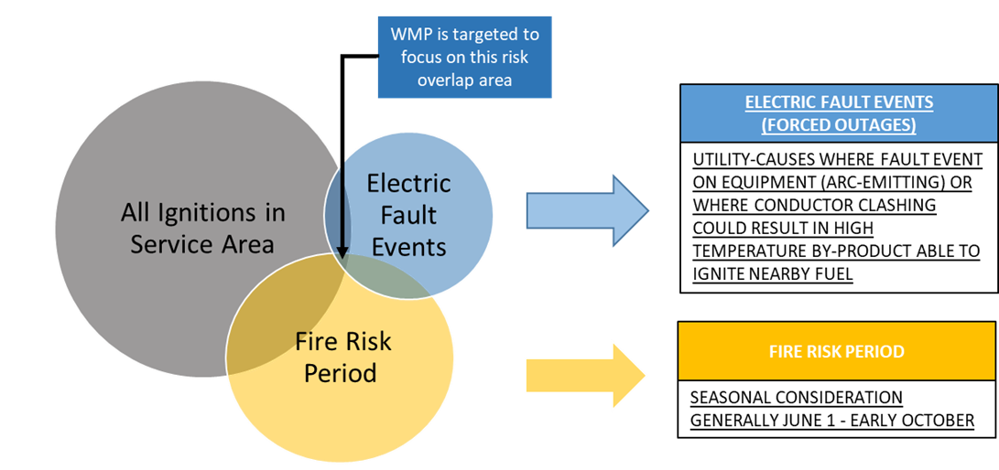
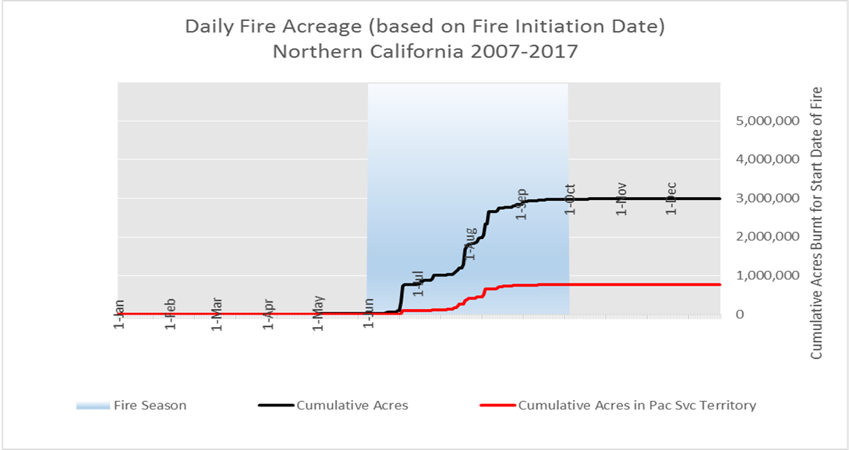
PacifiCorp’s Wildfire Risk Rubric

Slide 10
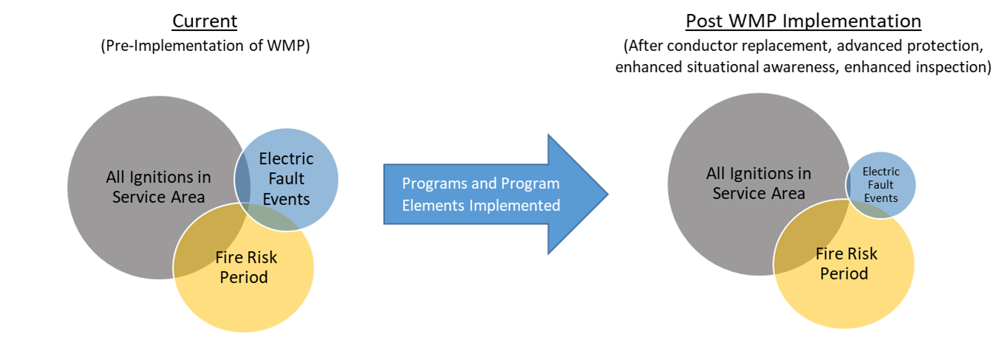
PacifiCorp’s Wildfire Risk Rubric, throughout the life of the WMP
As WMP improvements are made, ignition probability reduces

Slide 11
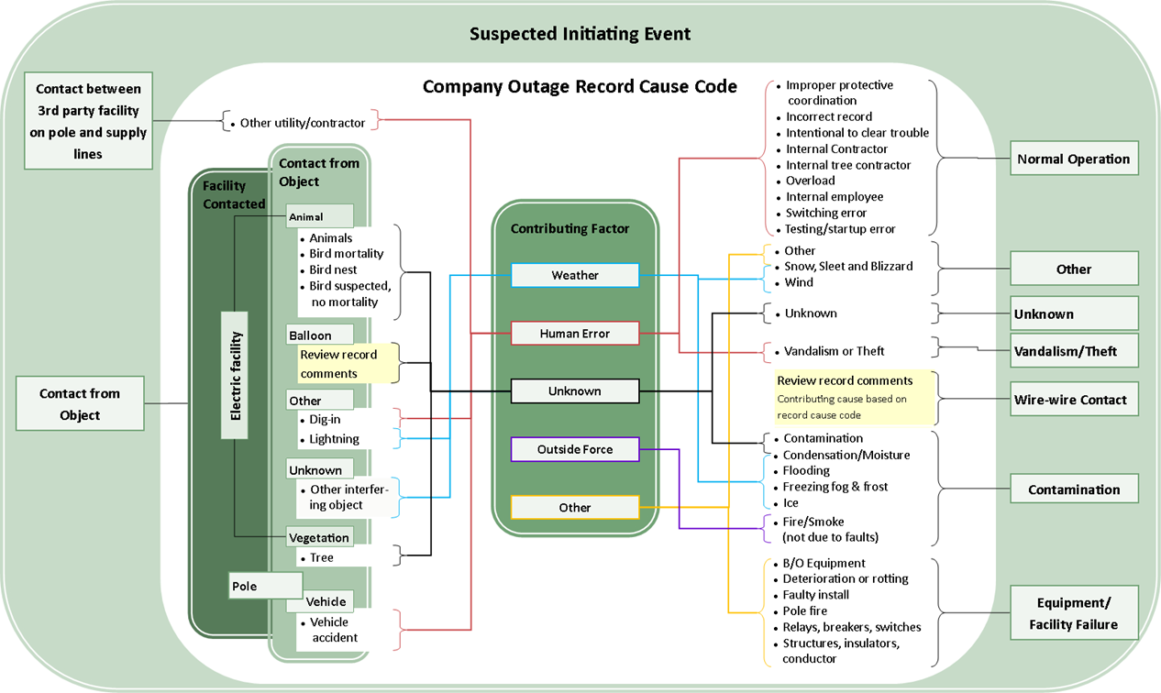
Process to Associate Outages to Ignition Probability Drivers

Slide 12
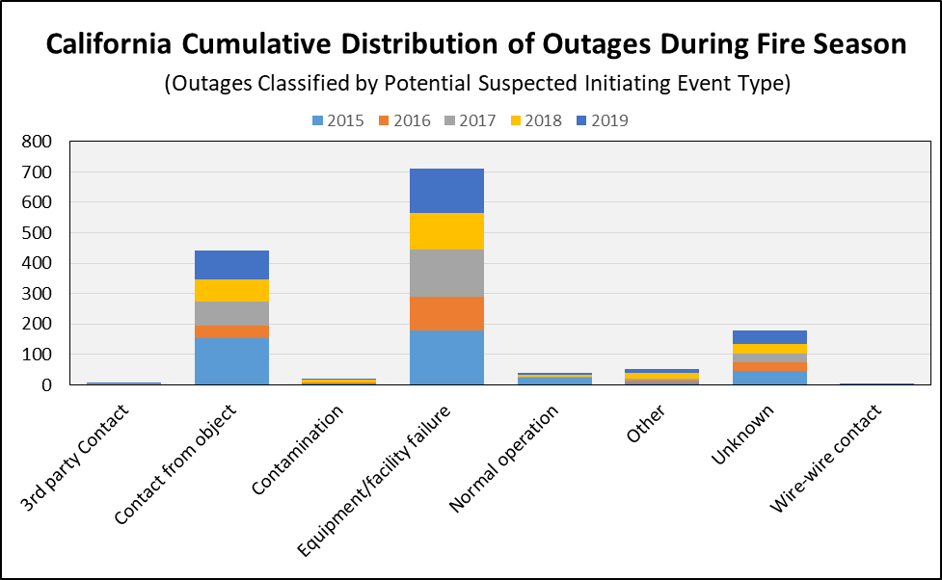
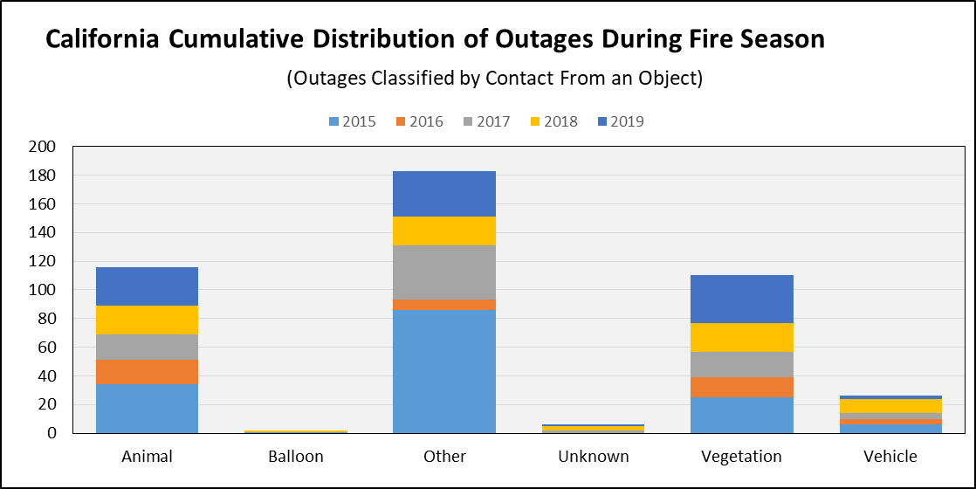
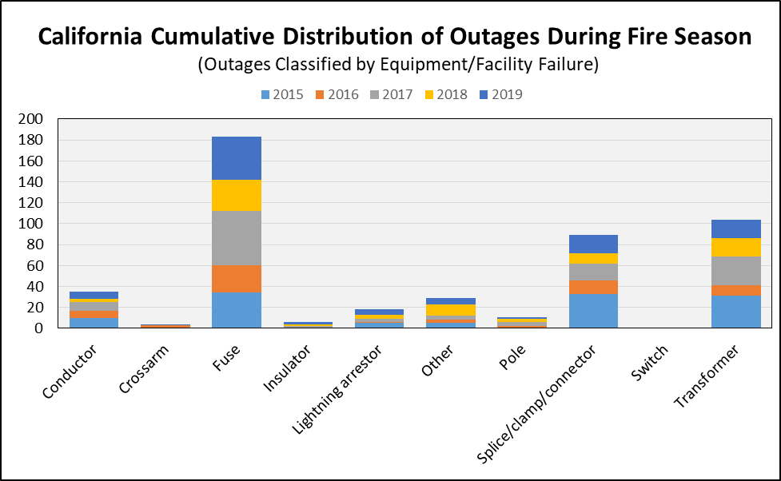
PacifiCorp’s Outage Data: Potential Ignitions

Slide 13
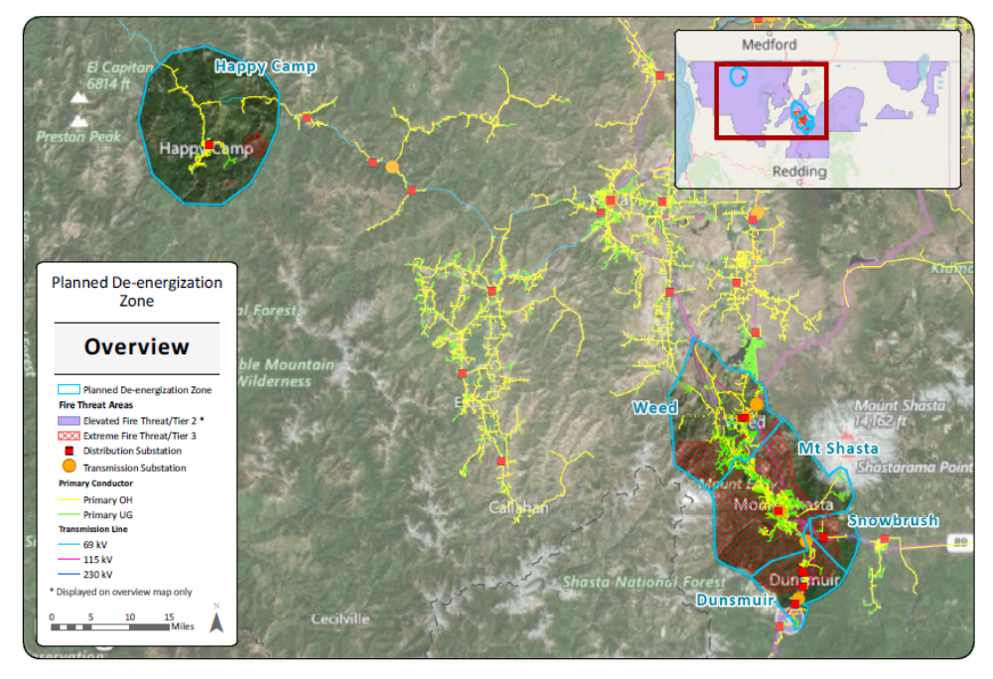
Public Safety Power Shutoff Overview
PacifiCorp’s plan for proactive de-energization is currently limited to Tier 3 areas, which are the extreme risk areas.
Breaking the two main areas into five Proactive De-energization Zones (PDZ) was done to minimize customer impact where appropriate, based on weather monitoring capability and circuit topology.

Slide 14
Proactive De-Energization: PDZ Event Triggers
 | PDZ Name | Substation | Circuits | Customers | Distribution OH | Distribution UG
1 | Happy Camp | Seiad, Happy Camp | 3 | 865 | 48.4 | 5.9
2 | Weed | Weed, International Paper | 5 | 2,589 | 90.5 | 62.1
3 | Mt. Shasta | Mt. Shasta | 6 | 5,074 | 86.4 | 76.7
4 | Dunsmuir | North & South Dunsmuir, Nutglade | 5 | 1,806 | 30.0 | 8.6
5 | Snowbrush | Snowbrush | 1 | 17 | 4.2 | 1.2
 | Total | 9 Substations | 20 | 10,351 | 259.5 | 154.5
Proactive De-energization Zone (PDZ) | = | OR |  | + | AND | + | AND
 |  | Wind gust (mph) | Sustained wind (mph) |  | FFWI6 |  | KBDI
Happy Camp |  | 31 | 16.7 |  | 30 |  | 622.2
Mt Shasta/Weed/Dunsmuir/Snowbrush |  | 31 | 16.7 |  | 30 |  | 622.2
Criteria Definitions:
Hourly Fosberg Fire Weather Index (FFWI) which uses temperature, relative humidity, 10-minute wind-speed factored into a single weather index which is correlated to influence on fire spread, over a 6 hour period (FFWI6).
The Keetch-Byram Drought Index (KBDI) which assesses the risk of fire by representing the net effect of evapotranspiration and precipitation in producing cumulative moisture deficiency.
Notes:
PacifiCorp developed an operating procedure that documents the process for a proactive de-energization event:
Utilizing automated weather systems monitoring, an alert is generated when thresholds are exceeded (wind, temperature, humidity, precipitation, and cumulative moisture deficiency), and a proactive de-energization event is triggered.
When an event is triggered, a Proactive De-energization Event Plan is prepared which contains the timing details, area, and forecasted duration of the event.
Notifications are then made to internal departments for next steps:
Customer Service for customer notification (48 hours notice is desired)
Emergency Management for local emergency services notification
Regulation for notification to the director of the CPUC safety and enforcement division (SED).
Local Operations for required switching / line patrolling
Regional Business Manager for preparation of customer care centers and large customer contact
Conditions are continuously monitored and when thresholds are no longer exceeded, lines are patrolled and re-energized.
As experience with proactive de-energization is gained, the company expects to evolve the plan incorporating lessons learned to improve the process.

Slide 15
Summary
PacifiCorp made improvements during 2019 with its WMP journey
Feedback gained from stakeholders through the year was incorporated into 2019 actions and into the 2020 WMP
PacifiCorp is poised to complete significant progress in 2020 (and beyond)
PacifiCorp appreciates the guidance and thorough approach with the WMP Guidelines
We look forward to continuing to refine our Plan as we hear from stakeholders and share experiences with other companies
Notes:
Choose from different slide layouts by selecting “New Slide”

