Slide 1
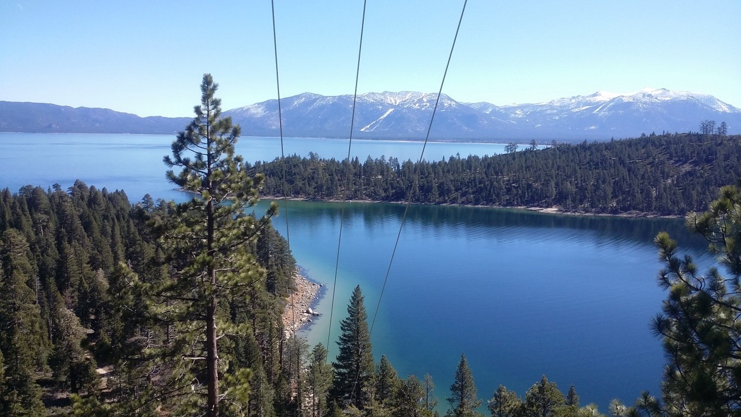
Liberty CalPeco
2020-2022 Wildfire Mitigation Plan
Eliot Jones
Senior Manager, Wildfire Prevention

Slide 2
Liberty CalPeco – 2020 WMP Overview
Liberty CalPeco’s 2020-2022 WMP includes capital expenditures of approximately $40 million.
  Grid Design and System Hardening accounts for most of the capital investment.
  Liberty CalPeco will also be undertaking a complete system survey/asset inventory in 2020 that will allow for identification and mitigation of hazards at a programmatic level on a system-wide basis.
Liberty CalPeco expects to incur approximately $6 million a year in incremental WMP O&M expenses.
  Repairs found during system survey.
  Vegetation Management Wood Removal/Fuel Reduction.
  Other expenses include increase in WMP staffing, enhanced vegetation management and forest resiliency corridors.

Slide 3
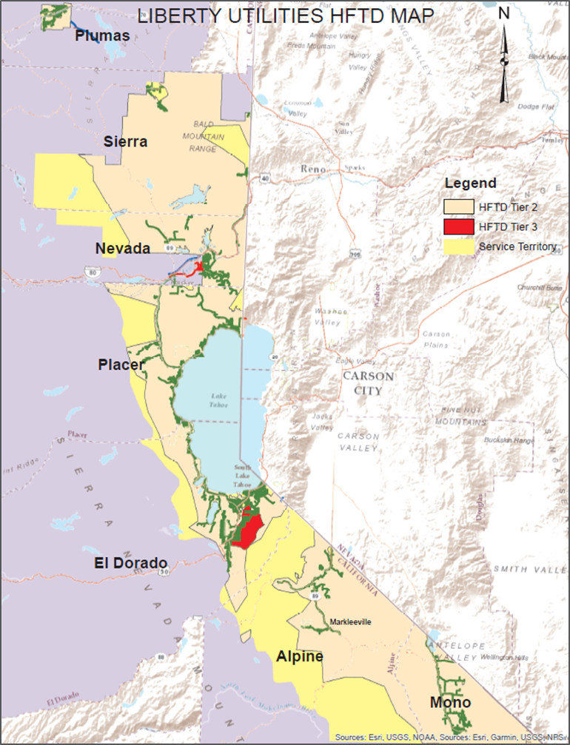
Liberty CalPeco Service Territory
Liberty CalPeco serves approximately 49,000 electric customers in California in and around the Lake Tahoe Basin.
Liberty CalPeco’s service territory includes portions of Placer, El Dorado, Nevada, Sierra, Plumas, Mono, and Alpine counties.
Almost 80% of customers are located in the Lake Tahoe Basin. The biggest population center is the City of South Lake Tahoe. The Liberty CalPeco service territory extends from Portola in the north to Markleeville and Topaz Lake in the south.

Slide 4
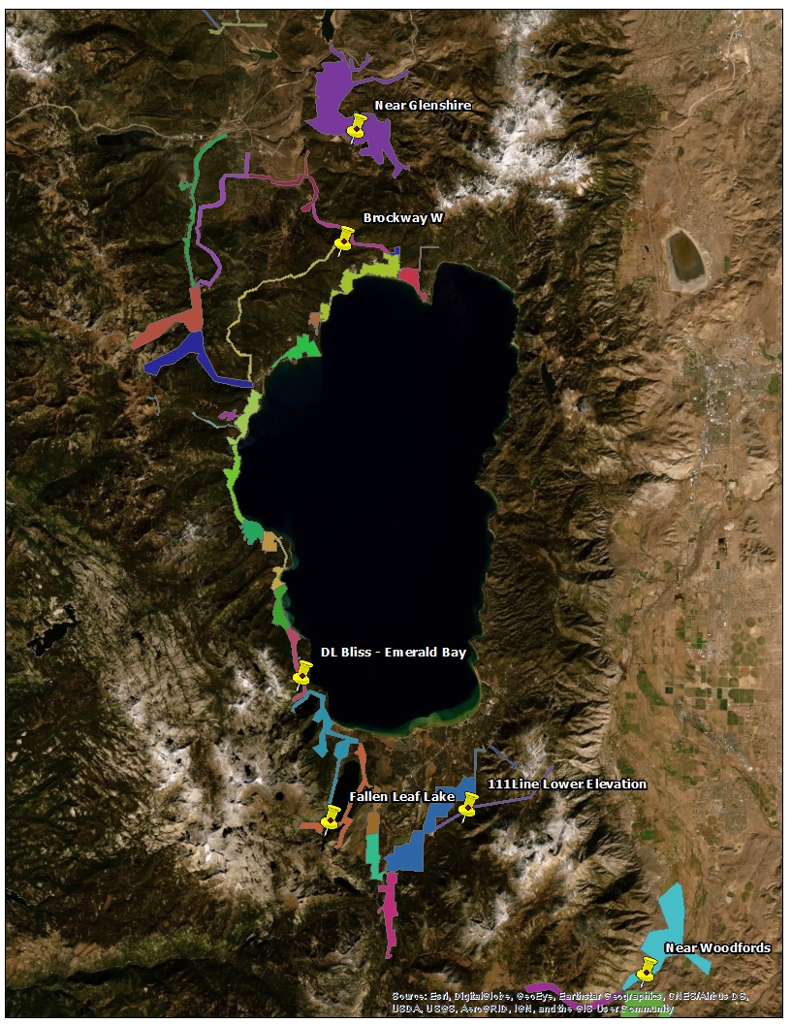
Situational Awareness and Forecasting
Advanced Weather Monitoring and Weather Stations
  In 2019, Liberty CalPeco developed a weather forecasting and notification tool to warn of potential elevated fire risk.
Fire Potential Index
  Assessment tool developed by SDG&E that is tailored to Liberty CalPeco’s climate, environment, and system.
  Designed to drive operational safety during fire season.
Weather Stations
  Installed 10 in 2019 and plan to install up to 40 more within next two years.

Slide 5
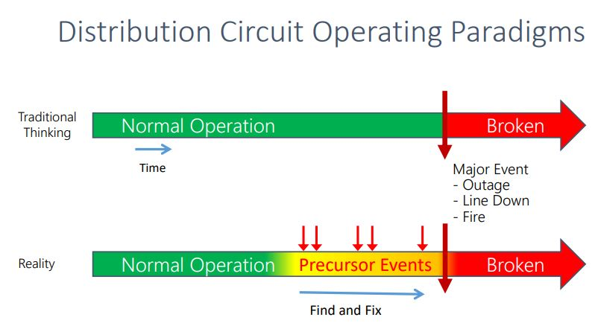
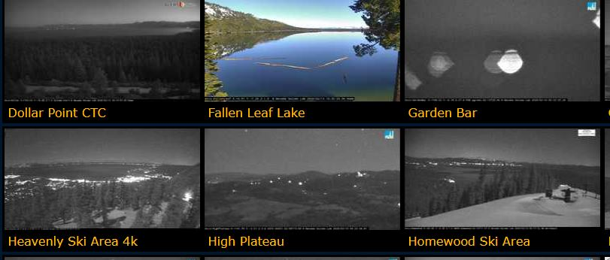
Situational Awareness and Forecasting
Continuous Monitoring Sensors
  Distribution Fault Anticipation
    Measures electric waveforms to detect line events that have a high fire potential of ignition (e.g. arcing connections).
  ALERTWildfire Cameras
    Monitoring high fire risk areas to allow for discovery of ignition events and support fire resources throughout a wildfire event.
Notes:
Talk about research partnerships

Slide 6
Enhanced Overhead Line & Substation Inspections and Maintenance
Improved tracking and reporting of current inspection and repair programs –Asset Inventory/GIS Update.
Survey of entire system with full assessment of G.O. 165 compliance requirements.
Maintenance and repairs as a result of detailed system survey.
LIDAR pilot program.
Potential programs
  Formal Quality Assurance and Quality Control Group independent of field crews (only for Vegetation Management)
  Drones
Notes:
Follow G.O. 165 and G.O. 174 compliance scheduling and G.O. 95 and G.O. 128 repair standards.
Intrusive Pole Inspections
Pole Loading Assessment (G.O. 95)

Slide 7
Grid Design & System Hardening
Covered Conductor Program
  Prioritizing high risk areas and existing permitted reconductor locations.
Wire Upgrade Program
  Replacing grey wire.
  Replacing open-wire secondary.
Tree Attachment Removal
Expulsion Fuse Replacements
  Targeting transformer fuses first.
  Replacing larger tap/lateral fusing with exempt type or electronic fault interrupters.
Substation Hardening
  Replacing oil circuit breakers with gas or vacuum breakers and replacing wood structures at substations.
Notes:
High Impedence Fault Detection

Slide 8
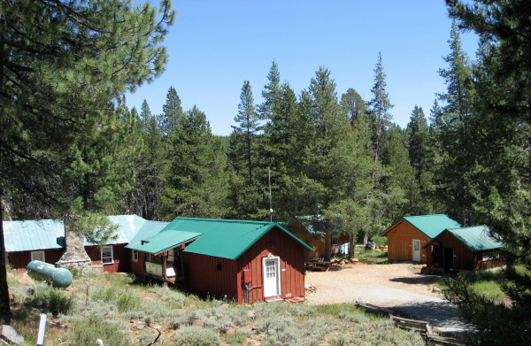
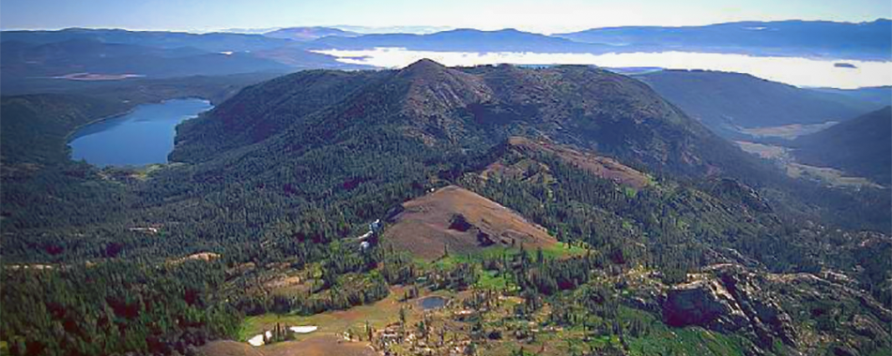
Grid Operations and PSPS Mitigations
Grid Topology improvements to mitigate/improve PSPS events
  Distribution Automation Control
  Installation of switches and reclosers to move toward DAC to allow for sectionalizing of lines during switching and PSPS events.
  Working in parallel with SCADA controls to keep as many customers in service.
Notes:
More isolation points allows for more flexibility during outages and PSPS events.

Slide 9
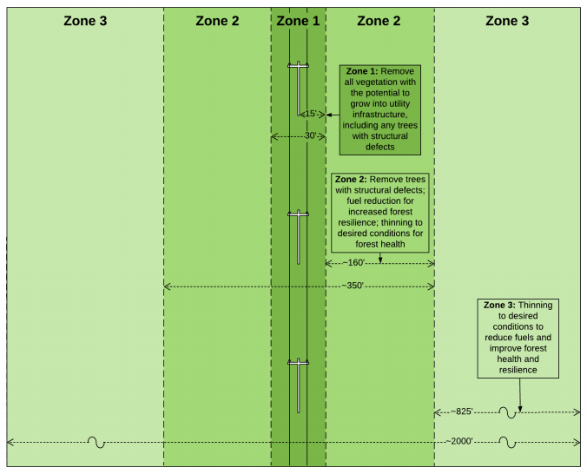
Vegetation Management Enhancements
Tier 3 Inspections
  Annual inspections will be conducted on approximately 50 miles of OH lines in Tier 3 HFTD to identify work on pruning or tree removals.
Forest Resiliency Corridor Project
  Collaborative effort with federal, state, and local agencies to conduct comprehensive forest resiliency and fuels reduction treatment.
  Assist with conducting forest management research along with investigating innovative technology opportunities.
Fuel Reduction and Wood Management Program
  Clearing of logs, bole wood, and branches left behind to reduce dry fuel source adjacent to power lines and infestation risk to remaining trees by forest insects.
  Explore opportunities for biomass utilization.

Slide 10

QUESTIONS
Notes:
Q: What was the reference to a CA Meeting on Chris Alario’s slide:
A: Building upon what Chris was stating at the beginning of the meeting about building a cohesive team/culture, he would like to have a combined CA meeting that includes all three CA locations.
Q: How are we doing on finding replacement for Randy?
A: Working diligently to find a replacement, had 4 offers out, unfortunately none have been successful in coming through, have more interviews set up next week.

