Slide 1
2023-2025 Wildfire Mitigation Plan
PUBLIC Workshop
For Large Electrical Corporation Submissions
April 27 & April 28, 2023
DAY TWO

Slide 2
INTRODUCTION

Slide 3
SAFETY MESSAGE
Be aware of your surroundings
Know your evacuation route(s)
Feel something, say something
Stand up and move occasionally

Slide 4
WORKSHOP LOGISTICS
Asking Questions
Ask written questions in the Zoom Q&A at any time
Raise your hand during the public questions portion of the panels
Hold questions for overall Q&A at the end of each day

Slide 5
Energy Safety Panel Moderators
Energy Safety Panel Moderators – Day Two
Situational Awareness and Forecasting– Emily Ginsburg
Risk Assessment and Mitigation Selection Strategy– Luis Medina (Level 4)

Slide 6
AGENDA – DAY TWO
9:25am – 12:00pm Situational Awareness and Forecasting Panel
11:15am, 10-minute break
12:00pm – 1:00pm Lunch
1:00pm – 3:00pm Risk Assessment and Mitigation Selection Strategy Panel
2:05pm, 10-minute break
3:00pm – 3:30pm Open Q&A (all panels)
3:40pm Adjourn

Slide 7
Situational Awareness & Forecasting
Panel

Slide 8
SDG&E

Slide 9
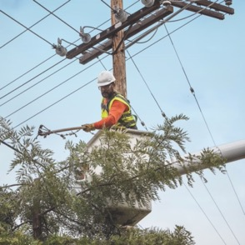

2023 – 2025
Wildfire Mitigation Plan
our programs | our impact

Slide 10
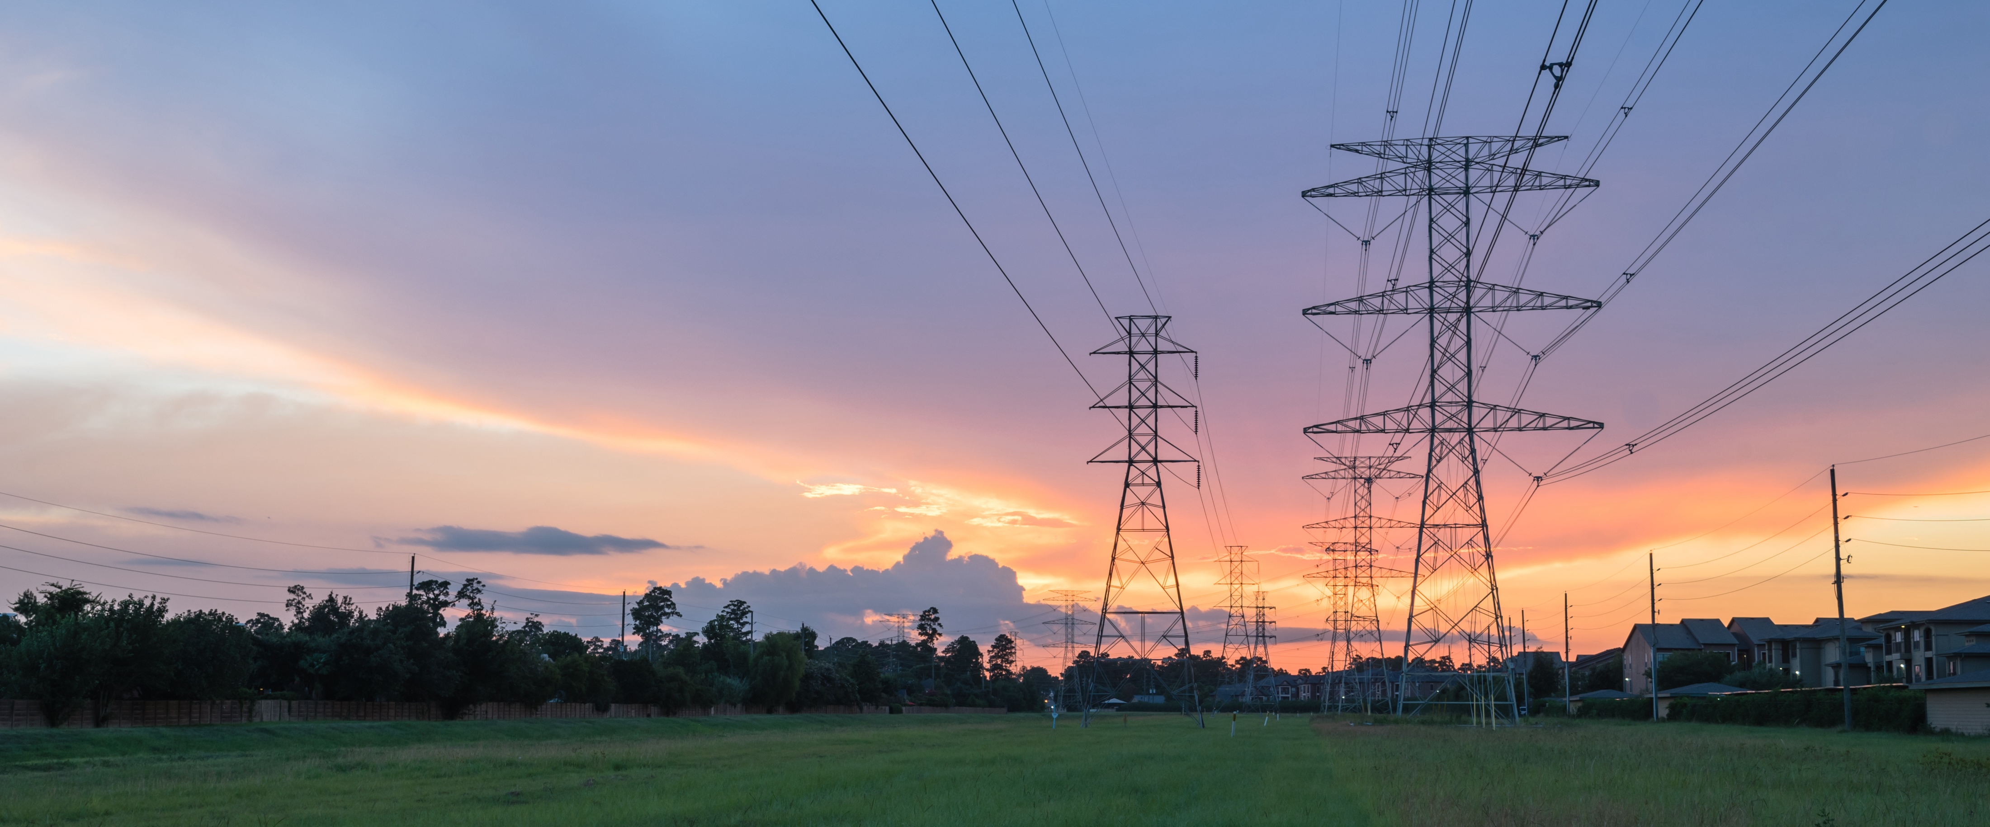
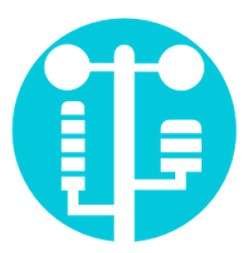
Chris Arends, Meteorology Program Manager
Situational
Awareness

Slide 11
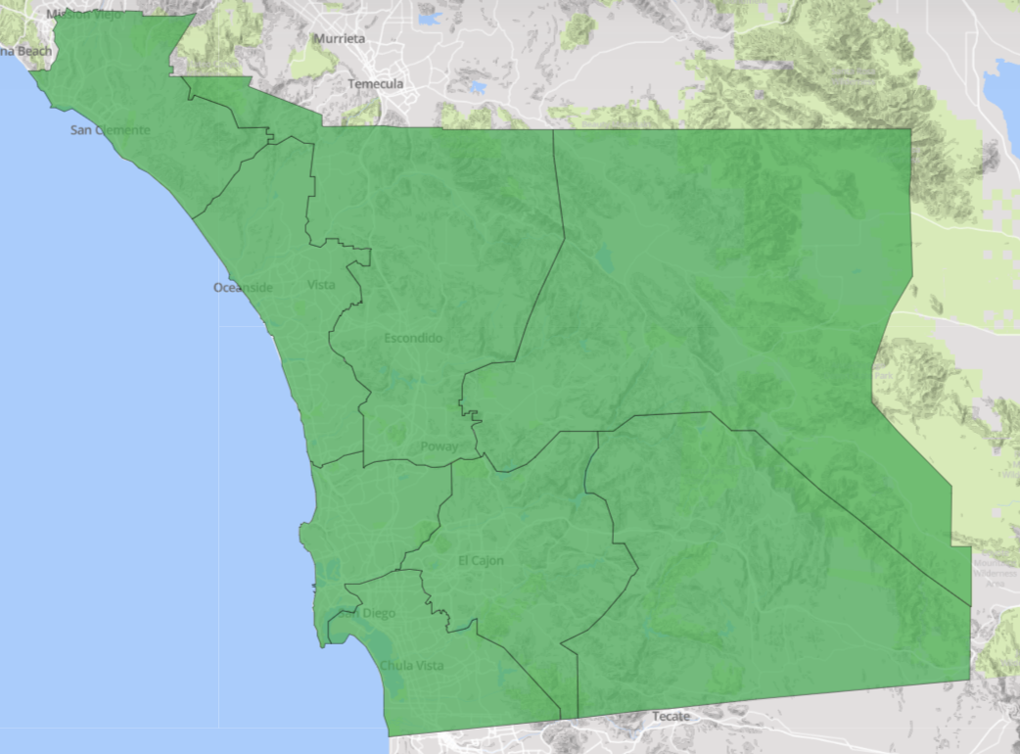
Accuracy of Fire Potential Index (FPI)
Over-prediction is most often due to planning for worst-case forecast scenarios that do not verify
Under-prediction found to have two main sources:
  Weather station choice for verification – use of stations with extreme conditions were unrepresentative of majority of the district
  Limitations of the FPI formula – does not account for high soil moistures immediately after rainfall that limits the fire potential before grass green-up can occur
Orange County
(OC): 81%
North East (NE): 85%
North Coast (NC): 92%
Ramona (RA): 87%
Beach Cities (BC): 89%
Eastern
(EA): 86%
Mountain Empire (ME): 87%
 | ME | RA | EA | NE | OC | NC | BC | CM
Accurate | 87% | 87% | 85% | 86% | 81% | 92% | 89% | 89%
Over-Predicted | 1% | 2% | 2% | 1% | 4% | 2% | 1% | 1%
Under-Predicted | 12% | 12% | 13% | 13% | 15% | 6% | 10% | 10%
Metro
(CM): 89%
*Results based on last 4.5 years

Slide 12
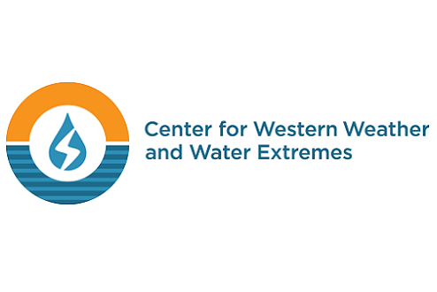
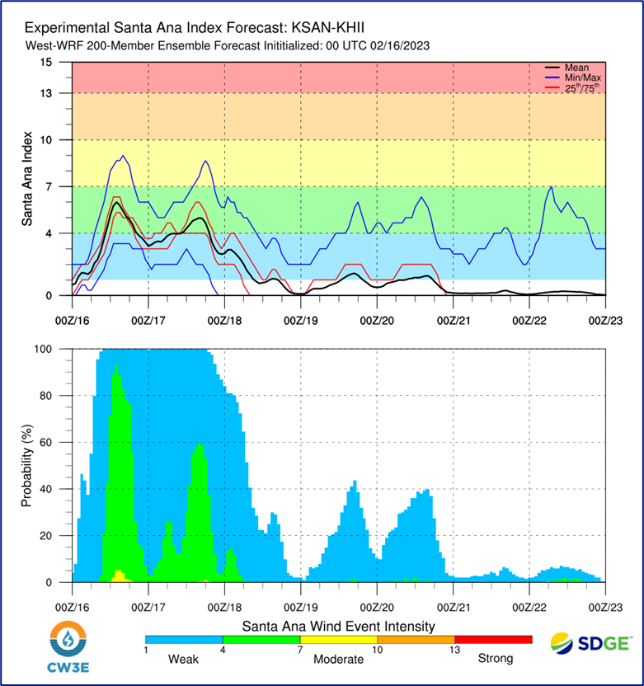
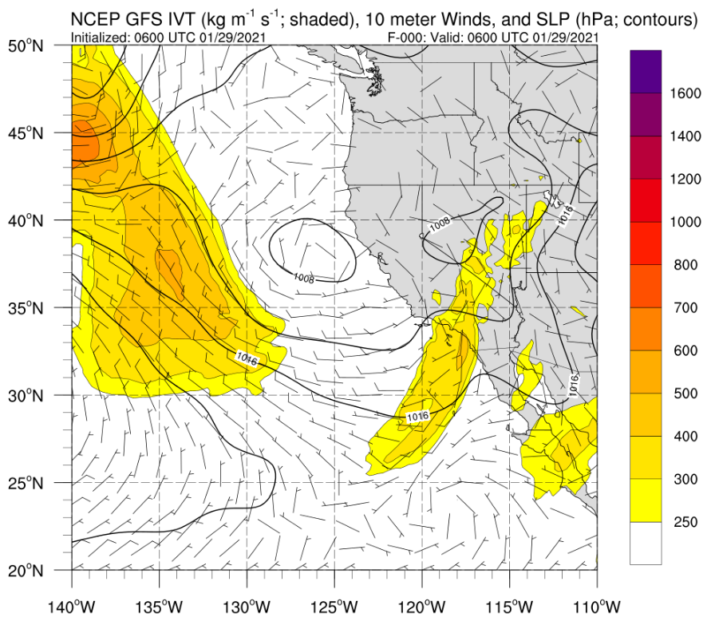
Academic Partnerships
Center for Western Weather and Water Extremes (CW3E), Scripps Institution of Oceanography, University of California San Diego
CW3E’s mission is to better understand, predict and apply extreme weather forecasting capabilities tailored to the unique meteorological conditions of the western U.S.
200-member weather model to predict extreme events by sampling a greater distribution of possible forecast outcomes:
7-day forecast tailored for SDG&E, predicting strength and probability of Santa Ana winds
Santa Ana Wind High-Resolution Modeling:
Wind forecasts for SDG&E at 333 m grid spacing trained with inputs from historical high impact Santa Ana wind events
Weather Hazards Summary Product:
Develop a forecasting summary of weather hazards over the SDG&E service territory
Three initiatives for 2023

Slide 13

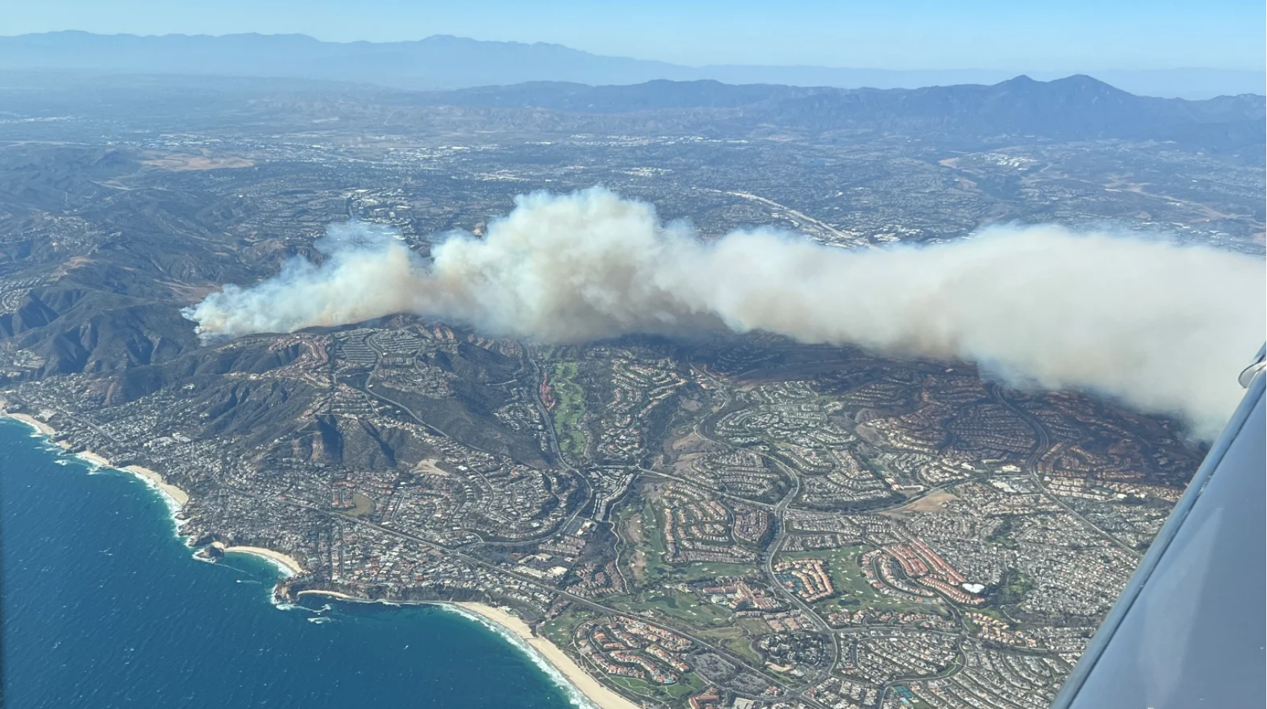
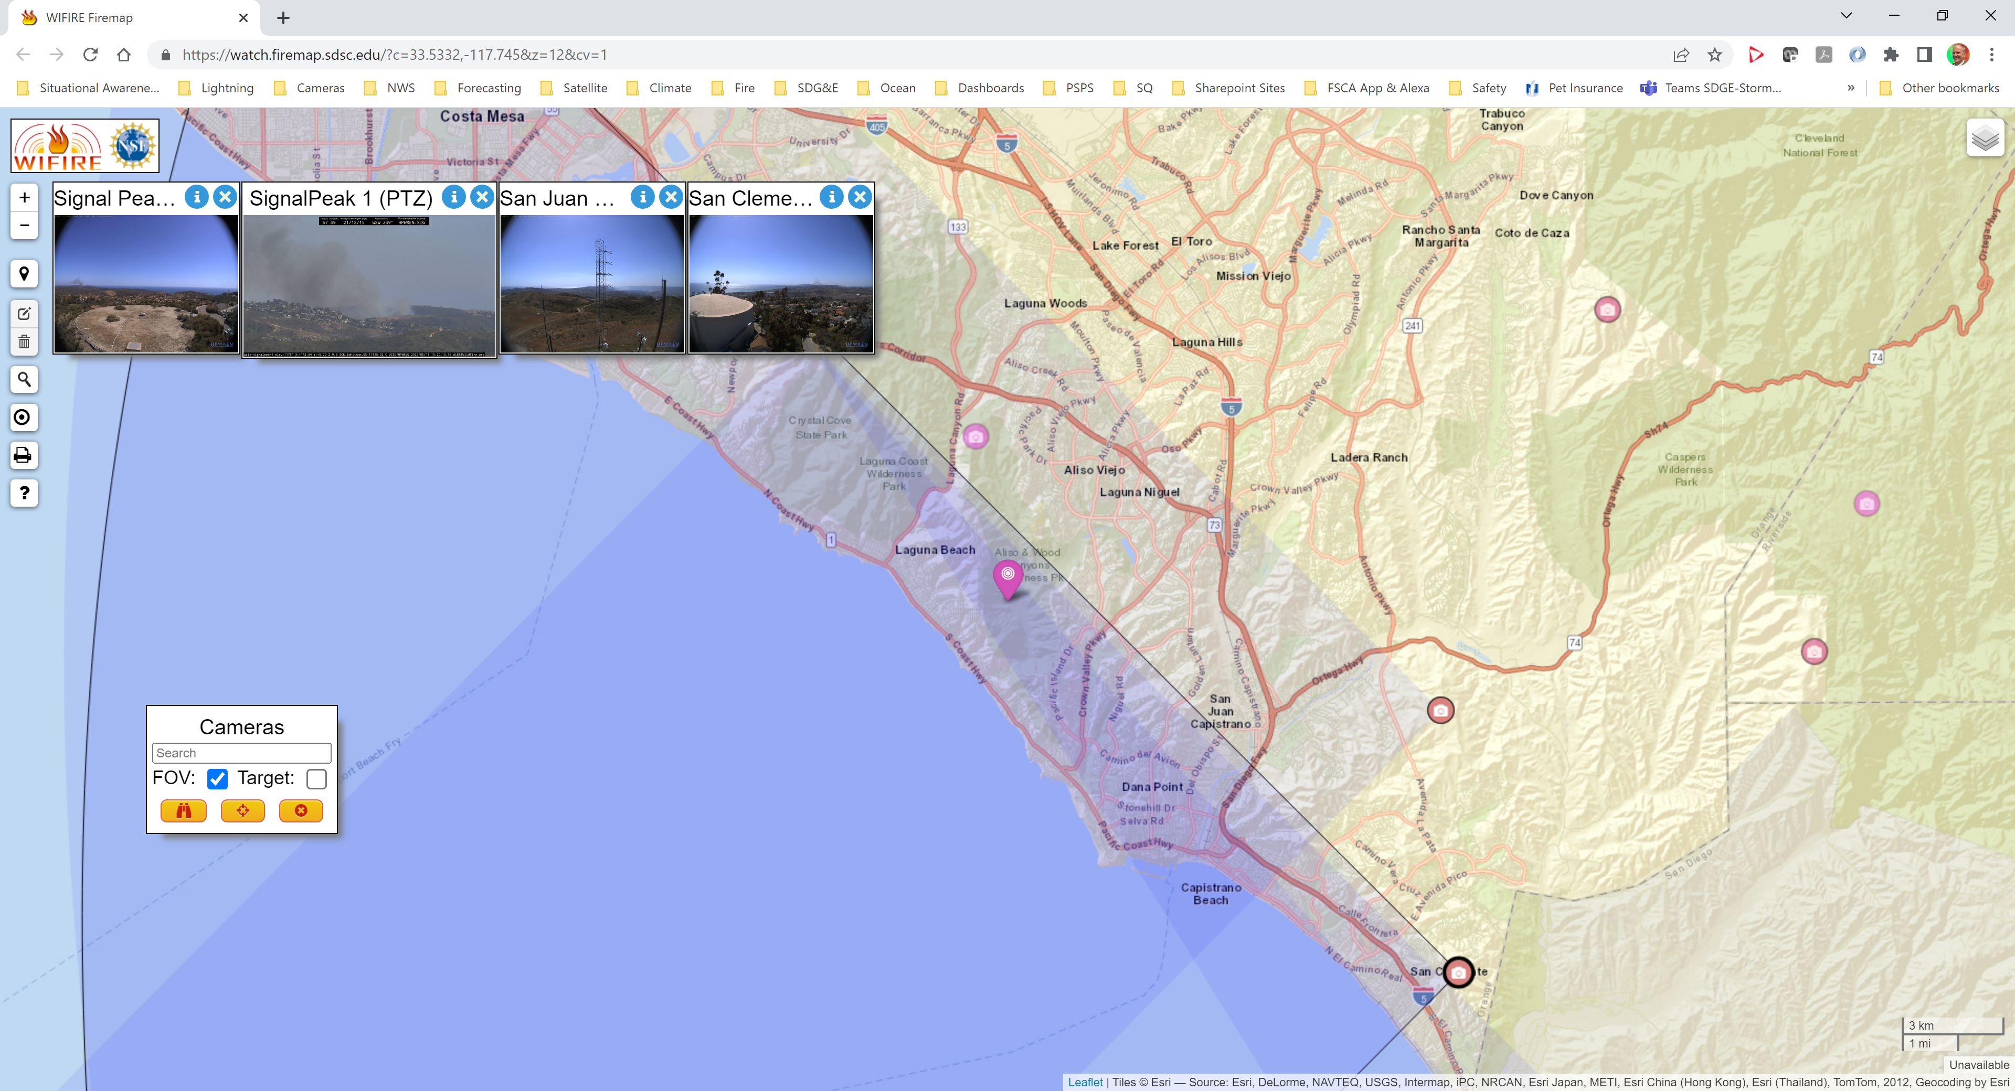
Academic Partnerships
University of Wisconsin-Madison Space Science and Engineering Center (SSEC)
SSEC is a world-class archive of satellite data, receiving, archiving and redistributing most geostationary weather satellite data produced globally. SSEC and SDG&E have partnered to increase situational awareness of wildfire ignitions in the service territory.
The new GOES-16/18 carry the Advanced Baseline Imager (ABI), a next-generation fire detection and characterization at 2 km spatial and 1–5-min. temporal resolutions
The Wildfire Automated Biomass Burning Algorithm (WFABBA) flags pixels that have a potential fire
Six categories of fire detection based on confidence and environmental factors
Kincade Fire (Sonoma): The WFABBA took 4 minutes from ignition to first detection

Slide 14

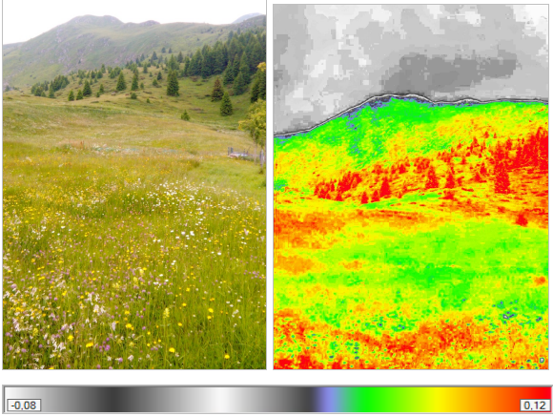
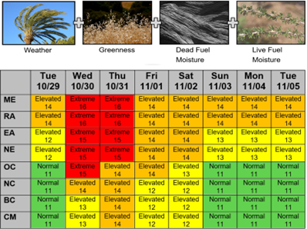
Academic Partnerships
San Jose State University (SJSU) Wildfire Interdisciplinary Research Center (WIRC)
The WIRC focuses on all aspects of wildfire science, conducting high-impact wildfire research so that improved tools and policies can be provided to the community and industry stakeholders around the world
Operationalizing the new machine learning live fuel moisture model (LFM) and integrate into WRF-SFIRE, a coupled atmosphere-wildfire model that can be queried for ignitions. Enable WRF-SFIRE simulations to serve Wildfire Analyst (WFA) desktop clients
Assess the accuracy of dead and live fuel moisture inputs into the SDGE Fire Potential Index (FPI). Explore methods for error reduction by assimilating in-situ and high-resolution satellite-based fuel moisture observations
Two initiatives for 2023

Slide 15
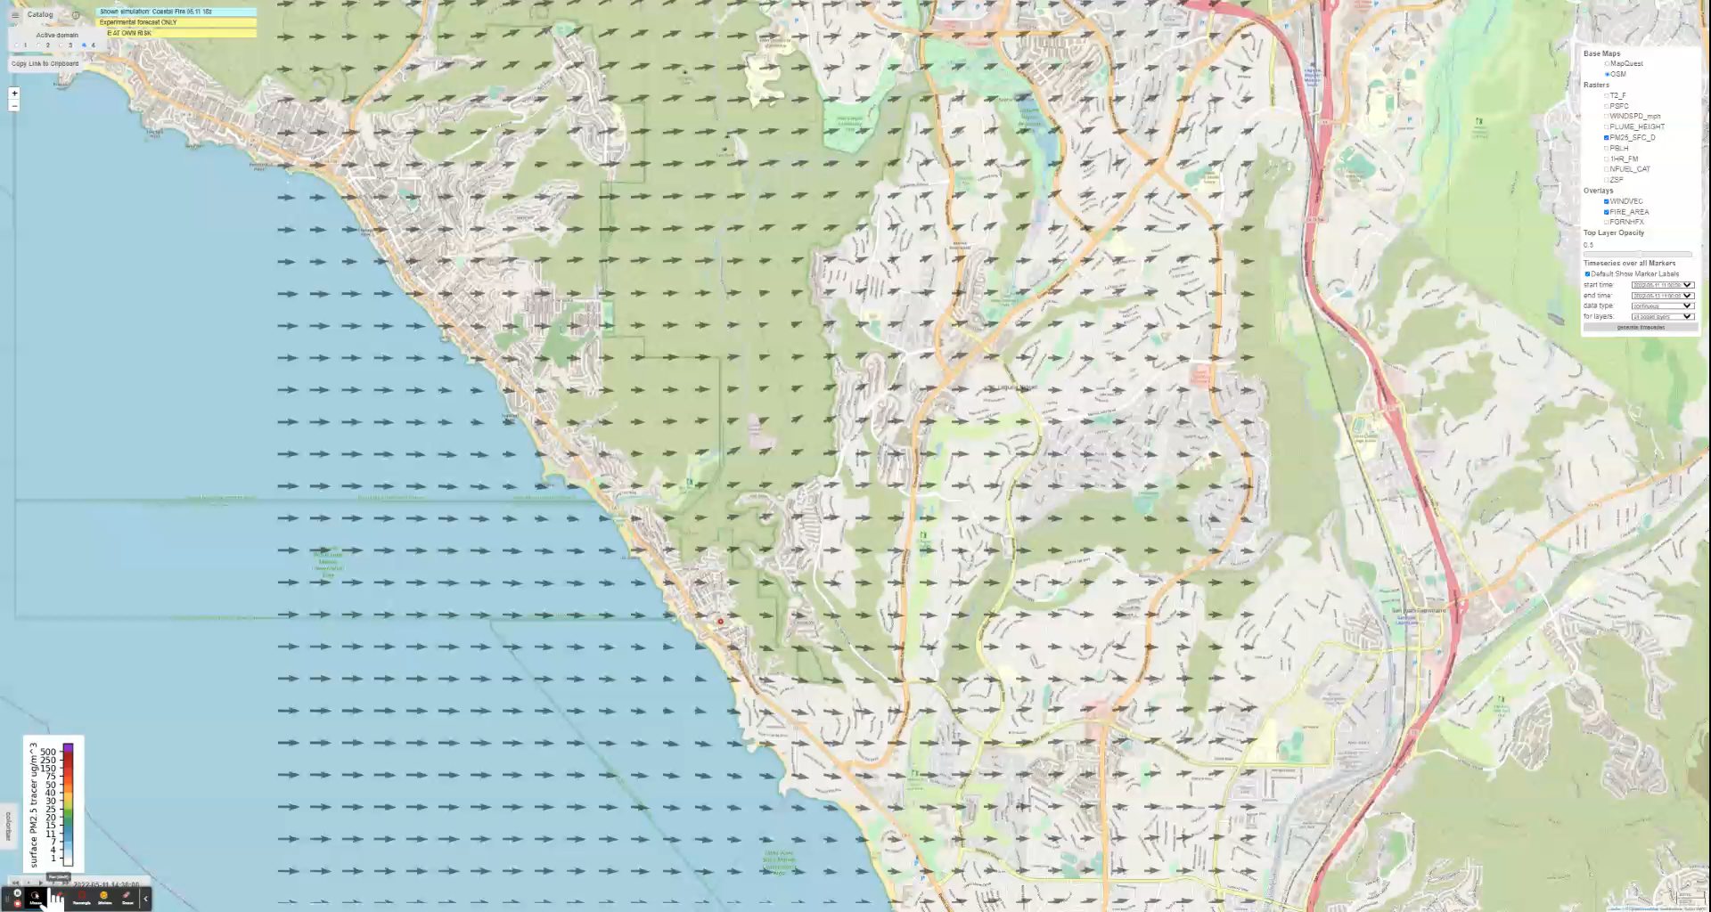
Coastal Fire (5-11-2022) Simulation with WRF-SFire
San Jose State Univ. is advancing fire science with WRF-SFIRE, which incorporates atmospheric modeling and fire spread modeling into the same application

Slide 16


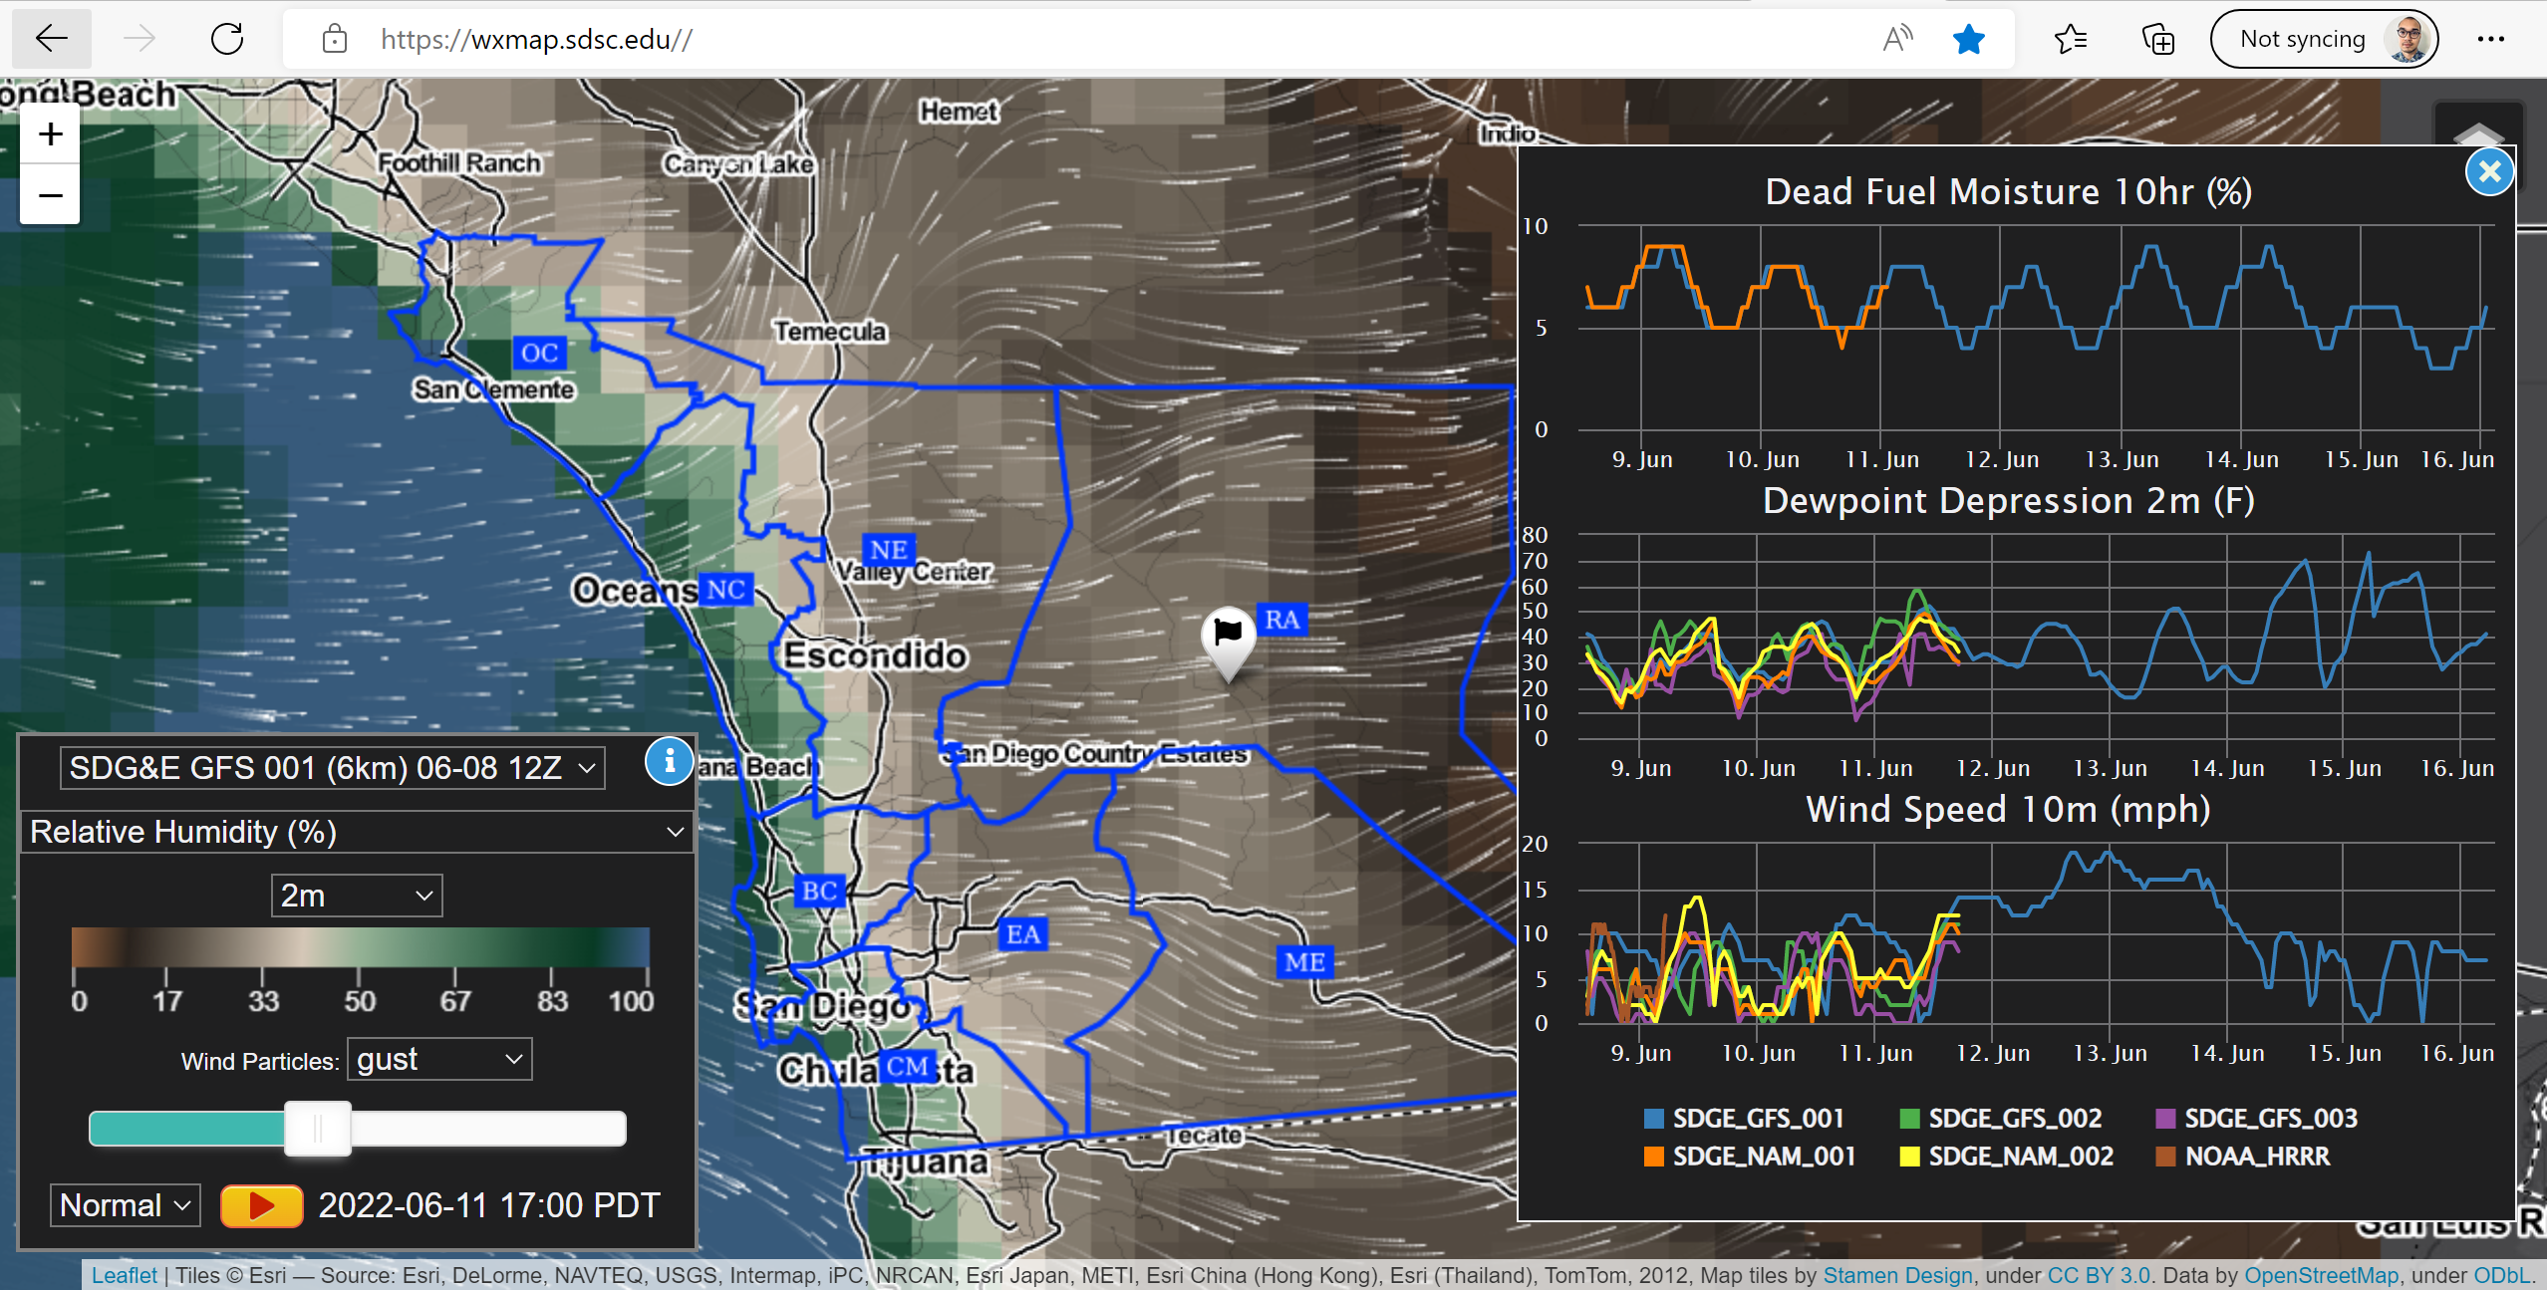
Academic Partnerships
San Diego Supercomputer Center (SDSC)
Ingests and stores SDG&E weather, fuels and post processed indices datasets, including the Outage Potential Index (OPI), Solar Potential Index (SPI), Fire Potential Index (FPI) and Santa Ana Wildfire Threat Index (SAWTI), to enable findability through web services and visual maps
Enhance SDG&E Weather and Fuel Data Intelligence Visualization Portal with defined user experience requirements. Constantly consider new datasets and visualizations such as aircraft observations
Design Physics Guided Machine Learning (PGML) Techniques for Next-Generation Fire Modeling at high spatiotemporal resolutions. Develop innovative computational methodologies to anticipate ignition locations and fire spread
Two initiatives for 2023

Slide 17
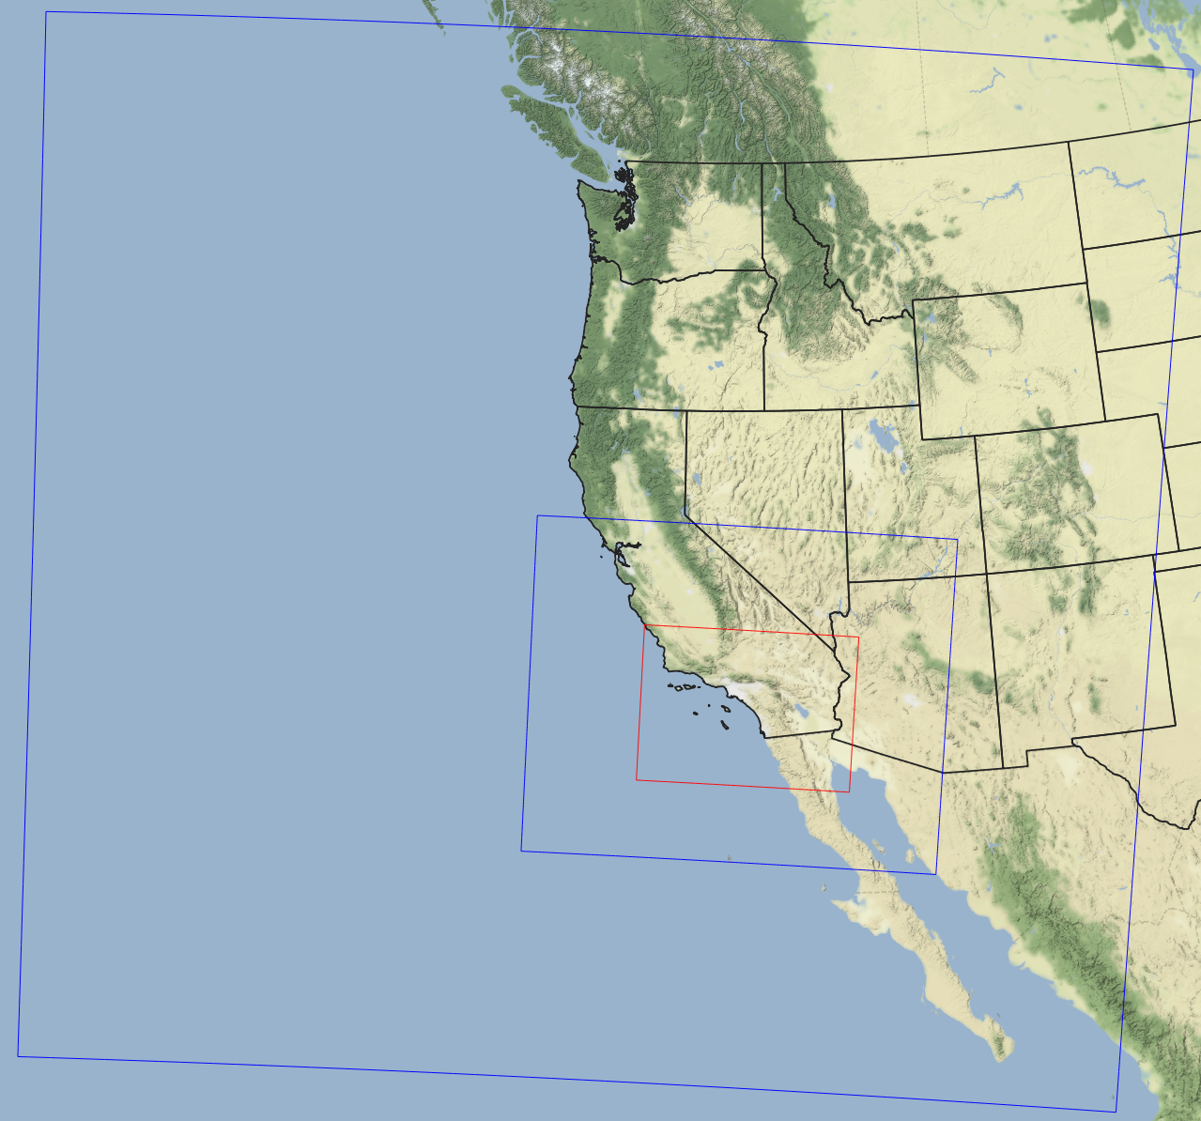
HPCC upgrade & improved WRF
Two new supercomputing clusters – to be operational in late 2023.
  ~400% increase in computing
Upgrading the operational WRF weather model from 2km to 1.5km grid and will be the new parent model for:
  Fire Potential Index (FPI)
  Santa Ana Wildfire Threat Index (SAWTI)
  Outage Potential Index (OPI)
  Solar Potential Index (SPI)
  Load Forecasting Model
  Fire Spread Modeling
Targeting the shorter-term (Day 1-4) weather conditions:
  Santa Ana winds
  Atmospheric Rivers
  Thunderstorms/Lightning
13.5 km
4.5 km
1.5 km

Slide 18
PG&E

Slide 19
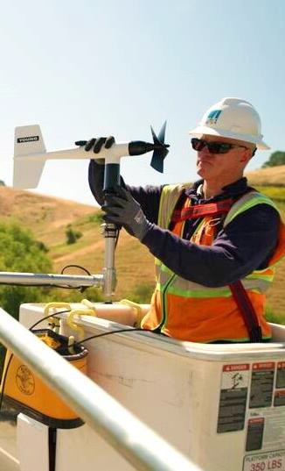
Panel 4: Situational Awareness and Forecasting
PG&E’s Situational Awareness programs focus on enhancing PG&E’s understanding of wildfire risk within its service territory and providing real time visibility its conditions
Current Development Planned Developments
PG&E has early fire detection systems – including satellite feeds (GOES, VIIRS, and MODIS) and over 600 HD cameras – located throughout PG&E’s service territory including its HFTD areas.
PG&E has a year-round weather station network of over 1,400 weather stations that monitors temperatures, wind speeds, wind gusts, and relative humidity, and they are crucial during PSPS events. These weather stations are primarily focused on the high fire risks areas of its service territory.
The two capabilities above (satellites, HD cameras and weather station information) are made available for public utilization and shared via this link:
  https://www.pge.com/en_US/safety/emergency- preparedness/natural-disaster/wildfires/weather- monitoring-awareness.page
PG&E works with Technosylva (also used by Cal Fire) to simulate fire spread and consequence impacts. These outputs are used to understand the impacts of wildfire risk and its consequences.
PG&E has 861 line sensors across 189 circuits and has Distribution Fault Anticipation (DFA) sensors on 74 circuits
PG&E will evaluate enhancements to its Fire Potential Index (FPI) and the Ignition Probability Weather (IPW) models. This will involve testing new features and types of model configurations that could improve model skill.
Artificial Intelligence processing of wildfire camera data will be enabled to provide automated wildfire notifications in an internal PG&E monitoring tool. AI fire detections will provide valuable to PG&E and first responder agencies regarding the presence of new fires.
PG&E plans to install line sensors on 120 additional circuits between 2023 and 2025. These new line sensors and other equipment will be predominantly located in Tier 2 and Tier 3 HFTD.
Scalable processes will be developed to enabled Early Fault Detection (EFD) and Distribution Fault Anticipation (DFA) sensors. EFD technology provides early detection of failing equipment and have the potential to detect vegetation encroachment. DFA provides detection and assistance in locating faults, abnormal power flow events, and categorization of events.
Some of the measures included in this presentation are contemplated as additional precautionary measures intended to further reduce the risk of wildfires.
1

Slide 20
SCE

Slide 21

Situational Awareness &
Forecasting (4/28)
21

Slide 22
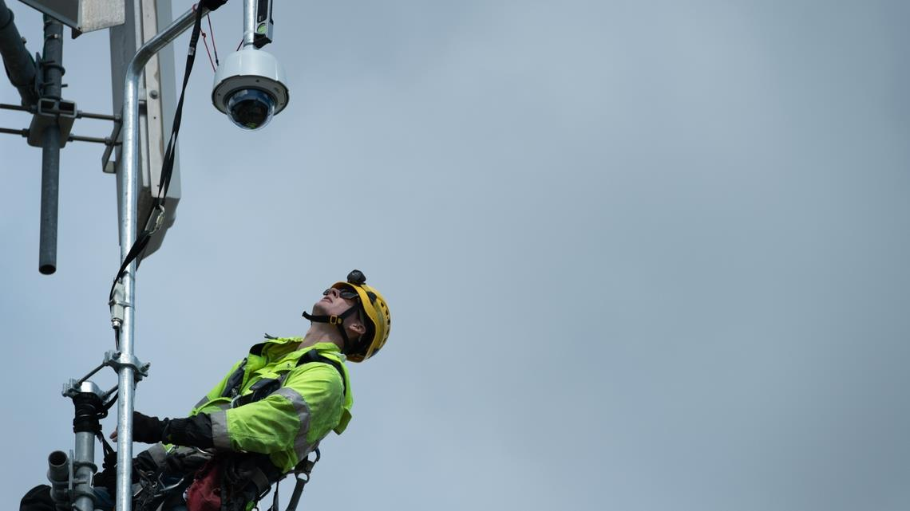
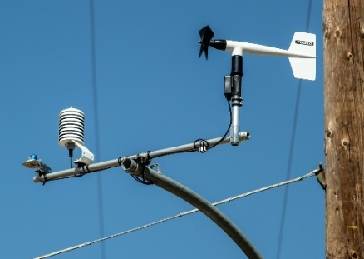
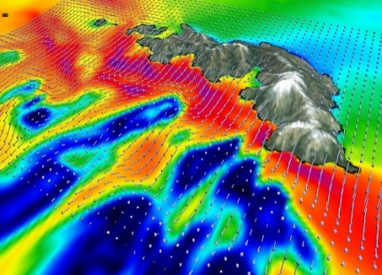

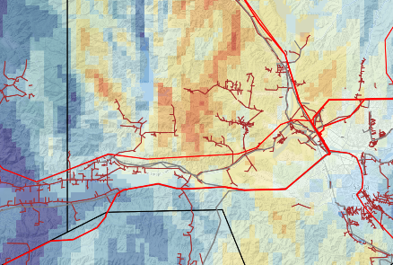
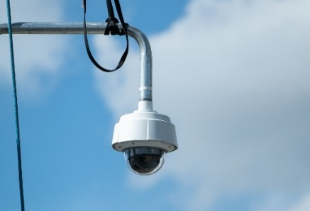
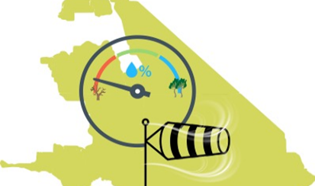
SCE: BOLSTERING SITUATIONAL AWARENESS CAPABILITIES
Observation Network
Modeling & Emerging Technologies
Weather Stations
Weather Modeling
1,600+ weather stations provide wind speed, gust, humidity and temperature data
Plans for a total of 1,725+ weather stations by 2025
Continuing to improve weather modeling by developing a high-resolution ensemble forecast
Expand machine learning capabilities to enhance weather forecasts
Fuel Sampling
Emerging Technologies
Piloting new weather and fuels forecast and observation techniques, such as, Vegetation Index, Large ensemble forecasting, Nowcasting, and Gridded Situational Awareness
Partnerships with University of Colorado, UCSB, Scripps, UCSD, SJSU, Cal Poly-SLO
Measuring vegetation moisture at 15 locations biweekly to help determine dry fuel conditions
Using data to train fuel moisture model to enhance operations
Wildfire Cameras
180+ cameras that provide thorough visibility of high fire risk areas to monitor wildfire conditions
Piloting cameras with artificial intelligence capabilities to detect wildfires
Fire Science Enhancements
Continue to build upon its fire science program by developing remote sensing technology, FPI 2.0, fire behavior matrix and fuels index
Advance fire spread modeling tools

Slide 23
SITUATIONAL AWARENESS & FORECASTING PANEL DISCUSSION
PANEL MEMBER or UTILITY REPRESENTATIVE | ORGANIZATION / TITLE
Chris Arends | SDG&E / Meteorology Program Manager
Jeff Fuentes | CalFire
Jessica Block | WSAB
Stephen Volmer | CalFire

Slide 24
1o minute break
Back at 11:25pm

Slide 25
OPEN QUESTIONS
AND ANSWERS
Reminder to raise hand, use Q&A function in Zoom.

Slide 26
LUNCH BREAK
Back at 1:00pm

Slide 27
RISK ASSESSMENT AND MITIGATION SELECTION STRATEGY PANEL

Slide 28
SCE

Slide 29
Risk Assessment &
Mitigation Selection Strategy (4/28)
29

Slide 30
SCE’s INTEGRATED WILDFIRE MITIGATION STRATEGY
SCE’s refined integrated wildfire mitigation strategy considers wildfire risk and PSPS impacts at circuit segments and mitigations that effectively addresses those risk drivers. We continue to prioritize hardening our riskiest areas first.
 | Risk Designation | Risk Criteria
Total High Fire Risk Area (HFRA) Overhead Distribution Segments (Total of ~9,600 circuit miles, of which about 45% is already hardened) | Severe Risk Areas ~1,520 of ~2,950 total miles already hardened* | Fire risk egress constrained locations, extreme high wind areas, communities of elevated fire concern, and extreme consequence areas
 | High Consequence Segments ~2,285 of ~4,400 total miles already hardened* | Locations that meet 300-acre consequence threshold at 8 hours or at risk of Public Safety Power Shutoff (PSPS)
 | Other HFRA Segments ~605 of ~2,250 total miles already hardened* | Locations that are not in a Severe Risk Area and do not meet High Consequence criteria
* “Hardened miles” refer to the miles of bare overhead lines replaced with covered conductor or underground cable and the associated infrastructure to complete those installation (i.e., FR pole as part of covered conductor installation). In some cases, alternatives such as REFCL, aerial bundled cable, or spacer cable are utilized.
30

Slide 31
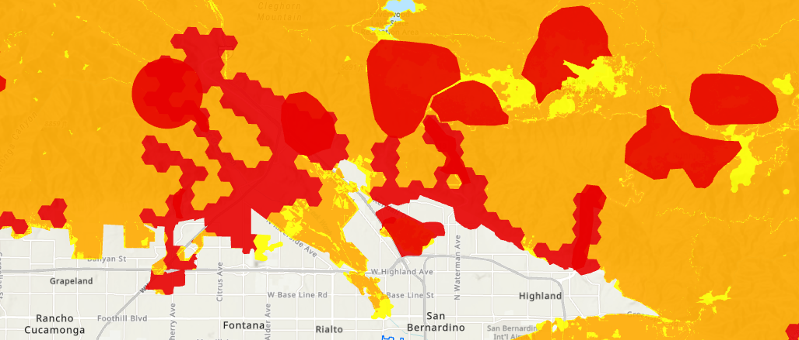
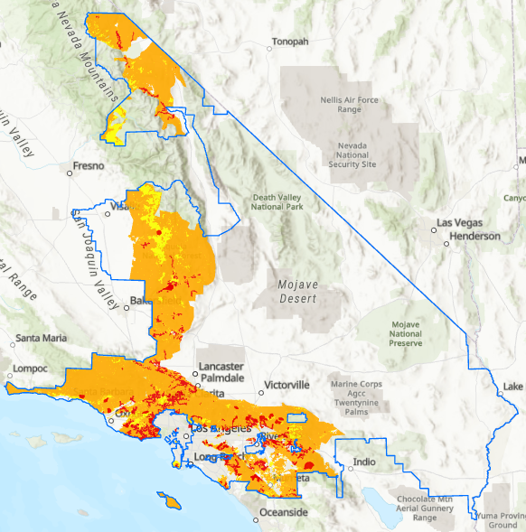
SCE HIGH FIRE RISK AREA RISK TRANCHES
Severe Risk Areas
High Consequence Areas
Other High Fire Risk Areas

Slide 32







Severe Risk Areas
HFRA Overhead Distribution Circuit Segments
Fire risk egress constrained locations
Burn-in-buffer to fire risk egress constrained locations
Extreme high wind areas within SCE’s HFRA
Extreme Technosylva consequence areas
Communities of elevated fire concern
Reassess Mitigation Portfolio if Preferred Solution Infeasible
Subject matter experts review, refine, and revise initial categorization using inspection photos, satellite images, maps, and other data. SMEs also consider location specific conditions like equipment present, weather conditions, terrain and topography to inform appropriate mitigation portfolios
Assign Mitigations to Segments
High Consequence
≥300 acres in 8 hours
PSPS frequency impacted circuit analysis
Feasibility Review of Mitigations
(if applicable)
Other HFRA
<300 acres in 8 hours
Identify Mitigations
Risk
Operations
Covered Conductor
Targeted Undergrounding
Hazard Tree Management
Probability of Ignition
Consequence
PSPS Risk
Timeline to deploy
Cost
Resource availability
Evaluate Mitigations
 | Goal | Preferred Mitigation
Severe Risk Area | Minimize ignition risk to the extent practicable | TUG or REFCL/CC++
High Consequence | Mitigate majority of significant ignition risk | CC++
Other HFRA | Replace retired/damaged bare wires + low cost/compliance-based mitigations | VM/I++
Covered Conductor testing
REFCL Pilot
Fast Curve Settings
Grid Hardening Work Prioritization
Veg. Management Work Prioritization
Asset Inspection Work Prioritization
Build Mitigation Portfolio for Risk Categories
Deploy Mitigation Activities

Slide 33
PG&E

Slide 34

Panel 5: Risk Assessment and Mitigation Selection Strategy
PG&E begins its mitigation selection process by evaluating risks and the most effective ways to address them, which allows them to regularly monitor and revise their existing programs, eliminate ineffective ones, and add new initiatives
Modeling Approach Balancing the Mitigation Portfolio
PG&E uses two types of risk models to evaluate wildfire risk. Operational risk models and planning risk models. This approach supports both real-time monitoring of conditions and long-term mitigation planning
Operational risk models focus on real time changing conditions for a short-term look forward view through monitoring and data collection to determine where risk is elevated in the service territory and inform grid operations, invoking when needed mitigations like EPSS and PSPS
Planning risk models guide the long-term planning work needed to change the grid to make it more resilient and achieve permanent risk reduction
Potential mitigation portfolios are evaluated using performance metrics to measure their effectiveness:
  Portfolio-wide ignition reduction in the HFTD and HFRA
  Reduction in customer impacts from EPSS and PSPS.
Optimizing the portfolio consists of balancing multiple factors such as risk reduction, local geographic and community considerations, feasibility constraints, available resources, regulatory requirements
Risk Evaluation Approach
The overriding objective when evaluating mitigation initiatives is to provide the greatest level risk reduction possible via multiple layers of protection as quickly as can be feasible deployed, while maintaining some flexibility to adapt to a changing risk profile
Operational mitigations are focused on fast and broad deployment, helping protect against changing wildfire exposure
Resilience mitigations are focused on targeted locations factoring in executability challenges to support faster deployment
Risk Evaluation Approach
Our approach is built on an iterative process that starts by identifying risks, evaluating how those risks impact our systems and the community, responding through mitigation and control programs, and monitoring how well our programs are working.
Some of the measures included in this presentation are contemplated as additional precautionary measures intended to further reduce the risk of wildfires.
1

Slide 35
SDG&E

Slide 36
2023 – 2025
Wildfire Mitigation Plan
Our programs | Our impact

Slide 37

Ashley Llacuna, Wildfire Mitigation Program Strategy Manager
Risk Assessment
& Modeling

Slide 38
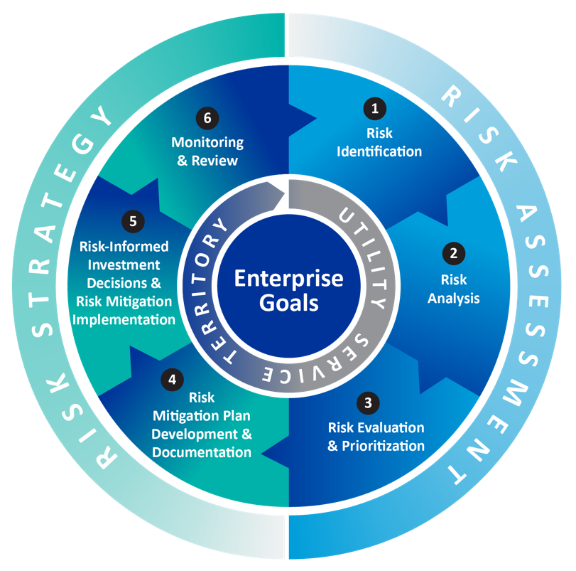



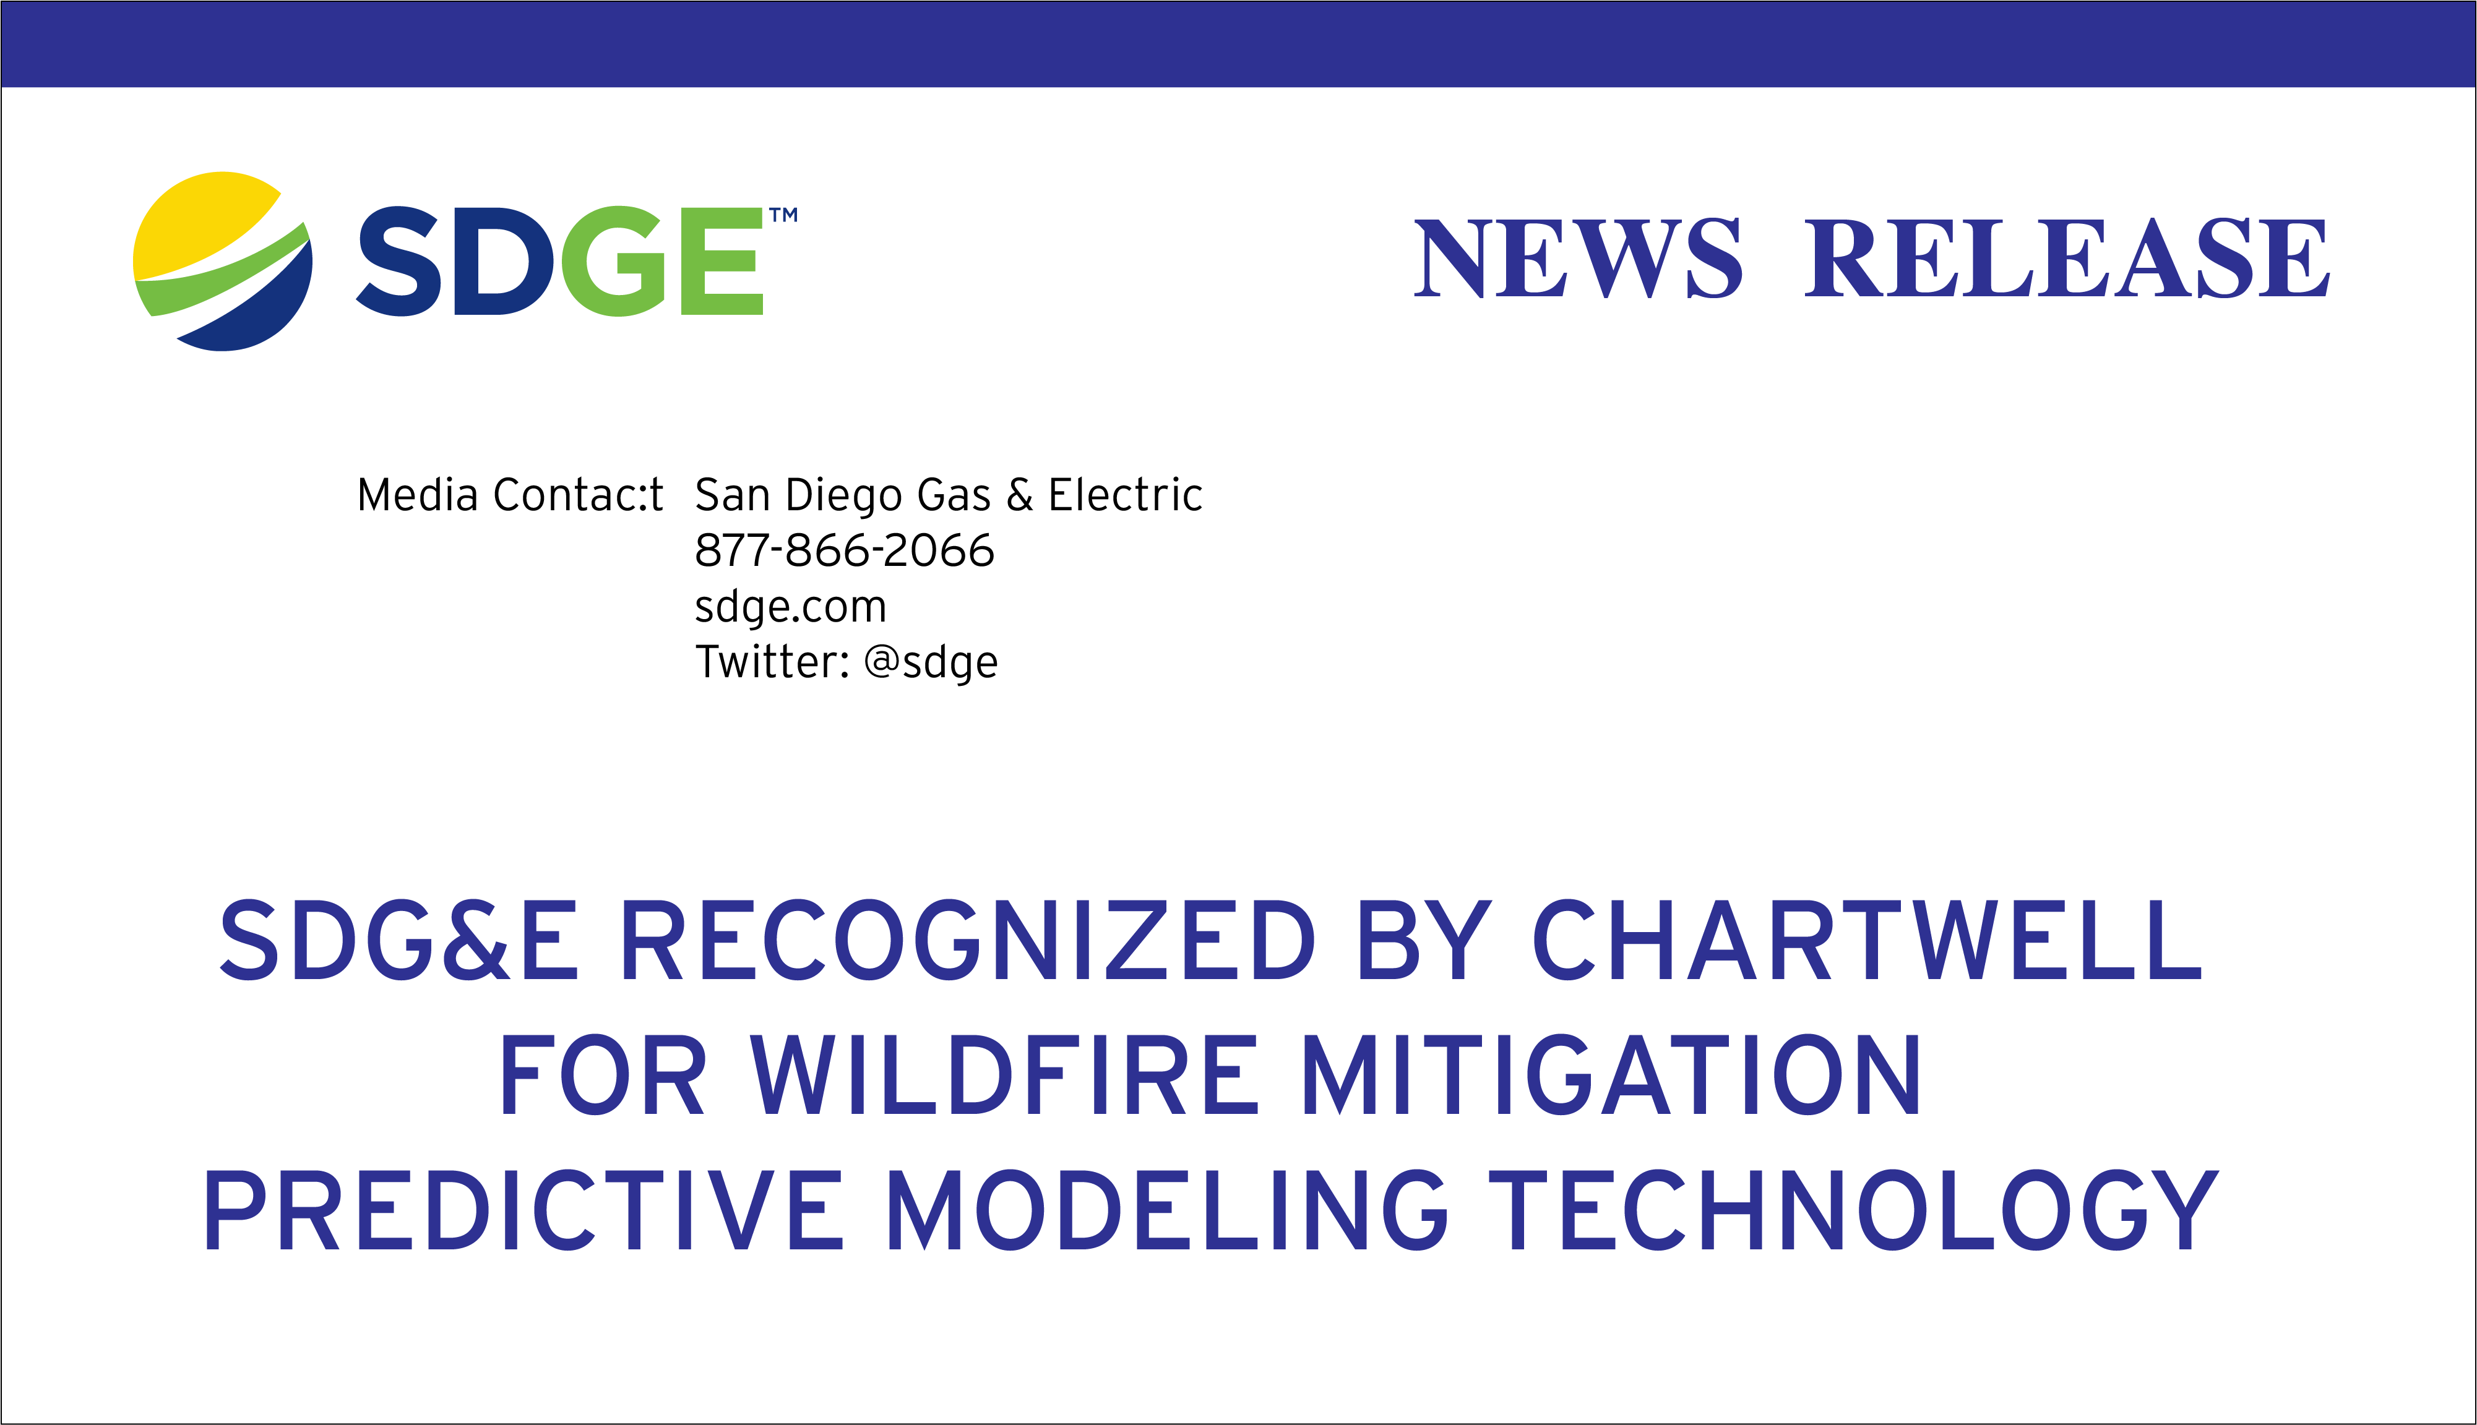
our approach
Risk-based
Data-driven
Collaborative

Slide 39
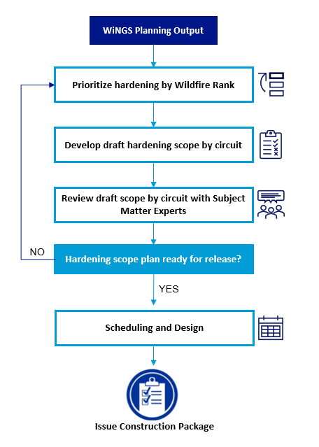
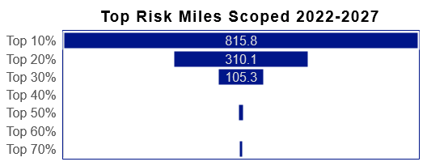
Mitigation Prioritization to Reduce Wildfire & PSPS Risk

Slide 40
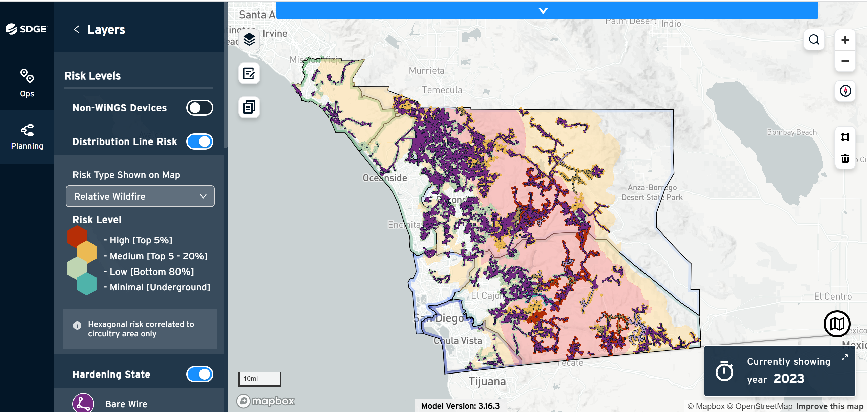
WiNGS Visualization

Slide 41
RISK ASSESSMENT AND
MITIGATION SELECTION
STRATEGY PANEL DISCUSSION
PANEL MEMBER or UTILITY REPRESENTATIVE | ORGANIZATION / TITLE
Ray Fugere | SCE Director
Joseph Mitchell | MGRA
Zoe Harrold | GPI
Jessica Block | WSAB

Slide 42
1o minute break
Back at 2:15pm

Slide 43
OPEN QUESTIONS
AND ANSWERS
Reminder to raise hand, use Q&A function in Zoom.

Slide 44
Open questions and answers – all panels

Slide 45
NEXT STEPS
Slides and workshop recording will be made available.
Written comments on PG&E, SCE, and SDG&E WMPs by May 26, 2023.
Energy Safety will host a public workshop on the small and multi-jurisdictional utilities and Independent Transmission Operators around late-May.

Slide 46
PUBLIC PARTICIPATION
Docket 2023-2025-WMPs is your primary source of information regarding WMP evaluations: https://efiling.energysafety.ca.gov/EFiling/DocketInformation.aspx?docketnumber=2023-2025-WMPs
Data Request (DR) responses are available at each electrical corporation’s website and summaries of DRs received by the utilities are available at: https://efiling.energysafety.ca.gov/EFiling/DocketInformation.aspx?docketnumber=2023-2025-WMP-DRs

