Slide 1
2023-2025 Wildfire Mitigation Plan
PUBLIC Workshop
For Large Electrical Corporation Submissions
April 27 & April 28, 2023
DAY ONE

Slide 2
INTRODUCTION

Slide 3
SAFETY MESSAGE
Be aware of your surroundings
Know your evacuation route(s)
Feel something, say something
Stand up and move occasionally

Slide 4
Opening Remarks
Electrical corporations are required to prepare and submit Wildfire Mitigation Plans (WMPs) to Energy Safety.
WMPs describe how the electrical corporation is constructing, maintaining, and operating its electrical lines and equipment in a manner that will minimize the risk of catastrophic wildfires.

Slide 5
WORKSHOP OBJECTIVES
Receive presentations on key areas of the large electrical corporations’ 2023-2025 Wildfire Mitigation Plans.
Provide the public and other stakeholders with the opportunity to ask questions about the electrical corporations’ WMPs.

Slide 6
WORKSHOP AGENDA (1/3)
Total of 5 panels over 2 days.
Each panel will consist of:
Utility presentations
Panel discussion
Short break
Public questions

Slide 7
WORKSHOP AGENDA (2/3)
Thursday 4/27:
Morning: Vegetation Management Panel
Lunch: 11:30am – 12:30pm
Afternoon:
  Grid Operations, Design, and Maintenance Panel
  Emergency Preparedness, Community Outreach, and Public Safety Power Shutoffs Panel
Open Q&A
Adjourn: 5:00pm

Slide 8
WORKSHOP AGENDA (3/3)
Friday 4/28:
Morning: Situational Awareness and Forecasting Panel
Lunch: 12:00pm – 1:00pm
Afternoon: Risk Assessment and Mitigation Selection Strategy Panel
Open Q&A
Adjourn: 3:40pm

Slide 9
WORKSHOP LOGISTICS
Asking Questions
Ask written questions in the Zoom Q&A at any time
Raise your hand during the public questions portion of the panels
Hold questions for Q&A session at the end of each day

Slide 10
Energy Safety Panel Moderators
Energy Safety Panel Moderators – Day One
Vegetation Management – Colin Lang
Grid Operations, Design, and Maintenance – Andie Biggs
Emergency Preparedness, Community Outreach, and Public Safety Power Shutoffs – Jessica McHale

Slide 11
AGENDA – DAY ONE
9:25am – 11:30am Vegetation Management Panel
10:35am, 10-minute break
11:30am – 12:30pm Lunch
12:30pm – 2:30pm Grid Operations, Design, and Maintenance Panel
1:35pm, 10-minute break
2:30pm – 4:30pm Emergency Preparedness, Community Outreach, and Public Safety Power Shutoffs Panel
3:35pm, 10-minute break
4:30pm – 5:00pm Open Q&A (all panels)
5:00pm Adjourn

Slide 12
Vegetation management
Panel

Slide 13
PG&E

Slide 14
Pacific Gas and Electric Company
2023 Wildfire Mitigation Plan Public Workshop Vegetation Management
April 27, 2023

Slide 15
Discussion Topics and Presenters
PG&E SPEAKERS
Andy Abranches
Senior Director, Wildfire Risk Management
Kamran Rasheed
Director, Vegetation Asset Strategy and Analytics
Stephen Simon
Senior Director, MID Quality Management
1 | Overview | 3
2 | Background and Shift from EVM | 4-5
3 | Focused Tree Inspections Program | 6
4 | VM for Operational Mitigation (EPSS) | 7
5 | Tree Removal Inventory Program | 8
6 | Quality Verification | 9
7 | Q&A | 10
8 | Appendix: Targets & Objectives | 11-13

Slide 16
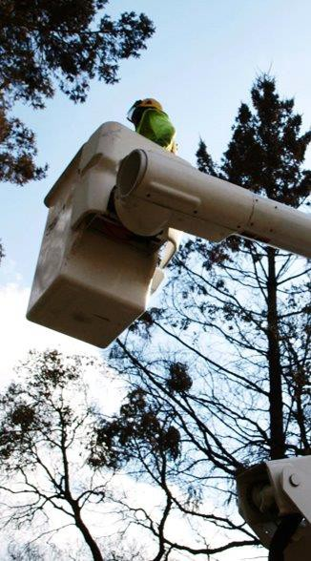
Overview
Two prong strategy for Vegetation Management for this WMP period – (1) Improve the base veg management work via improved tools, processes and training; (2) Utilize field input and risk models to targeted vegetation work for maximum benefit
Current Development Planned Developments
Over the course of 2022, the PG&E Vegetation Management program inspected and mitigated vegetation encroachment and dead and dying trees across approximately 100,000 miles of overhead distribution and transmission electric facilities via the routine program. A second patrol was also performed within the HFTD (25,000 distribution miles and 5000 transmission miles).
PG&E also performs removal/clearing of vegetation around select Transmission and Distribution poles and towers in accordance with PRC Section 4292, to maintain a firebreak of at least 10 ft in radius (out from the pole) up to 8 ft up from the ground per Title14 CCR 1254.
During 2022 PG&E completed the deployment of EPSS capabilities across the HFTD and HFRA areas. The Enhanced Vegetation Management (EVM) program was sunset at the end of 2022
PG&E VM currently uses multiple centrally managed- systems to document planned and completed vegetation work. We are building a tool to manage and support our various program requirements and work processes. This started in 2021 and will continue in 2023
PG&E has outlined a Focused Tree Inspection program for Areas of Concern (AOC) to target VM work in areas at higher risk of vegetation failure The pilot will focus on the highest risk areas and may be adjusted annually based on prior years events.
VM for Operational Mitigations is intended to reduce outages and potential ignitions by performing targeted VM work on EPSS-enabled circuits based on historic vegetation outages. Additional tree work may be prescribed on 2023 EPSS-enabled circuits that experience higher degree of vegetation outages.
A transitional program is being created to re-inspect and work trees previously identified for abatement in the EVM program, but that have not yet been worked, based on a risk informed approach.
The Vegetation Management program standards and procedures will be updated and operationalized in 2023 to drive standardization and best practice adoption across all vegetation work.

Slide 17
Ongoing Vegetation Management Programs
Standard Vegetation Programs
Transmission programs include Routine NERC and Routine Non-NERC. These are annual Integrated Vegetation Management (IVM) Programs recurring according to the vegetation growth response. PG&E’s Transmission vegetation inspection capabilities use technologies such as Light Detection and Ranging (LiDAR). See Section 8.2.2.1;
Distribution programs include Routine patrols which occur annually, and Second Patrol which occurs approximately six months offset from Routine patrols. See Section 8.2.2.2;
Substations: PG&E assesses the area around Electric Transmission (ET) Substations in High Fire Threat District (HFTD) and High Fire Risk Area (HFRA) areas to identify potential flammable fuels and vegetation for removal. See Section 8.2.2.3;
Vegetation and Fuels Management: PG&E’s VM has various programs supporting vegetation and fuels management activities. See Section 8.2.3;
Quality Assurance/Quality Control: PG&E’s VM Quality Team encompasses Quality Assurance (QA), Quality Verification (QV), and Quality Control (QC). See Section 8.2.5;
Supporting Improved Execution of Standard Programs
VM Enterprise System
PG&E’s VM team is implementing a multi-year project to centralize the capture of inspection, trimming and removal activities into a single software platform
Centralized Constraint Management
PG&E’s VM team is building out processes to address three types of constraints:
(1) customer constraints, (2) environmental constraints, and (3) permitting constraints
Workforce Training & Planning
PG&E has developed Tree Crew and Inspector Training programs to develop a steady pipeline of qualified personnel who may later join our contract or internal VM workforce
PG&E’s PI basics training path and related training courses provide personnel with an opportunity to earn
continuing education credit that can be used towards obtaining ISA certification
PG&E’s educational partnerships allow us to provide employees and contractors with a direct path of
obtaining certification
To bolster recruitment and the pipeline of qualified personnel, PG&E has partnered with the IBEW and educational institutions, such as the California Community College system, to establish a training program designed to provide the skills and knowledge necessary to perform tree crew work safely & competently

Slide 18
Specific, Targeted Programs to Replace EVM
Reason for Replacing EVM
Programs Replacing EVM
Focused Tree Inspections
EVM Scope
Specific areas of focus were developed, primarily in the HFRA, where efforts will be concentrated to inspect and address high-risk locations impacted by vegetation
Initiated in 2019, EVM Represents a process by which PG&E went above and beyond regulatory requirements, through technologies such as LiDAR, to address the highest risk Circuit Protection Zones (CPZs)
VM for Operational Mitigations
VM Mitigation RSE Comparison
This program is intended to help reduce outages and potential ignitions using a risk informed, targeted plan to mitigate potential vegetation contacts based on historic vegetation caused outages
14.5
For EVM
<
105.7
For EPSS
Tree Removal Inventory
Given the significantly higher RSE through EPSS relative to EVM, the vegetation management program decided to switch away from EVM to Distribution Routine Patrol
This program is intended to systemically work down trees that were previously identified through EVM inspections. Annual risk-ranked workplans will be developed to mitigate highest risk

Slide 19




Focused Tree Inspections (FTI) Program in Areas of Concern (AOC)
Purpose
Scope of Work
Target highest-priority areas and complete a focused tree inspection pilot project in Q2 of this year
Initial set of 300 OH line miles for the pilot to inform and shape the future Focused Tree Inspection Program
Changes Since the Last WMP
Data Sets used to Develop FTI
Developed Areas of Concern to identify highest-risk miles associated with potential tree falls using all available data and local inputs (includes 4,800 miles in 20 counties)
PSS: Circuit Review and Scoring by County
Meteorology: 30 Year Re-analysis packages and PSPS lookback polygons
VM: PSPS Damage, Outage Clusters 2018-2021, Ignitions and Regional Review of Second Patrol Areas with requests and recommendations
HFRA: High Fire Risk Area (HFRA) v5.1 - Baseline
EPSS: EPSS Buffer v5.1 – Additional areas outside HFTD/HFRA that are subject to EPSS execution under specific conditions
2023 Prioritization
~300 Pilot miles will address 16% of total score reduction
Pilot AOCs are ranked 2, 5, 6, and 15 from overall AOC WDRM v3 Ranking
Pilot Project is distributed across 4 Regions
The full program target scope addresses ~93% of total score reduction

Slide 20

















VM for Operational Mitigation (EPSS)
Purpose
Scope of Work
Reduce the frequency of vegetation outages on EPSS-enabled circuits
Extent of Condition Patrols – Patrols conducted after veg related EPSS outages to mitigate future veg outages
EPSS CEMI 8+ Locations – Targeted vegetation work in areas where customers experienced 8 or more EPSS outages in 2022
Reactive Work – Extent of Condition Patrols Estimated Trees by County †
EPSS CEMI 8+ Locations Estimated Trees by County †
2,500
2,162
3,000
2,573
2,000
2,500
1,500
2,000
1,634
1,500
1,497
1,254
1,000
1,000
630
592
467
652
650
500
347
233
500
404
377
65
47
16
9
0
0
† Units reflected are estimates based on known reactive work
† Units reflected are estimates based on known work

Slide 21
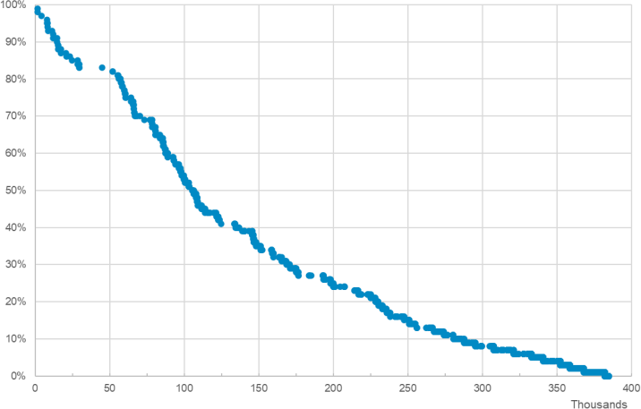
Tree Removal Inventory (TRI) Program
Purpose
Scope of Work
Removing trees that were marked for abatement under the EVM program
TRI is intended to work down the inventory of EVM marked trees starting with 15,000 trees in 2023
Changes Since the Last WMP EVM Inventory Estimated Risk Buy Down
Created this targeted program, the Tree Removal Inventory program, to address trees previously marked under EVM using WDRM Trunk model v3.0 to prioritize
Total inventory risk is reduced by:
2023: ~10% w/ 15k trees removed
2024: ~15% w/ 35k trees removed
2025: ~25% w/ 60k trees removed
2026: ~35% w/ 85k trees removed
2027: ~55% w/ 110k trees removed
2023 Prioritization
The 2023 WMP Commitment target is to remove 15,000 EVM trees and will lead to a reduction in ignition risk of >10%;
The 2023 scope of work provides 45,000 trees in 8 counties to ensure that 15,000 are removed given customer and permitting constrains on this work
Removals are subject to constraint resolution

Slide 22


Vegetation Management Quality Verification (QV)*
Purpose of VM Quality Management
Scope of Work
Assure safety, risk reduction, continuous improvement and deliver for our customers and hometowns.
Performance of Quality assessments of completed wildfire mitigation work to ensure safety, compliance and data informed continuous improvement.
Changes Since the Last WMP
Quality Targets and Results
Implementation of a robust Quality Management System (QMS) across the VM Distribution, Transmission and Vegetation Clearing programs in HFTD areas.
Program | 2023 Target | 2023 YTD Actual (as of 4/21/2023) | 2022 Performance | Change
VM – Distribution HFTD | 95.00% | 99.64% | 91.34% | +8.3pp
VM – Transmission HFTD | 95.00% | 100.00% | 94.21% | +5.8pp
VM – Vegetation Control (VC) HFTD | 95.00% | 99.14% | 90.26% | +8.9pp
*Quality Verification (QV) is a subpart of Quality Assurance within PG&E’s QMS

Slide 23
Questions?

Slide 24

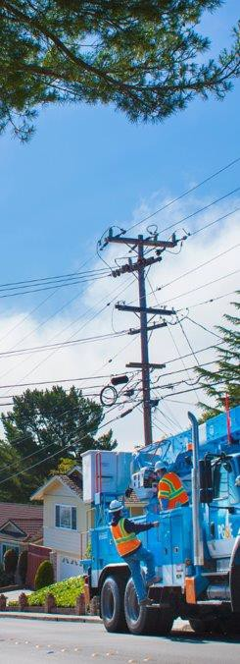
Objectives – Vegetation Management
ID | Objective Name & Description | Timeframe
VM-03 | Focused Tree Inspection Program Identify areas of concern (AOCs). Initiate a pilot in at least one AOC, and fully implement a cross sectional functional team to determine value of a multi-year historical tree data set. | 3 Year Objective
VM-09 | Constraint Resolution Procedural Guideline Develop a process of centralizing constraint resolutions, focused on customer, environmental, and permitting constraints. Once identified, develop a process to mitigate constraints. | 3 Year Objective
VM-10 | Inspection in HFTD and HFRA supporting key vegetation management initiatives Continue multiple inspection activities in HFTD and HFRA supporting key vegetation management initiatives. | 10 Year Objective
VM-11 | Enhance and refine Focus Tree Inspection – Areas of Concern (AOC) Enhance and refine Focus Tree Inspection – Areas of Concern (AOC) development criteria and application of the AOCs to vegetation management programs. | 10 Year Objective
VM-12 | Evaluate emerging technologies Evaluate emerging technologies to enhance focus of and streamline execution of vegetation management inspections. | 10 Year Objective
Replace picture

Slide 25

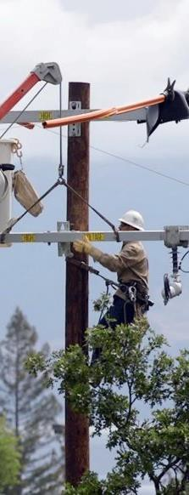
Targets – Vegetation Management
ID | Target Name & Description | 2023 | 2024 | 2025
VM-01 | LiDAR Data Collection - Transmission Collect LiDAR data of transmission system, to include both HFTD/ HFRA and non-HFTD miles. | 17,500 miles | 17,500 miles | 17,500 miles
VM-02 | Pole Clearing Program Inspect, clear, and maintain, where necessary on poles per Vegetation Control Standard TD-7112S. | 77,503 poles | 2023 YE | 2024 YE
VM-04 | Tree Removal Removal of trees identified from the legacy Enhanced Vegetation Management (EVM) program. | 15,000 trees | 20,000 trees | 25,000 trees
VM-05 | Defensible Space Inspections (DSI) – Distribution Substation Complete defensible space inspections in alignment with the guidelines set forth in LAND 4001P-01. | 131 distribution substations | 131 distribution substations | 131 distribution substations

Slide 26
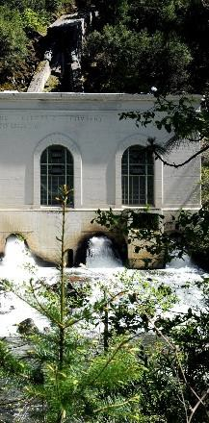
Targets – Vegetation Management ( Continued)
ID | Target Name & Description | 2023 | 2024 | 2025
VM-06 | Defensible Space Inspections (DSI) – Transmission Substation Collect LiDAR data of transmission system, to include both HFTD/ HFRA and non-HFTD miles. | 55 transmission substations | 55 transmission substations | 55 transmission substations
VM-07 | Defensible Space Inspections (DSI) – Hydroelectric Substations and Powerhouses Inspect, clear, and maintain, where necessary on poles per Vegetation Control Standard TD-7112S. | 61 hydroelectric substations | 61 hydroelectric substations | 61 hydroelectric substations
VM-08 | Vegetation Management – Quality Verification (QV) Removal of trees identified from the legacy Enhanced Vegetation Management (EVM) program. | 95% verification pass rate | 95% verification pass rate | 95% verification pass rate

Slide 27
SCE

Slide 28

Vegetation Management (4/27)
28

Slide 29
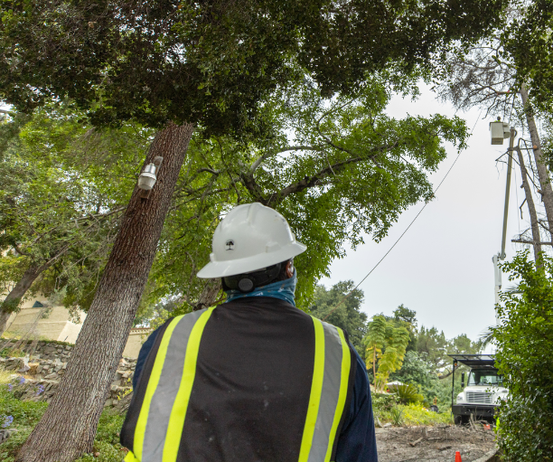
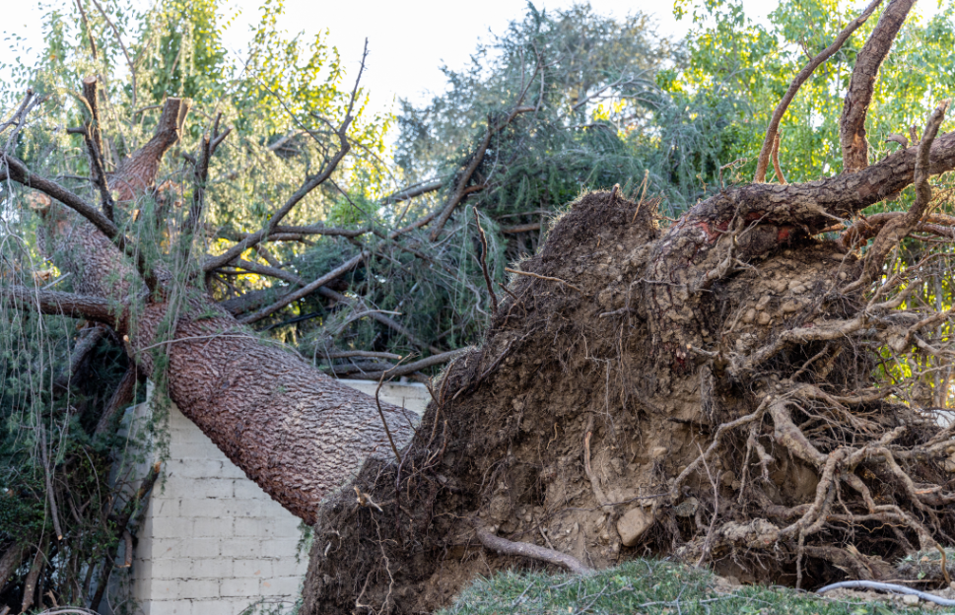
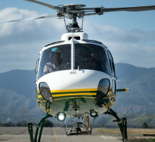
SCE: VEGETATION MANAGEMENT
2023 Initiatives
VM-1 Hazard Tree Management Program
VM-2 Structure Brushing
VM-3 Expanded Clearance Legacy Facilities
VM-4 Dead and Dying Tree Removal
VM-6 Work Management Tool
VM-7 Distribution Inspections
VM-8 Transmission Inspections
VM-9 LiDAR for Distribution
VM-10 LiDAR for Transmission
Consolidated Inspection Strategy
Improve Risk-Informed Processes
Remote Sensing
Centralized tree inspection schedule for Routine Line Clearing, Hazard Tree, and Dead and Dying Tree Removal Program
Improve scheduling capability and increase granularity for work prioritization based on risk factors (e.g., species, clearance)
Transition majority of ground inspection for vegetation line
clearing in HFRA to remote sensing technology (e.g.,
LiDAR, satellite)
SCE Wildfire Fact Sheets

Slide 30
SDG&E

Slide 31
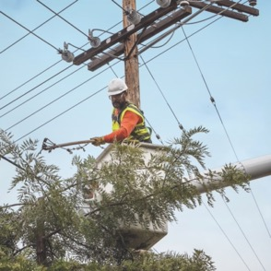

2023 – 2025
Wildfire Mitigation Plan
Our programs | Our impact

Slide 32
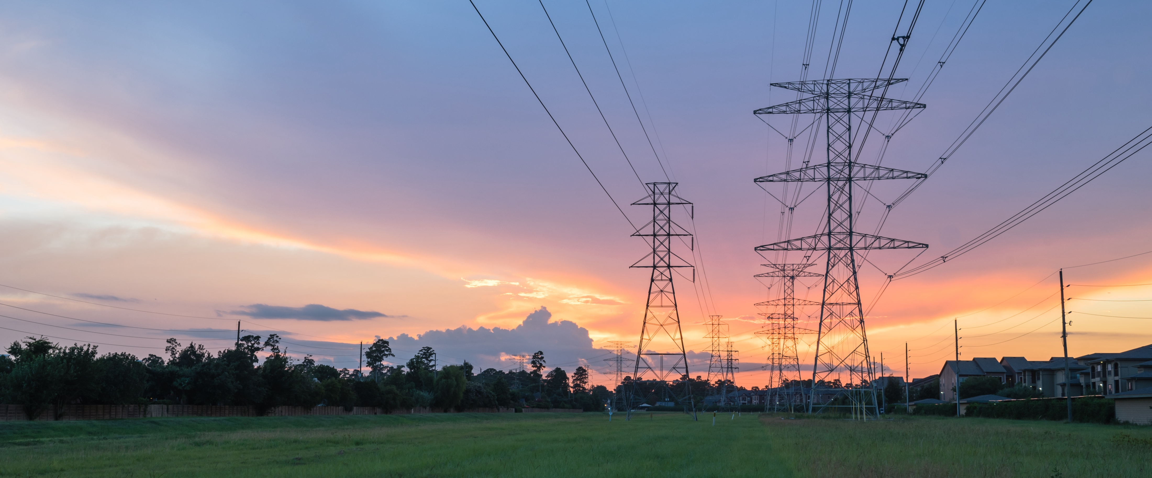

Michael Daleo, Vegetation Management WMP Program Manager
Vegetation
Management

Slide 33
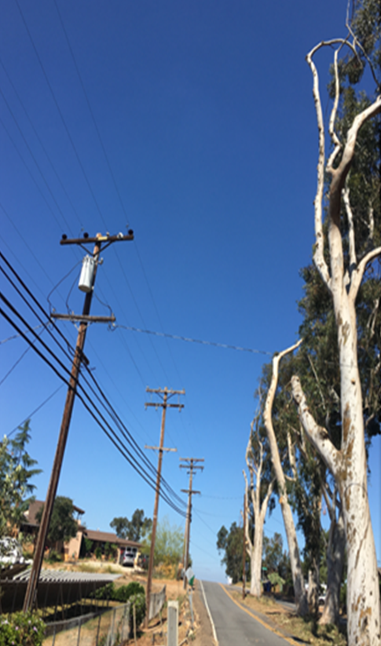
Vegetation Management
Continue to safely, effectively & proactively mitigate fire risk through multiple, annual Vegetation Management activities
2022 Accomplishments
Zero contractor-caused outages on distribution system
Zero tree-related ignitions on distribution system
~11k targeted trees trimmed or removed to enhanced clearances in HFTD
~11k trees distributed to promote sustainability & environmental enhancement
Two tree inspection activities within entire HFTD
Completed fuels management on 500 elevated-risk poles in HFTD
Sustainability - 51% of all green waste diverted from landfill to recycling centers
2023 Planning
Modify off-cycle HFTD inspection schedule using risk-based model
Proof of concept initiative using satellite imagery technology
Further engage customers through interactive online survey
Plant or distribute 10k trees, supporting company sustainability initiative
Fire Safe 3.0
Fire Science + Innovation Lab Development
Artificial Intelligence Implementation
Created Vegetation Risk Index
Enabled High-Speed Weather Data
Fire Safe 2.0
Innovated Modeling Tools
Implemented Real-Time Weather Alerts
Aggressively Fire-Hardened Infrastructure
Leveraged Public Safety Power Shutoffs (PSPS)
Fire Safe 1.0
Initiated Weather Network
Installed Cameras
Hired Meteorologists
Added Aerial Support
33

Slide 34
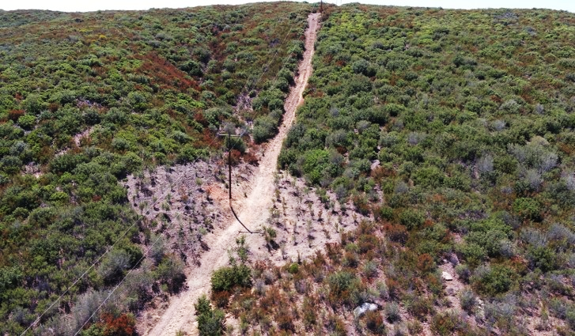
Preparing for 2023 Wildfire Season
Mitigating wildfire risk through Enhanced Vegetation Management
~490,000 inventory trees in service territory
~250,000 trees in HFTD annually receive a second, "Level 2 inspection"
~11,000 trees targeted for enhanced clearances in 2023
~2,000 additional poles brushed in non-SRA
500 poles targeted for Fuels Management
34

Slide 35
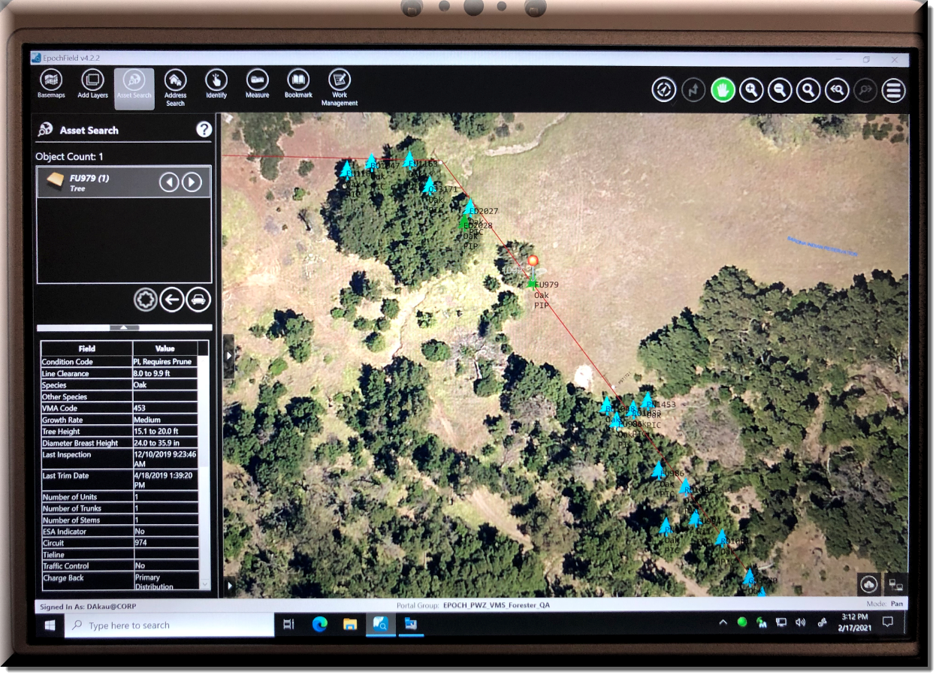
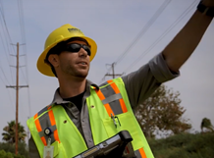
Tree Inventory Database
Data-rich inventory database of all tree and pole brush records going back over 20 years
All contractor activities (pre-inspection, tree trimming, auditing) uploaded to server nightly
Outage investigation documentation within tree records
2022 Improvements
Accurate GPS positioning of inventory tree assets
Electronic documentation of customer refusals and deferred work
Multiple database enhancements including Genus-species capture; new electronic work orders for off-cycle activities; additional GIS mapping layers for visualization and situational awareness
35

Slide 36
VEGETATION MANAGEMENT
PANEL DISCUSSION
PANEL MEMBER or UTILITY REPRESENTATIVE | ORGANIZATION / TITLE
Andy Abranches | PG&E / Sr. Director – Wildfire Risk Management
Henry Sweat | CPUC SPD
Gregg Morris | GPI
Mike Esposito | CalFire

Slide 37
1o minute break
Back at 10:45am

Slide 38
OPEN QUESTIONS
AND ANSWERS
Reminder to raise hand or use Q&A function in Zoom.

Slide 39
LUNCH BREAK
Back at 12:30pm

Slide 40
GRID OPERATIONS, DESIGN, AND MAINTENANCE PANEL

Slide 41
SCE

Slide 42
Grid Operation, Design & Maintenance (4/27)
42

Slide 43
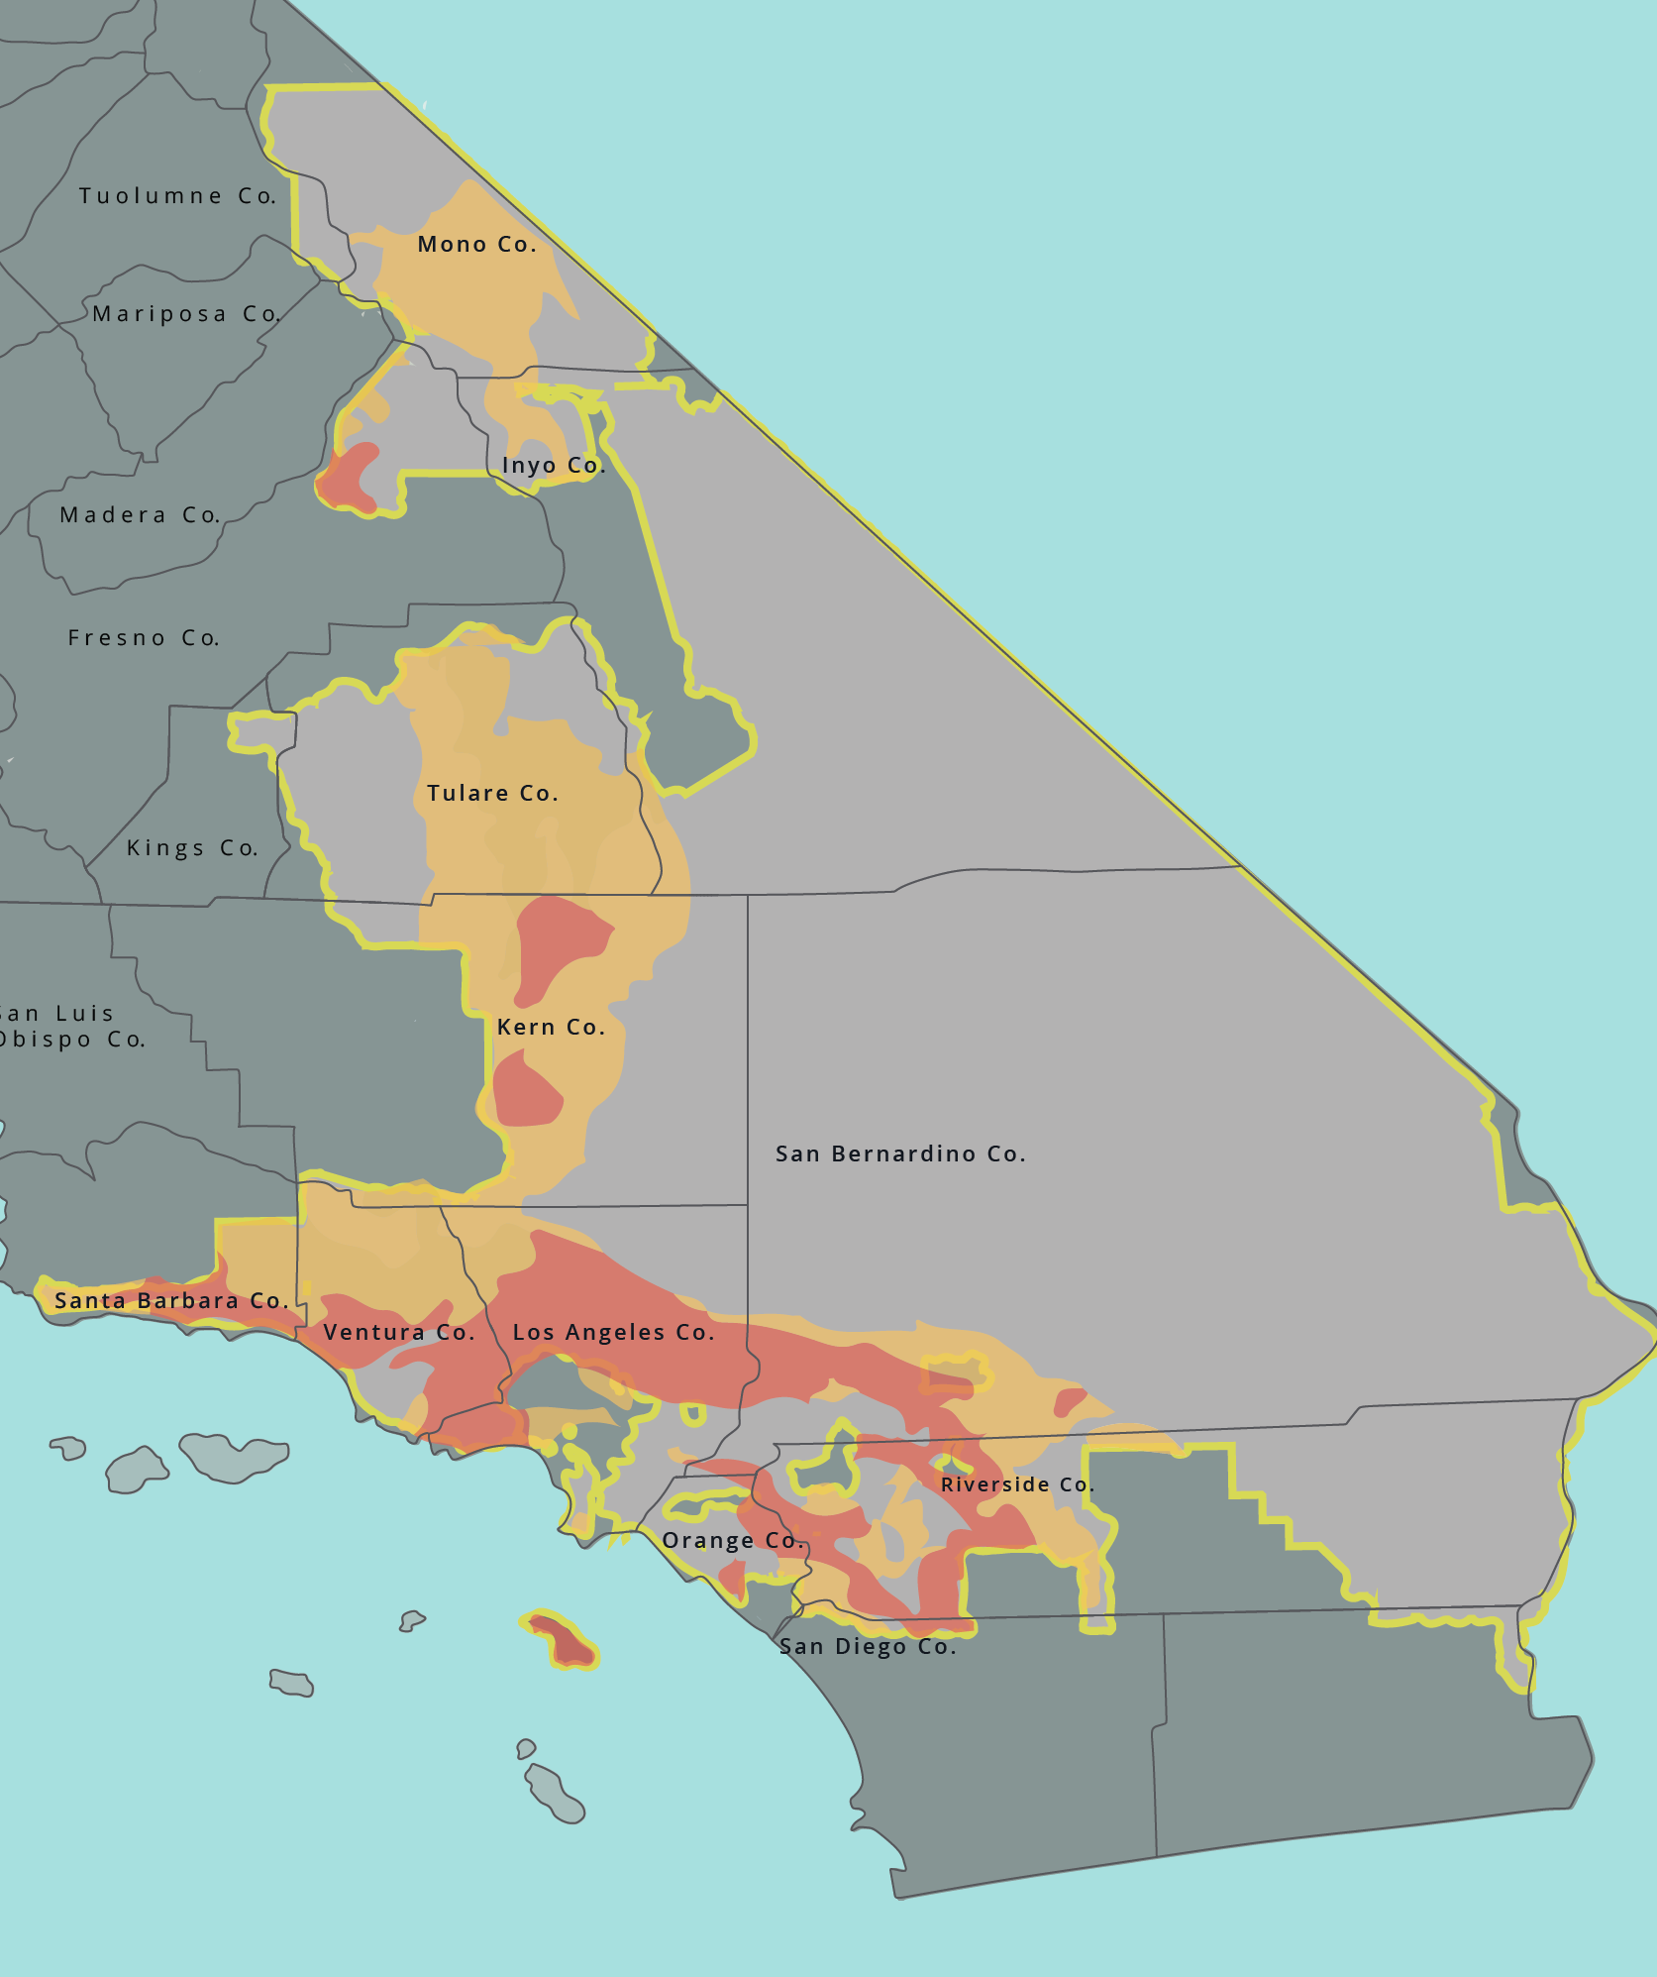
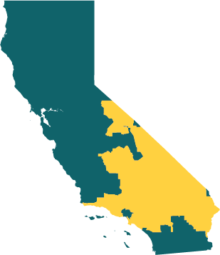



SCE SERVICE AREA & HIGH FIRE RISK AREAS
50,000 SQ. MI.
of SCE service area across southern, central and coastal California
14,000 SQ. MI.
of high fire risk areas
5M
customer accounts or 15M residents in SCE’s service area
1.3M
customer accounts or 3.9M residents served by circuits in high fire risk areas
SCE Service Area
County Lines
Tier 2 – Elevated Fire Threat
Tier 3 – Extreme Fire Threat
51,000 MI.
of SCE overhead distribution and transmission lines
14,000 MI.
in high fire risk areas
1.4M
power poles and towers
311,000
in high fire risk areas
Counties with high fire risk area served by SCE | Fresno Inyo Kern Los Angeles Mono Orange Riverside San Bernardino Santa Barbara Tulare Ventura | Counties with no or limited high fire risk areas served by SCE | Imperial Kings Madera Tuolumne
27% of SCE's service area is in high fire risk areas

Slide 44
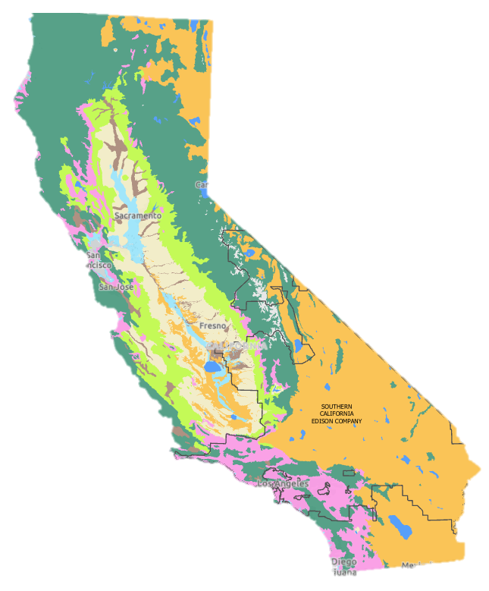




COVERED CONDUCTOR AND TARGETED UNDERGROUNDING ARE EFFECTIVE MEASURES TO REDUCE WILDFIRE & PSPS RISKS
Continue to implement covered conductor to expeditiously reduce wildfire risk specific to SCE.
Undergrounding pursued for certain locations based on unique risk factors.
Geography
Cost to Implement
Execution Speed
Unique Factors
Vegetation Type
Evergreen Forest
Deciduous Forest
Broadleaved Forest
Chaparral
Grassland
Desert Scrub
Cost per mile¹
$ in Millions
Avg. Implementation Time
In Months
Undergrounding is considered where there is:
Communities of elevated fire concern
High burn frequency
Limited egress
Wind speeds exceeding covered conductor PSPS thresholds
Exceptionally high potential consequence (>10,000 acres)
Operational feasibility
 |  | Covered Conductor | Under-ground
 | Initiate | ~2–3 | ~2–3
 | Plan | ~6–9 | ~9–15
 | Schedule | ~6–9 | ~9–15
 | Execute | ~2–3 | ~5–15
 | Total | 16–24+ | 25–48+
Chaparral (brushland) presents different primary risk factors than heavily forested areas
1. Based on data provided in SCE’s 2023-25 WMP

Slide 45

COVERED CONDUCTOR
About 4,400 miles of covered conductor, covering about 45% of SCE’s overhead distribution lines in high fire risk areas
Covered conductor estimated to be about 70% effective in mitigating ignition risk
SCE targeting 2,850 additional miles over 2023-2025

Slide 46
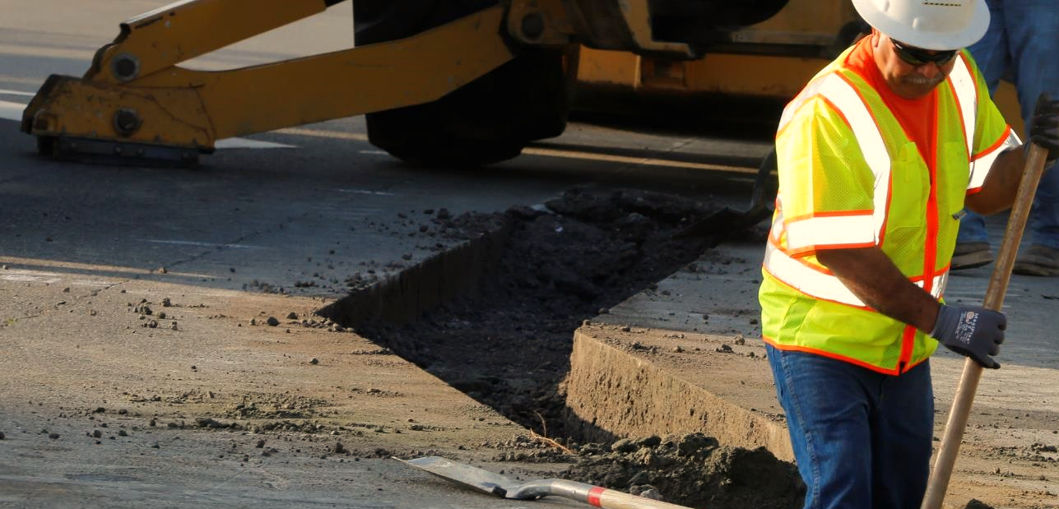
TARGETED UNDERGROUNDING
Completed more than 20 miles of undergrounding in targeted high fire risk areas based on risk criteria and feasibility
Ramping up scope in the coming years
About 7,200 miles, or about 43% of primary distribution lines in high fire risk areas, already undergrounded
SCE is targeting 75 additional miles over 2023-2025

Slide 47
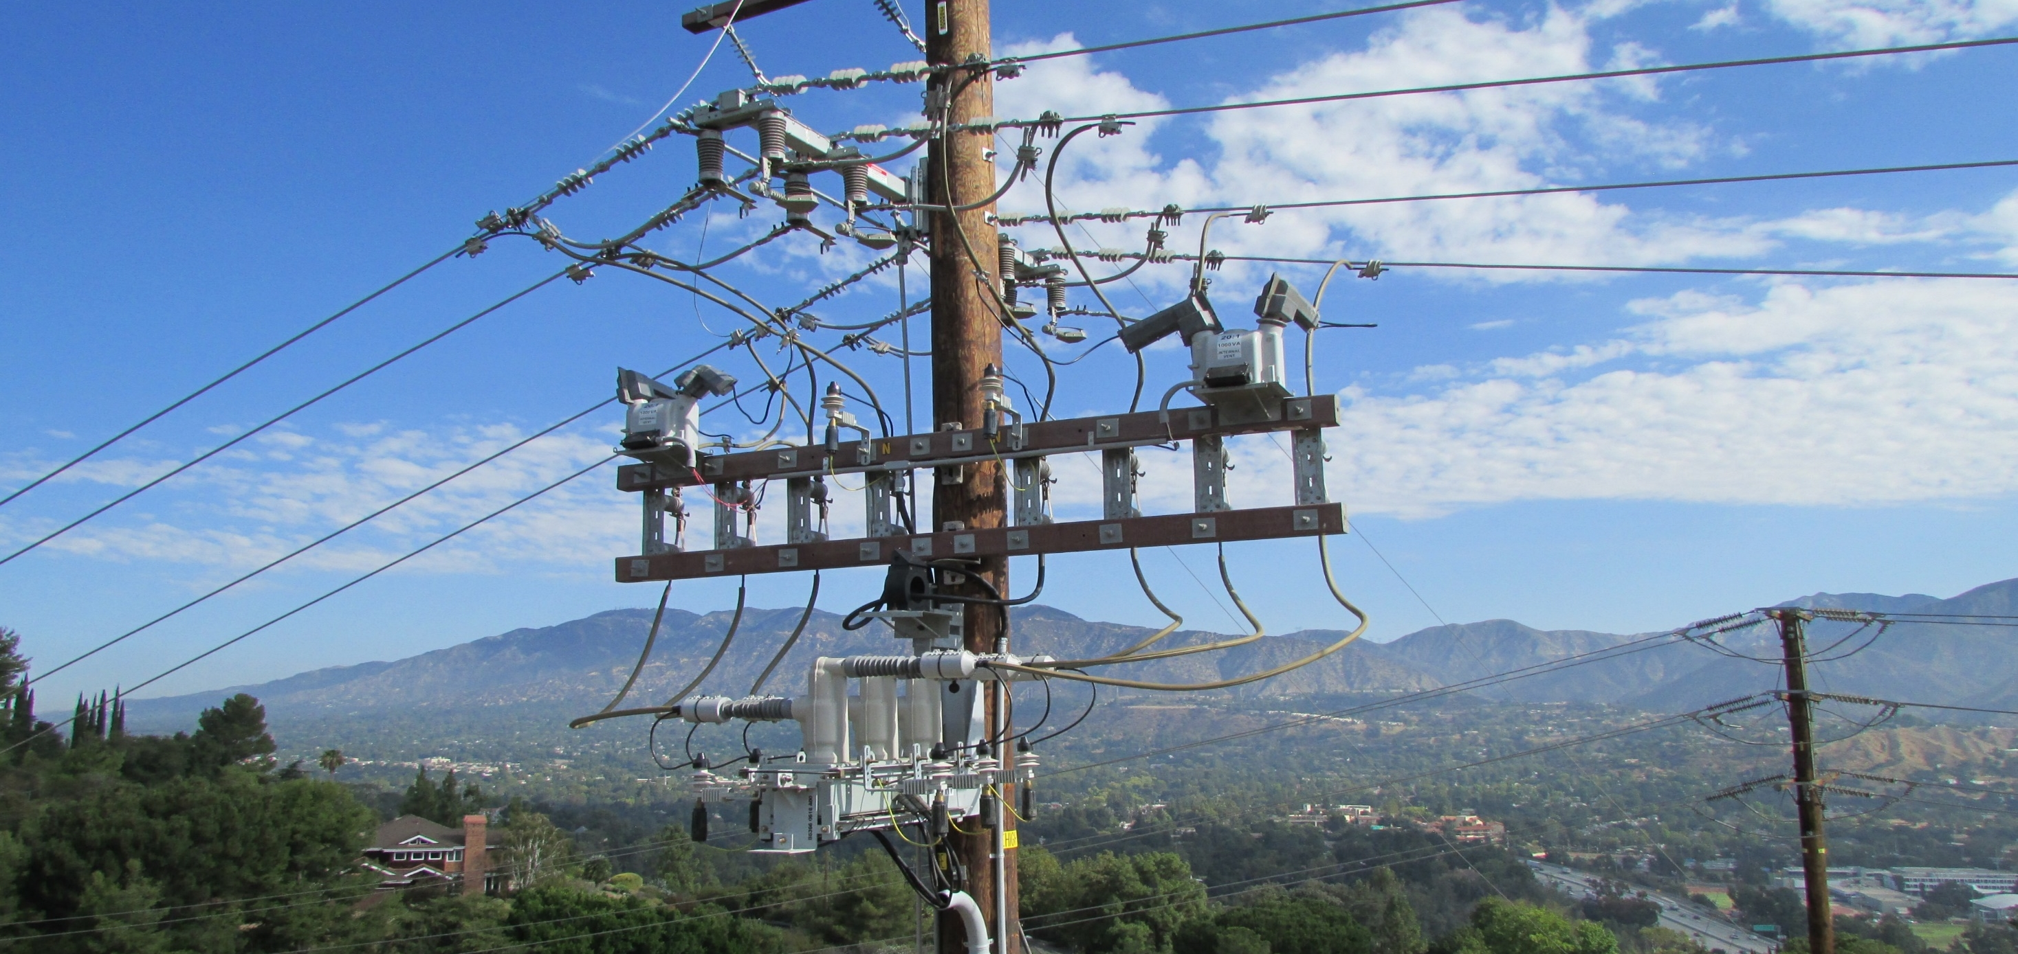
PROTECTIVE DEVICES & SETTINGS
13,700+ fast-acting fuses installed or replaced to interrupt electrical current more quickly when there is a fault
150+ remote-controlled sectionalizing devices installed to segment and isolate portions of circuits during PSPS events. Thousands installed prior to 2018 before the wildfire mitigation program began
Faster grid protection settings used in high fire risk areas during elevated fire conditions for a quicker reduction in fault energy
REFCL technology detects when a single power line has fallen to the ground and almost instantly reduces energy released

Slide 48
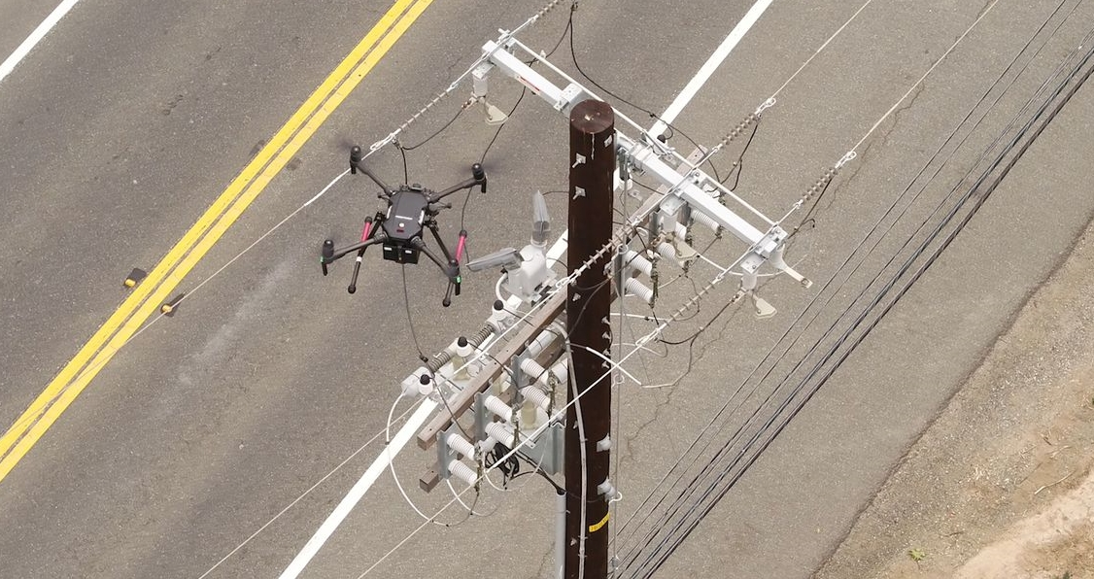
HIGH FIRE RISK INSPECTIONS
Inspect electrical equipment for maintenance, repairs or replacement
In 2023, inspecting portions of transmission and distribution equipment that comprise about 99% of wildfire risk
2022 HIGHLIGHTS
Completed 162,721 distribution inspections and detected 75,000 conditions for repairs
Completed 17,225 transmission inspections and detected 3,000 conditions repairs

Slide 49
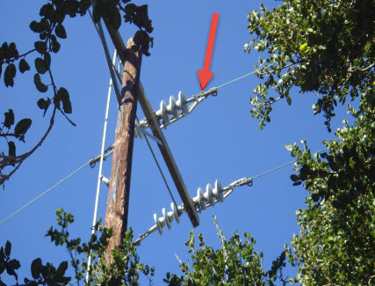
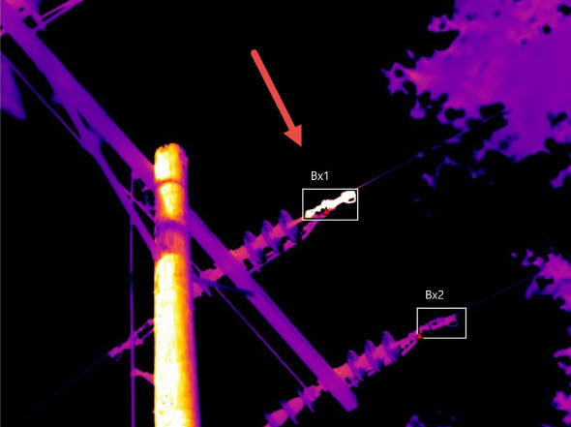
ADDITIONAL INSPECTION METHODS
In addition to high fire risk ground and aerial inspections, SCE utilizes the following risk-informed inspection methods to identify anomalies not visible to the naked eye:
4,400+ overhead distribution circuit miles in HFRA with infrared (IR) in 2022; targeting approximately 5,300 circuit miles in 2023
1,000+ transmission circuit miles with IR and corona scanning in 2022; continuing to target approximately 1,000 circuit miles in 2023
75+ spans and 60+ splices with LineVue and X-ray respectively in 2022; targeting approximately 50 spans (LineVue) and 50 splices (X-ray) in 2023

Slide 50
PG&E

Slide 51
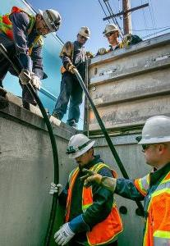
Panel 2: Grid Design, Operations, and Maintenance
PG&E’s Grid Design and System Hardening initiatives focus on mitigating wildfire risk in Tier 2 and 3 HFTD and HFRA areas within PG&E’s service territory
Current Development Planned Developments
In 2022, PG&E completed 180 miles of undergrounding compared to the target of 175 miles. Of the undergrounding miles completed in 2022, approximately 60 of those miles were completed as part of the Butte County Rebuild Program
Since 2019, PG&E has installed 960 miles of hardened distribution overhead conductor, including 335 overhead system hardening miles in 2022
In 2022, EPSS settings for 4,830 distribution protection devices were engineered and installed across more than 44,000 miles of conductor to provide EPSS protection, leading to a 68% reduction in CPUC-reportable ignitions in HFTD while EPSS was enabled. Protection devices on another 47 transmission lines were also engineered to provide EPSS protection
In 2021 and 2022 PG&E closed more than 350,000 tags across the distribution system, including approximately 195,000 tags in the HFTD/HFRA
PG&E’s larger plan is to complete 2,285 miles of overall system
hardening work from 2023-2026.
PG&E has current annual targets for undergrounding 2,100 miles for 2023-2026. These targets include the undergrounding work as part of the Butte County Rebuild which will be complete by 2025
PG&E’s estimated overhead covered conductor mileage from 2023- 2026 is 285 miles, which is in line with our strategy to focus on undergrounding
In 2023, Down Conductor Detection (DCD) settings will be installed on
more than 500 devices to further enhance EPSS protection
PG&E will clear approximately 130,000 ignition-risk HFTD/HFRA tags by the end of the 2023-2025 WMP cycle
Some of the measures included in this presentation are contemplated as additional precautionary measures intended to further reduce the risk of wildfires.
1

Slide 52
SDG&E

Slide 53
2023 – 2025
Wildfire Mitigation Plan
Our programs | Our impact

Slide 54
Shaun Gahagan, Wildfire Mitigation Program Manager
Grid Design, Operations
& Maintenance

Slide 55
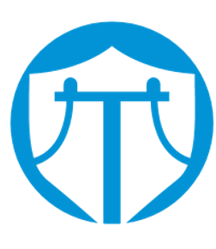
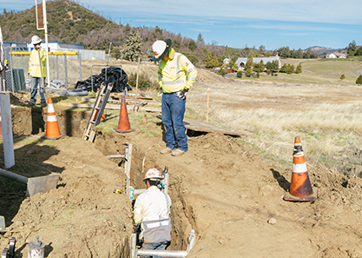
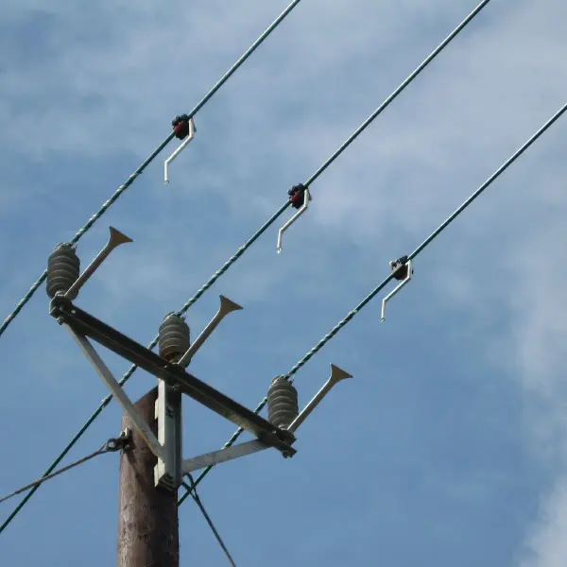

Grid Hardening
Transmission
Strategic Undergrounding
Covered Conductor
93
miles hardened on transmission lines 2020-2022
88
miles installed 2020-2022
45
miles planned for completion 2023 - 2025
160
miles planned for completion 2023 - 2025
2026
planned completion of tier 2 and tier 3 areas
65%
reduction in risk against wildfires
84%
effectiveness of hardening against wildfires.
125
miles installed 2020-2022
359
miles planned for completion by 2025
6,600
customers expected to remove impact of PSPS
98%
reduction in risk against wildfires.

Slide 56
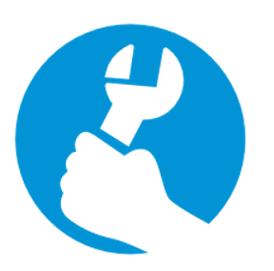
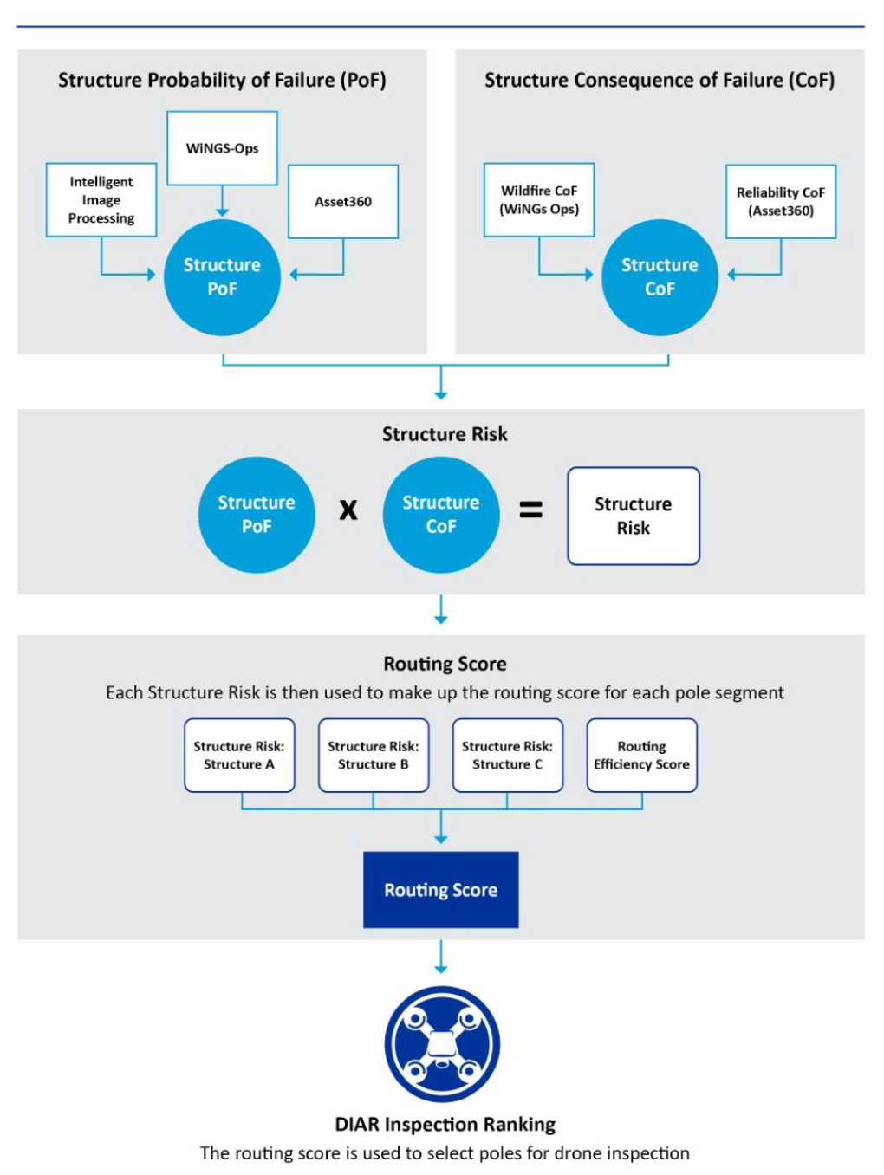
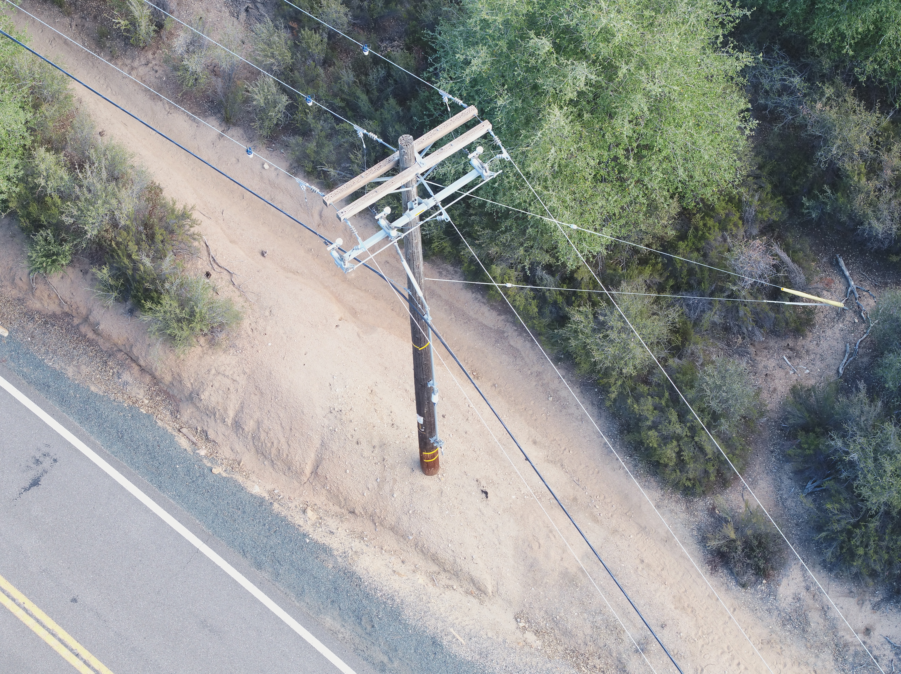
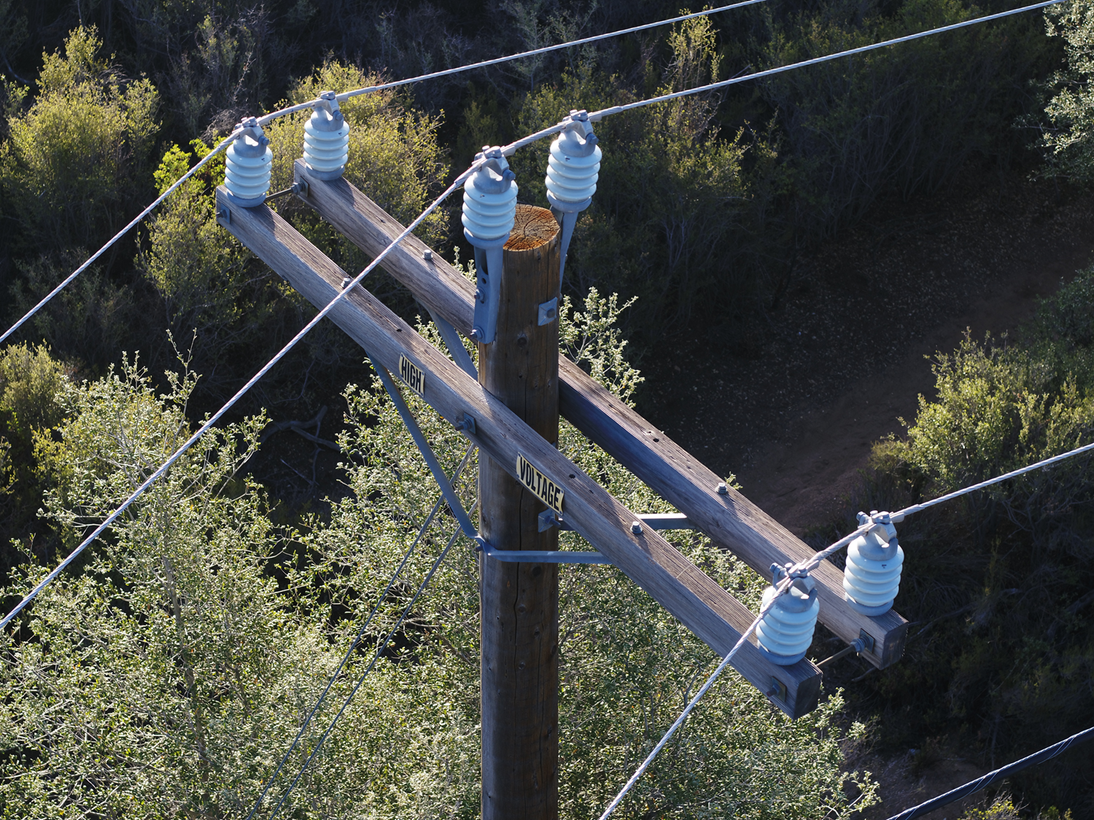
Asset Replacement
Risk-informed drone inspections
2.3
million images captured
85k
structures photographed in tier 2 and tier 3 of the HFTD
96
machine learning models created
41%
reduction in field time

Slide 57
GRID OPERATIONS, DESIGN, and MAINTENANCE PANEL DISCUSSION
PANEL MEMBER or UTILITY REPRESENTATIVE | ORGANIZATION / TITLE
Ray Fugere | SCE / Director
Holly Wehrman | CPUC CalAdvocates
Wendy Al-Mukdad | CPUC SPD
Thomas Long | TURN

Slide 58
1o minute break
Back at 1:45pm

Slide 59
OPEN QUESTIONS
AND ANSWERS
Reminder to raise hand, use Q&A function in Zoom.

Slide 60
EMERGENCY PREPAREDNESS, COMMUNITY OUTREACH,
AND PSPS PANEL

Slide 61
SDG&E

Slide 62
Mona Freels, Emergency Services Manager
Emergency
Preparedness

Slide 63
ICS Integration
Required FEMA/CAL OES trainings:
SEMS Intro
IS 100
IS 200
IS 700
Required internal trainings:
  EOC orientation
  Summer readiness
  Section-specific
634 EOC Responders
ICS Training:
  EOC Responders
  Field Responders
  Utility Field Commander
  Field Safety Officer
  ICS Field Mentoring
First Responder Training:
  Fire Personnel
  Law Enforcement Personnel

Slide 64
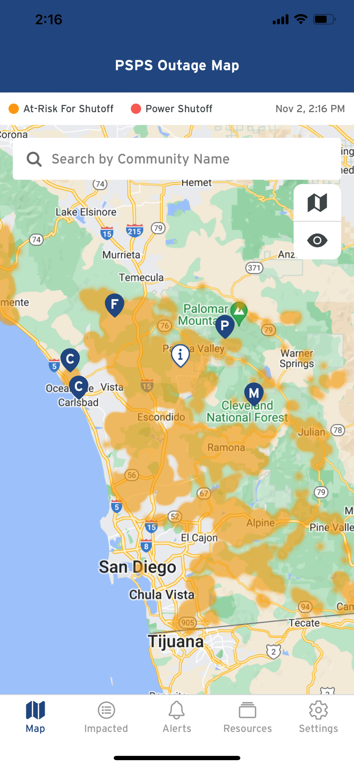
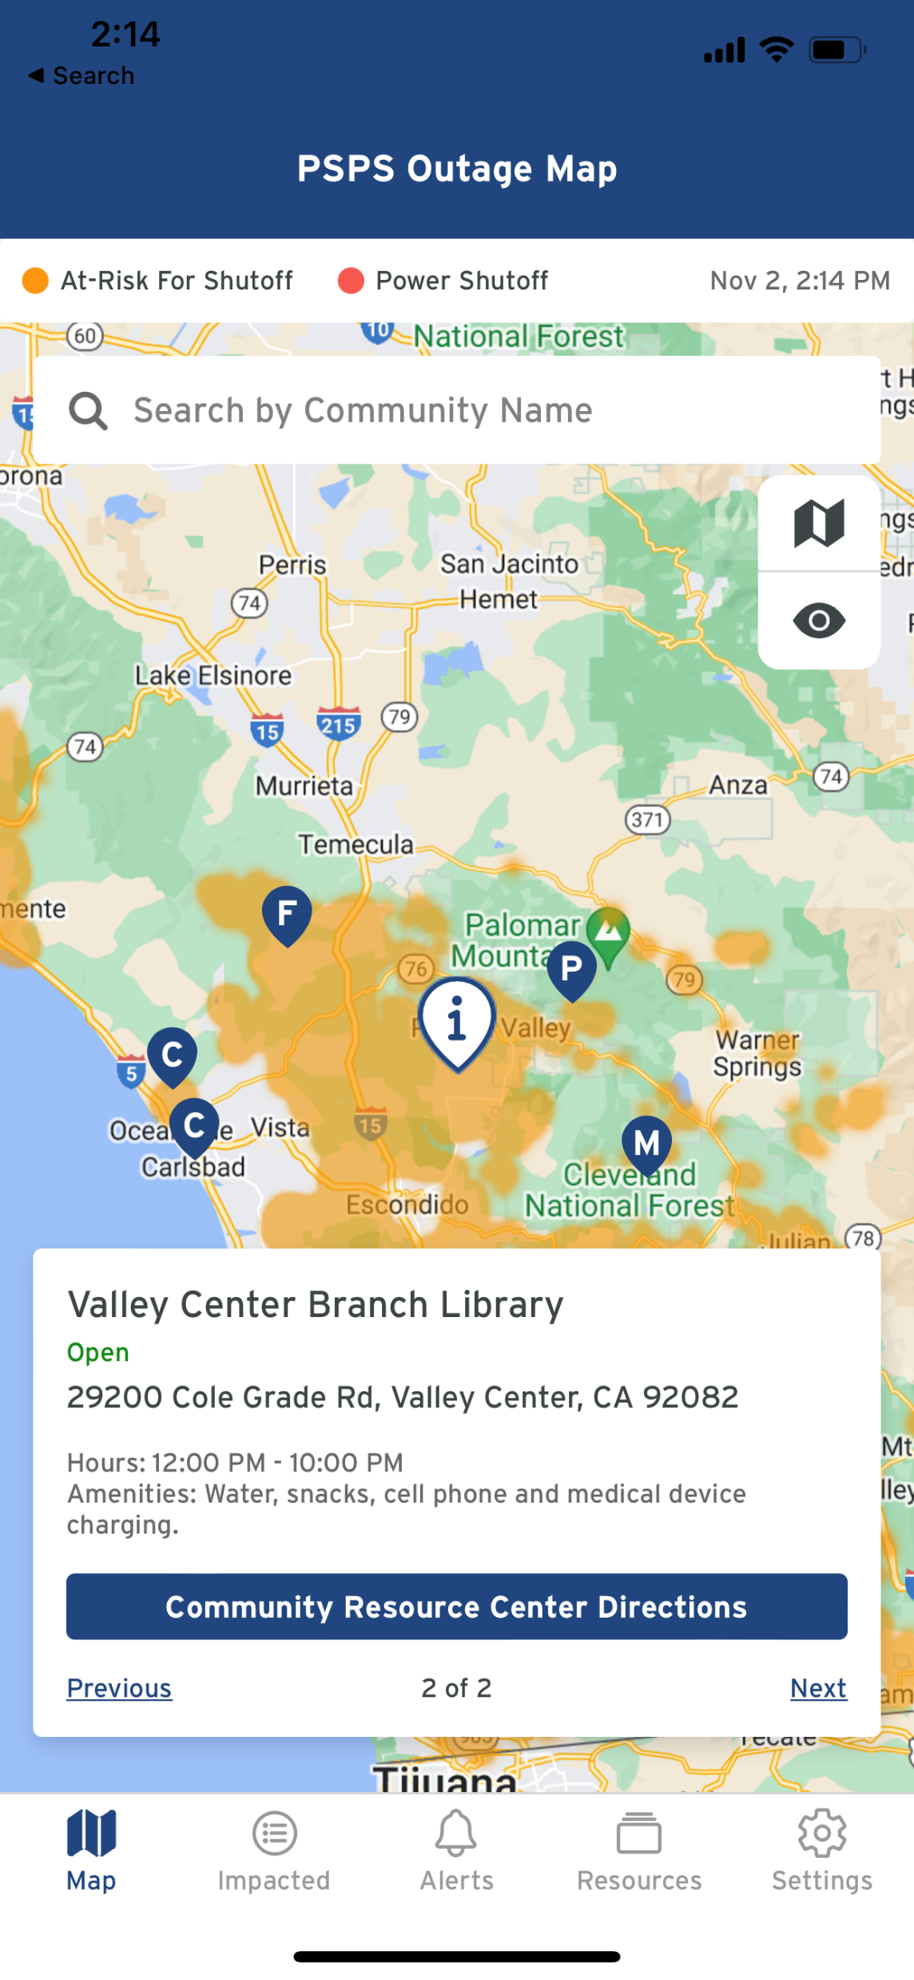
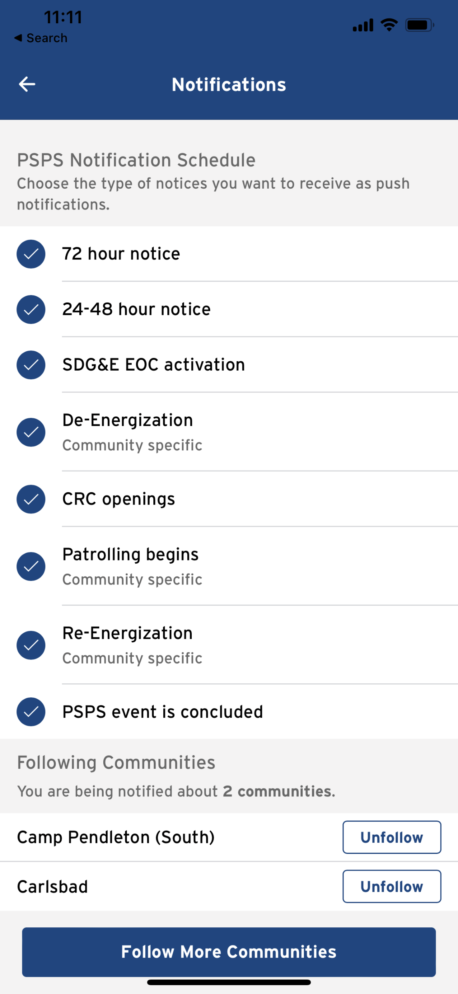
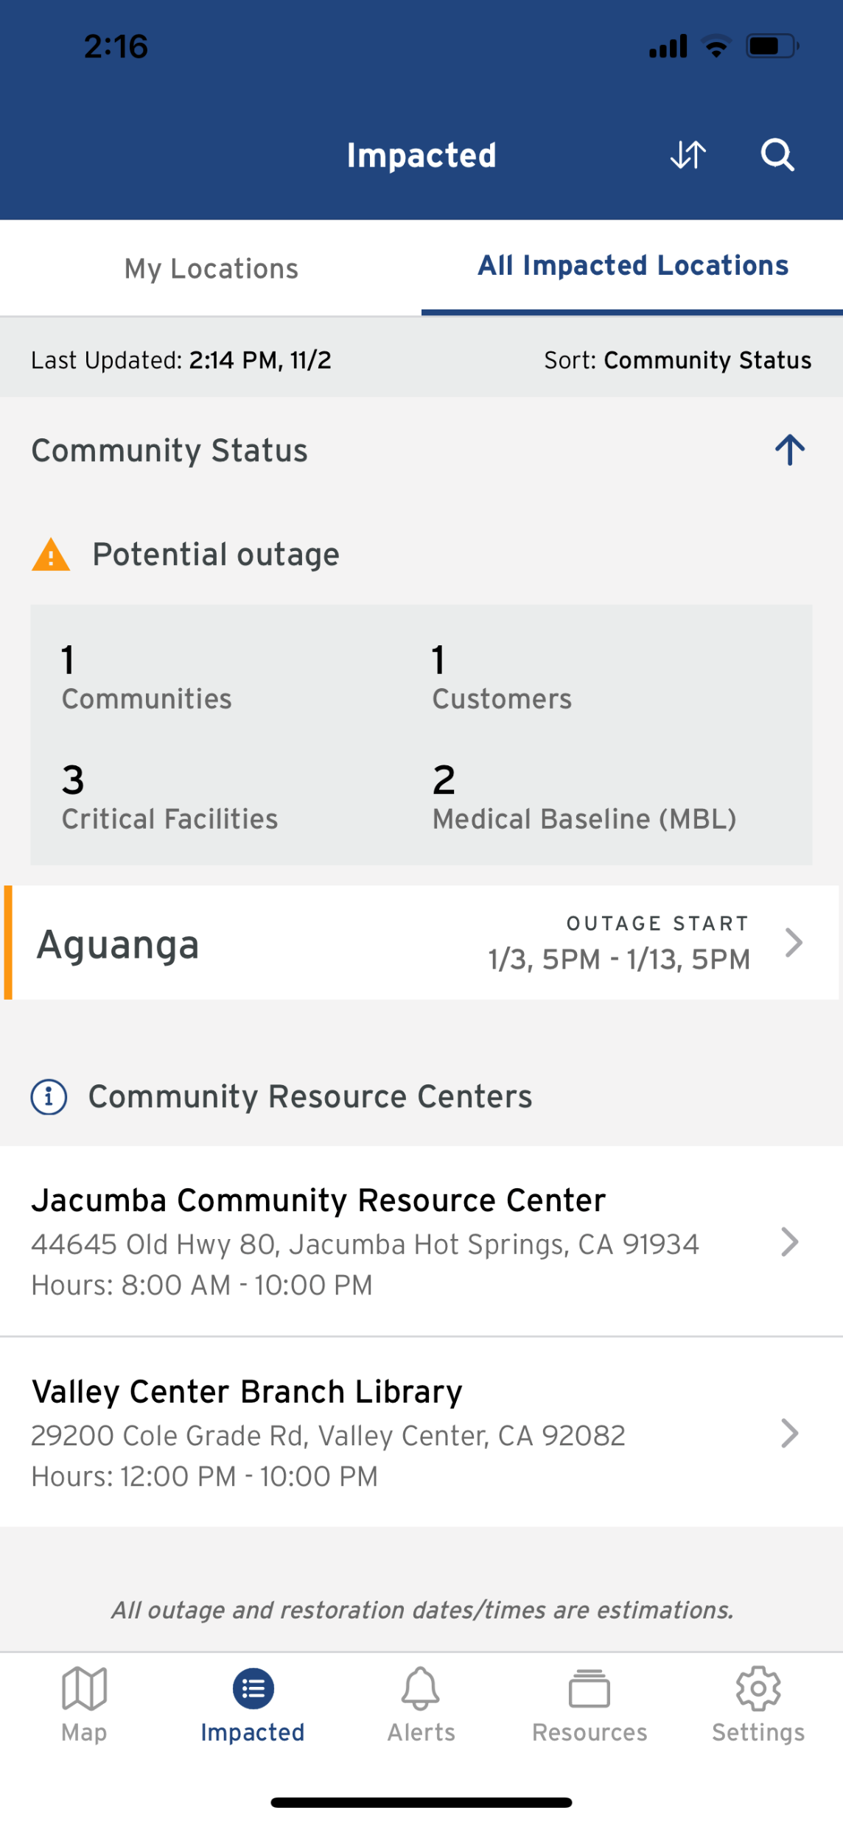
Public Safety Partner Portal
  Will be all-hazards, including wildfire by Sep. 1, 2023
  Information by device
  Partners can follow communities
  Customized push notifications
  Mapping
  Social Media Kits
  Links to external resources like 211 San Diego
  24/7 contacts into the EOC

Slide 65
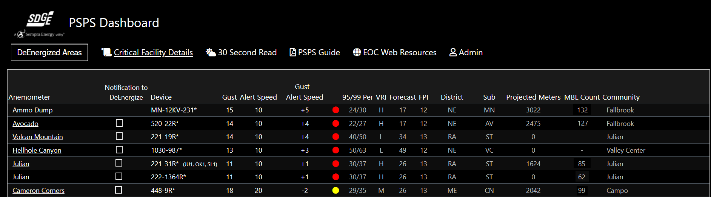
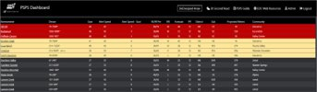
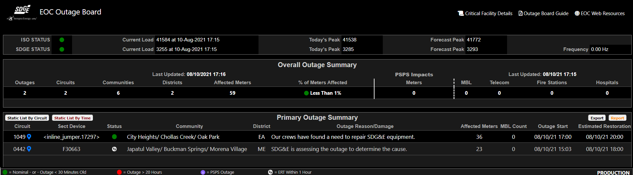
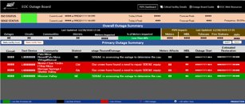
Human Factor Engineering – EOC Dashboards
Pre-Redesign

Slide 66
Robb Henderson, Senior Marketing Communications Advisor
Danielle De Clercq, AFN Customer Strategy Manager
Community
Outreach

Slide 67
Public Education & Outreach
Diverse Communications & Outreach Channels
Dedicated PSPS education​​ campaign
Service territory-wide, year-round campaign (Mar-Dec)
  Customized Tribal and AFN communications
  Increase understanding of PSPS criteria
  Leverage 20+ diverse communication platforms​​
Communicate in 21 prevalent languages in service territory and American Sign Language​
Dedicated Spanish Communications Manager​
Customer Notifications
Enhanced Accessibility, Available in 21 prevalent languages
American Sign Language (audio & text)
Address level notifications available through PSPS mobile app including non-account holders
Research
Post-season Research (Q1/Q2)
Pre-season and Post-season Research planned for Q3/Q4
MARKETING TACTICS | Q1 | Q2 | Q3 | Q4
Print Advertising |  | X | X | X
Outdoor Advertising |  | X | X | X
Television/ Radio |  | X | X | X
Social Media Advertising |  | X | X | X
Digital Advertising |  | X | X | X
Customized AFN Campaign |  |  | X | X
Website & Video Update | X | X | X
Updated PSPS Notifications |  | X | X
In-studio Media Interviews |  | X | X | X
Strategic Story Pitching |  | X | X | X
Social Media (Organic) | X | X | X | X
Print Collateral | X | X | X

Slide 68

Mitigation of impacts on
individuals with AFN
SDG&E has identified ~423k unique AFN customers, which is ~33%⁽¹⁾ of our residential customer base
Enhance Identification
& Understanding of
AFN Community
Collaborate with
Community Experts to
Identify & Reach
Mapped “AFN” customers across database
  ~423,000 total customer accounts with AFN (~33%)
  ~44,000 customer accounts with AFN in HFTD (~10%)
Continued AFN customer research
AFN Statewide and Collaborative Councils, Regional Working Groups and Core Planning team
AFN Support Partners (e.g., 211)
Partnerships with State, County and Local Orgs
Enhanced Tribal Support
Increased AFN CBOs & focus on PSPS support
AFN Database Fields
CARE | Hearing Impairment
FERA | Vision Impairment
Medical Baseline | Disability
Life Support | Seniors
Temperature Sensitive | Non-English
Large Font Bill | Durable Medical Equipment⁽²⁾
Braille Bill | Assistive Technology⁽²⁾
Enable customers
to “self-identify”
Broadened ability to “self-identify” as having an AFN
Enhanced messaging and communication materials
Newly added self-ID webform on SDG&E website
To date, ~7,850 customers identified through self-ID
Based on residential customer accounts (1.3m). Note Many AFN customers fall into multiple categories (e.g. CARE + MBL)
Additional identifiers to be added in Q2 2023

Slide 69

Support for individuals with AFN
New and continued enhancements to further reach and support individuals with Access and Functional Needs
PSPS Support Services
Community Resource Centers
Accessibility
Digital Accessibility
Accessible Hazard Alert System (AHAS)
Centralized Resource Hub
Pantry and Warm Food Options
Transportation and Hotel Stays
Wellness Checks
Video Remote Interpreting (VRI) for Customer-Facing Representatives
Customer Communications
PrepareforPowerDown.com
Community Engagement
AFN Self-Identification
Wildfire Safety Fairs
Outreach through CBOs
Amplified Notifications through CBOs
Tribal Partnerships
Targeted Marketing
Resiliency Resources

Slide 70
Jonathan Woldemariam, Director – Wildfire Mitigation & Vegetation Management
Public Safety
Power Shutoff (PSPS)

Slide 71
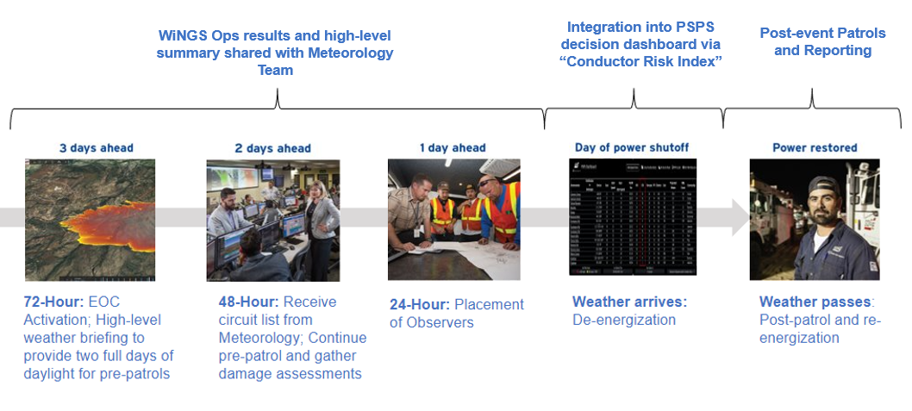
WiNGS Ops
Assisting PSPS decision-making

Slide 72

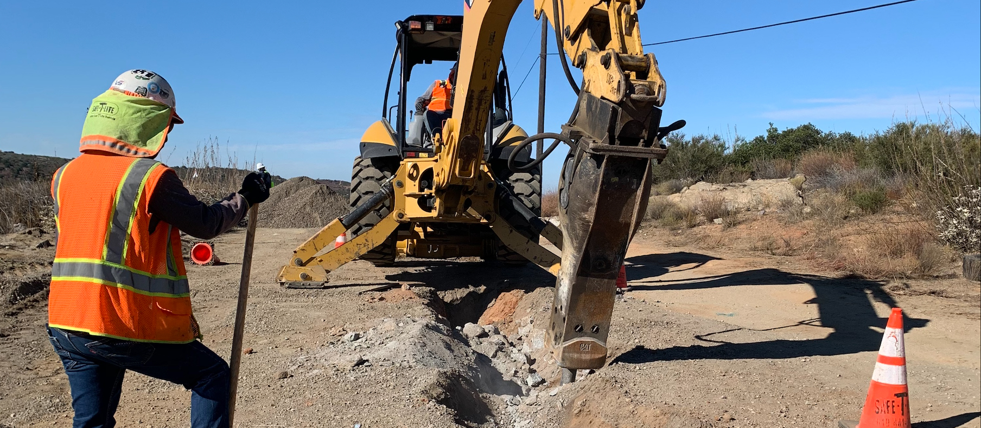

our impact
Programs reduce PSPS impacts on top 15 frequently de-energized circuits
68 miles completed in 2022
571 miles to be completed by 2032
650 customers mitigated in 2022
5,000 customers to be mitigated by 2032
A CASE STUDY:
successful mitigations of frequently de-energized circuits
Strategic
Undergrounding
71 SCADA devices installed
2,400-8,000 customers mitigated
PSPS Sectionalizing
Hell Hole Canyon saw wind gusts of 61 mph during the November 2021 PSPS. The customers on this portion of the circuit
were able to avoid a PSPS de-energization due to strategic undergrounding
efforts that were
completed in June 2021.
1,540 customers participated
Backup Resiliency Programs
*Frequently de-energized circuit is defined by OEIS as a circuit experiencing three or more PSPS de-energizations in a calendar year Using a timeframe of 2018-2022, 15 circuits totaling 8,320 customers have been identified as "frequently de-energized"

Slide 73
PG&E

Slide 74
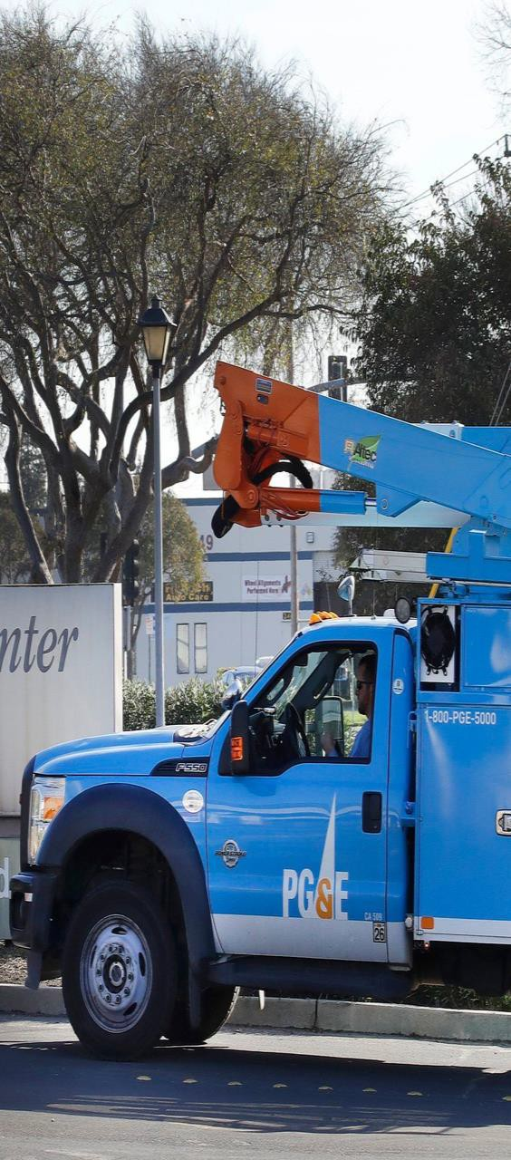
Panel 3: Emergency Preparedness, Community Outreach and PSPS
PG&E’s Emergency Preparedness and Response (EP&R) Plan bolsters the response to emergencies by improving governance, strengthening coordination among functional areas, and improving collaboration with external partners. PG&E’s community outreach and public awareness initiatives focus on ensuring that all stakeholders understand the wildfire safety programs, their benefits, the potential impacts, and the support that is available to them. PSPS initiatives demonstrate a focus on more accurately modeling the need for a PSPS events, reducing the impact to customers, and hardening systems to prevent PSPS events.
Current Development Planned Developments
PG&E has implemented various communications and media channels to inform the public of emergency events, including direct customer notifications, PSPS address alerts, PSPS portal, updated PG&E website information, local media press releases, and live agent call center customer support.
PG&E collaborates with community-based organizations (CBOs) and critical facilities to enact a localized education strategy, leveraging automated outage notifications, follow-up Interactive Voice Recording (IVR) messages, customer e-mails, social media posts, and community meetings.
In 2022, because of favorable weather, PG&E reported 0 events where de-energization was initiated, which represents the first time since before 2018 that this occurred.
In 2021, the FPI model and IPW models were enhanced with better data and improved analytical modeling, which guides PSPS decision-making
PG&E annually reviews, and if appropriate, revises the Company Emergency Response Plan (CERP) and the two wildfire-related annexes (the Wildfire Annex and the PSPS Annex) to improve emergency response.
Over the next 10 years, PG&E aims to hold community engagement meetings within the five PG&E regions of service that will include, but are not limited to, a mix of webinars, open houses, town halls, and/or answer centers.
PG&E has a plan in place to reduce PSPS impacts by approximately 55,000 customer events for the 2023-2025 period by completing Wildfire mitigation projects including undergrounding.
PG&E is working to provide portable batteries to customers at risk of more frequent EPSS outages or PSPS events with a focus on AFN, MBL, and self-identified vulnerable populations.
Further improvements are planned for the PSPS decision making including updates to the IPW and FPI models and continued updates to the base datasets feeding the models
Some of the measures included in this presentation are contemplated as additional precautionary measures intended to further reduce the risk of wildfires.
1

Slide 75
SCE

Slide 76
Emergency Preparedness, Community Outreach & PSPS (4/27)
76

Slide 77

SCE: Emergency Preparedness, Community Outreach & PSPS
Emergency Preparedness
Community Outreach
PSPS
Issuing Resource Guides for all tribal and local governments (May distribution)
Community wildfire meetings
Critical infrastructure workshops
Emergency preparedness plan sharing with public safety partners, encompassing PSPS, AHP, EEAP, WMP
Self-identification pilot to better identify AFN customers
Expanding CBO network to better serve AFN communities
Installation of covered conductor and additional switching devices to reduce PSPS scope and duration
Continuing to enhance weather forecasting through machine learning
Expanded eligibility for critical care back-up batteries
Improve PSPS operations and notifications through automation
Training: On track for all IMT members to be fully qualified by 7/1, including position-specific training across key functions
PSPS Full-Scale exercises with observers, functional and tabletop exercises in May
Improving customer-provided contact data
Maintaining and expanding aerial firefighting resource availability

Slide 78
EMERGENCY PREPAREDNESS, COMMUNITY OUTREACH,
AND PSPS PANEL DISCUSSION
PANEL MEMBER or UTILITY REPRESENTATIVE | ORGANIZATION / TITLE
Mona Freels | SDG&E / Emergency Services Manager
Justin Hagler | CPUC CalAdvocates
Will Abrams | Self
Megan Somogyi | Local Governments Representative

Slide 79
1o minute break
Back at 3:45pm

Slide 80
OPEN QUESTIONS
AND ANSWERS
Reminder to raise hand, use Q&A function in Zoom.

Slide 81
Open questions and answers – all panels

Slide 82
PUBLIC PARTICIPATION
Docket 2023-2025-WMPs is your primary source of information regarding WMP evaluations: https://efiling.energysafety.ca.gov/EFiling/DocketInformation.aspx?docketnumber=2023-2025-WMPs
Data Request (DR) responses are available at each electrical corporation’s website and summaries of DRs received by the utilities are available at: https://efiling.energysafety.ca.gov/EFiling/DocketInformation.aspx?docketnumber=2023-2025-WMP-DRs

