Slide 1
2023-2025 Wildfire Mitigation Plan
PUBLIC Workshop
For Small and Multi-Jurisdictional
Utility Submissions
June 16, 2023

Slide 2
Introduction

Slide 3
SAFETY MESSAGE
Be aware of your surroundings
Know your evacuation route(s)
Feel something, say something
Stand up and move occasionally

Slide 4
Opening Remarks
Electrical corporations are required to prepare and submit Wildfire Mitigation Plans (WMPs) to Energy Safety.
WMPs describe how the electrical corporation is constructing, maintaining, and operating its electrical lines and equipment in a manner that will minimize the risk of catastrophic wildfires.

Slide 5
AGENDA
10:00 a.m. – 10:10 a.m. Introduction
10:10 a.m. – 12:00 p.m. Risk Assessment and Mitigation Selection
12:00 p.m. – 1:00 p.m. Lunch
1:00 p.m. – 2:30 p.m. Grid Operation, Design, and Maintenance
2:30 p.m. – 4:00 p.m. Vegetation Management
4:00 p.m. – 5:00 p.m. Open Questions and Answer (all topics)
5:00 p.m. Adjourn

Slide 6
WORKSHOP LOGISTICS
Asking Questions
Ask written questions in the Zoom Q&A at any time
Raise your hand during the public questions portion of the panels
Hold questions for overall Q&A at the end the day

Slide 7
Energy Safety Panel Moderators
Energy Safety Panel Moderators
Risk Assessment and Mitigation
Selection Strategy – Luis Medina (Level 4)
Grid Operations, Design, and
Maintenance – Andie Biggs
Vegetation Management – Colin Lang

Slide 8
Risk Assessment & Mitigation Selection

Slide 9
Risk Assessment & Mitigation Selection PANEL DISCUSSION
PANEL MEMBER or UTILITY REPRESENTATIVE | ORGANIZATION / TITLE
Luis Medina (Moderator) | Level 4 Ventures/Subject Matter Expert
Kevin Benson | PacifiCorp/Director of Asset Risk
Paul Marconi | BVES/President
Eliot Jones | Liberty/Senior Manager, Wildfire Prevention
Zoë Harrold | GPI/Scientist
John Mader | WASB Board Member

Slide 10
Pacificorp

Slide 11
2023 Wildfire Mitigation Plan Update
Risk Assessment and Mitigation Selection Strategy
Kevin Benson, Director of Asset Risk
June 16, 2023

Slide 12
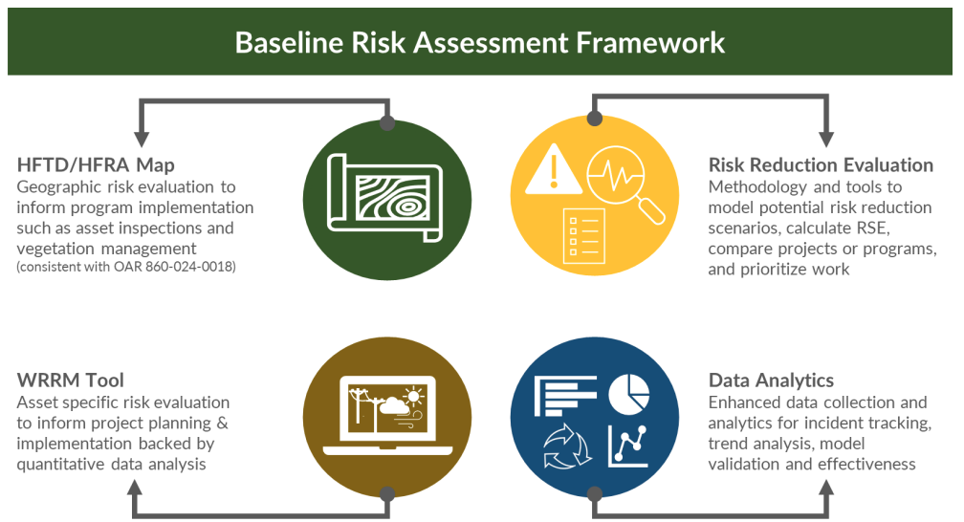



Risk Assessment
In 2023:
Complete implementation of
WRRM and ignition risk.
Continue refinement of RSE calculation methodology and calculate RSE for grid hardening initiatives
Procure Data Analytics Software
Implement Refreshed FHCA Map
Implement, Evaluate, & Continuously Improve
WRRM Procured
WRRM Configured
WRRM Testing
Implement WRRM
Implement Data Analytics Software
Q4 2022
Q3 2022
Q1 2023
Q2 2023
Q3 2023
Q4 2023
Q1 2024
Q2 2024

Slide 13
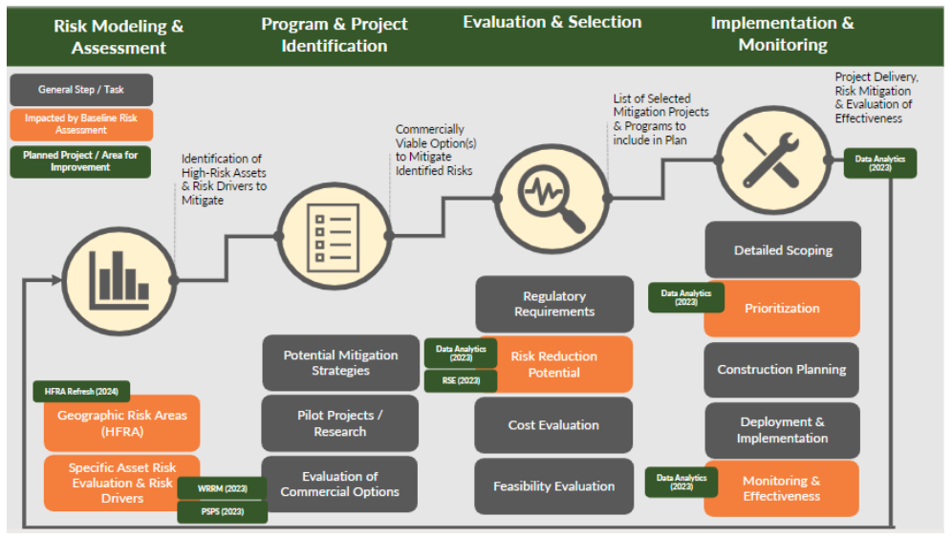
  Mitigation Selection Strategy
Q1 2023
Q2 2023
Q3 2023
Project scoping requirements gathering
RSE Calculations and Refinement
Mitigation Effort Selections and Application
Q4 2023
RSE Continuous Improvement

Slide 15
BVES

Slide 16

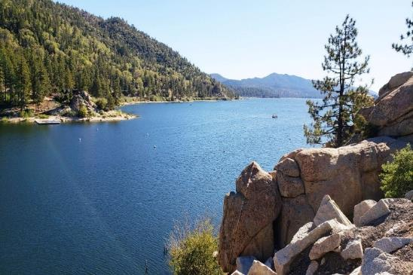


SMJU WMP Workshop
BVES Risk Assessment
Paul Marconi, President, Treasurer, and Secretary
June 16, 2023
Powering The Mountain Since 1929

Slide 17
Risk Methodology and Assessment
As BVES is moving to implement additional modeling capability, BVES expects the overall risk assessment process by the 2024 WMP Update reflect the figure the left.
BVES’s Risk-Based Decision-Making Framework (BVES Risk Register Model) is consistent with other SMJUs based on direction from the Commission (CPUC D. 19-04-020 of April 25, 2019) and based on International Standardization Organization’s “Risk Management – Principles and Guidelines” (“ISO 31000”).
Contracted Technosylva to further improve situational awareness. Better understanding of the risk environment should improve BVES’s resource allocation. This effort leverages Technosylva’s Wildfire Analyst Enterprise (WFA-E) software capabilities and solutions implemented across California for other electric utility companies.
Implementing Technosylva’s WRRM, which uses historical climatology (weather & fuel moisture data) as key input weather scenarios to improve its asset risk analysis. The model produces risk metrics by running fire spread simulations for each weather scenario territory wide. The outputs can then be aggregated based on percentile and assigned to assets.
PSPS Consequence
PSPS Likelihood
BVES Risk Register Model
Reax Engineering Consequence Maps
Technosylva WFA-E
Fire Safety Matrix
Reax Engineering Ignition Probability Maps
BVES Risk Register Model
Technosylva WFA-E
Planning Risk Assessment/Overall Utility Risk
Distribution Asset Data, Historical Outages and Ignitions
Wildfire Risk
PSPS Risk
Wildfire Consequence
BVES Risk Register Model
Reax Engineering Consequence Maps
Technosylva WFA-E
Wildfire Likelihood
BVES Risk Register Model
Fire Safety Matrix
Distribution Asset Data, Historical Outages and Ignitions
Reax Engineering Ignition Probability Maps
Technosylva WFA-E
NFDRS & Forecasted Weather
Technosylva WRRM
Technosylva WRRM
Technosylva WRRM
Technosylva FPI
Technosylva WRRM

Slide 18
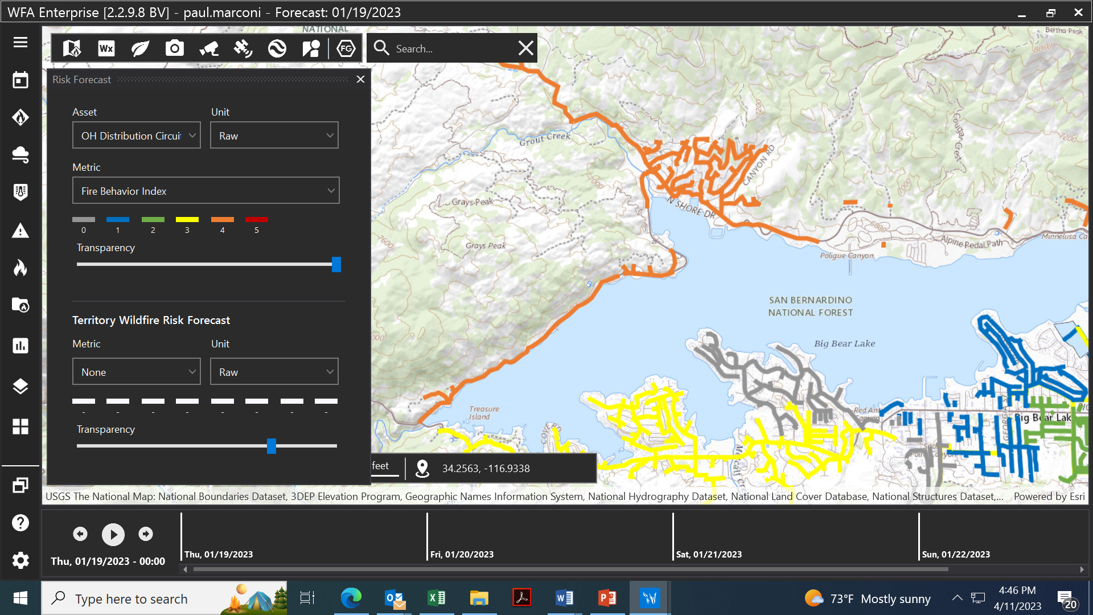
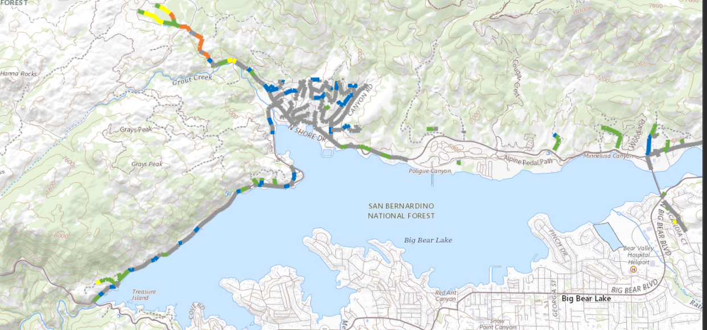
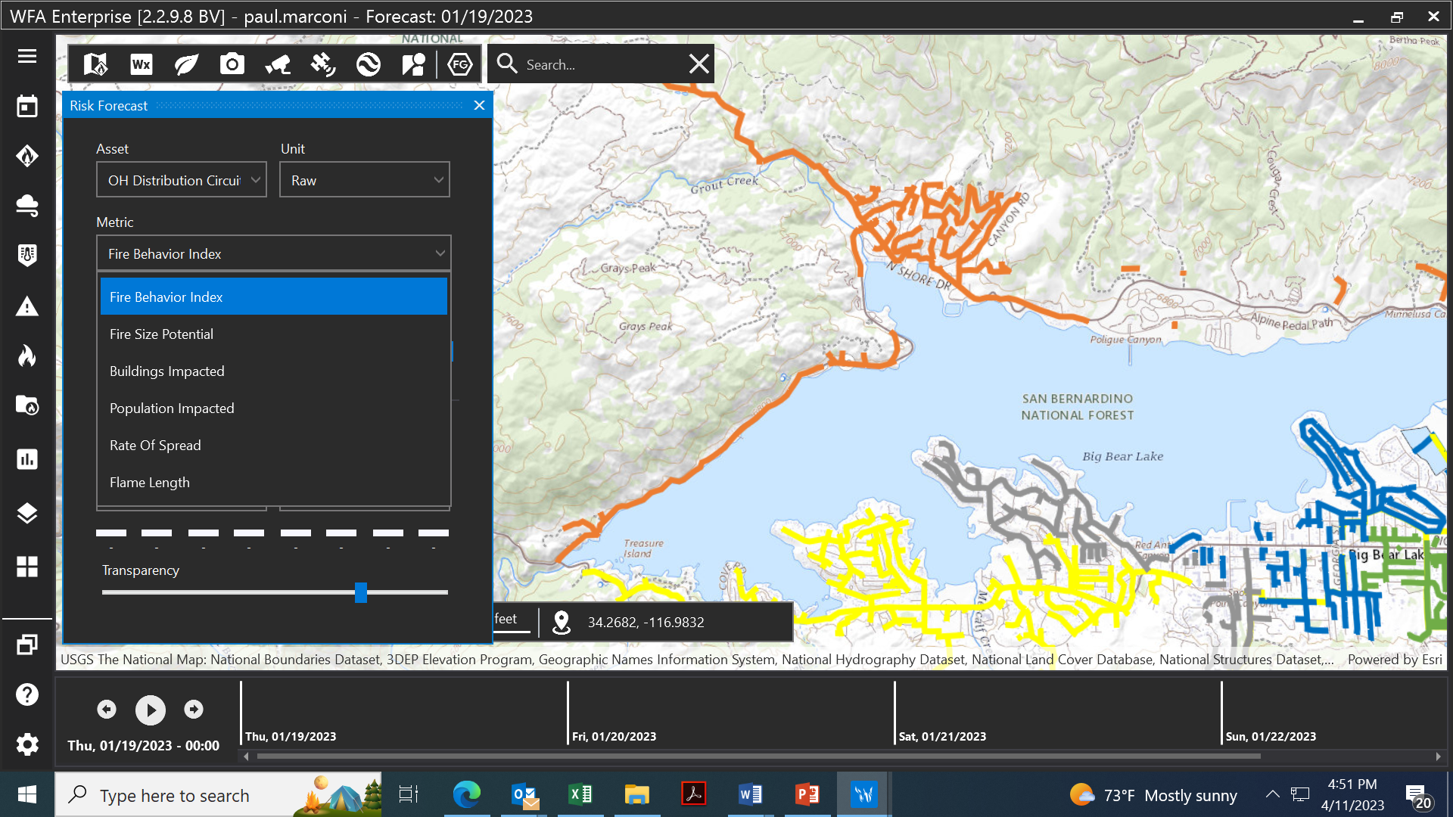
Forecasting Fire Risk
Sample fire risk forecast at the system level
Sample fire risk forecast
at the circuit level.
BVES began utilizing Technosylva’s WFA-E application in 2022 greatly enhancing its near real time forecasting and modeling capabilities with respect to wildfire risk.
  Real time weather and wildfire risk data is processed to provide a risk forecast.
  BVES staff can now perform fire spread predictions based on the fire risk forecast.
The fire model is expected to reach a confidence level of 60%.
  Validation is usually done using satellite products and/or known fire perimeters where the uncertainty is known to be within a range.
Technosylva is developing a BVES specific Fire Potential Index (FPI.
Fire risk metric selection

Slide 19
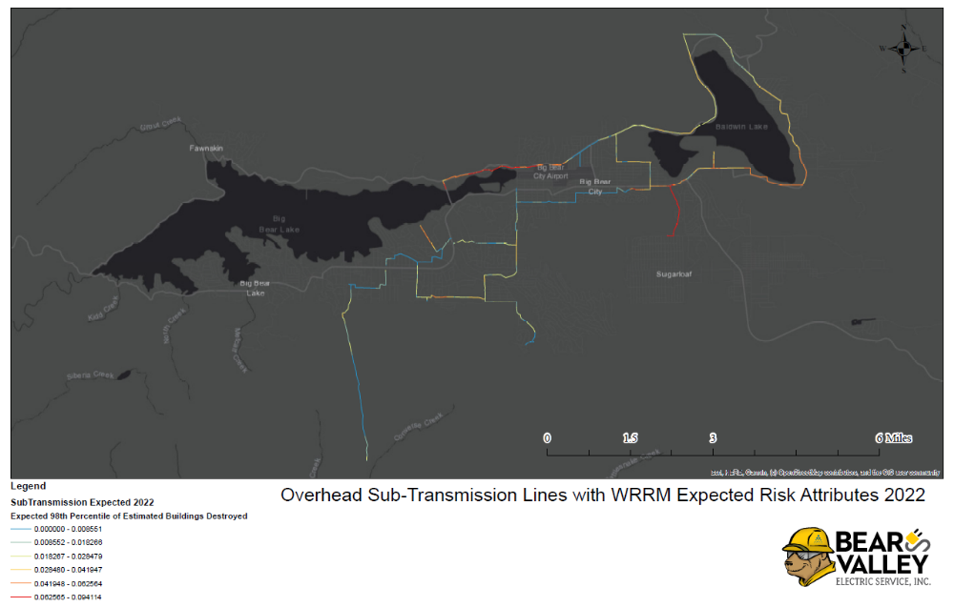
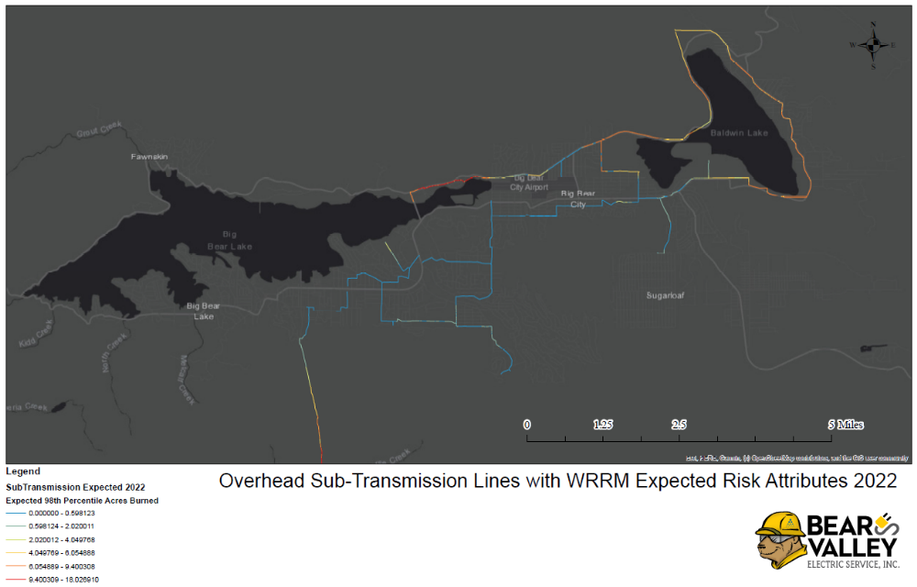
WRRM Output
Buildings Destroyed
Acres Burned

Slide 20
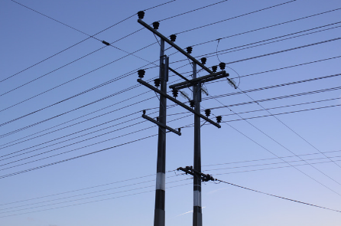

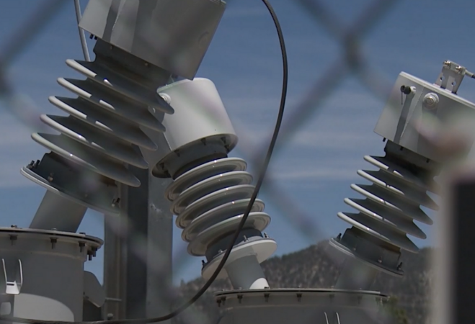
Questions
Slide 20
Powering The Mountain Since 1929

Slide 21
Liberty

Slide 22


Risk Assessment
Eliot Jones, Senior Manager, Wildfire Prevention

Slide 23

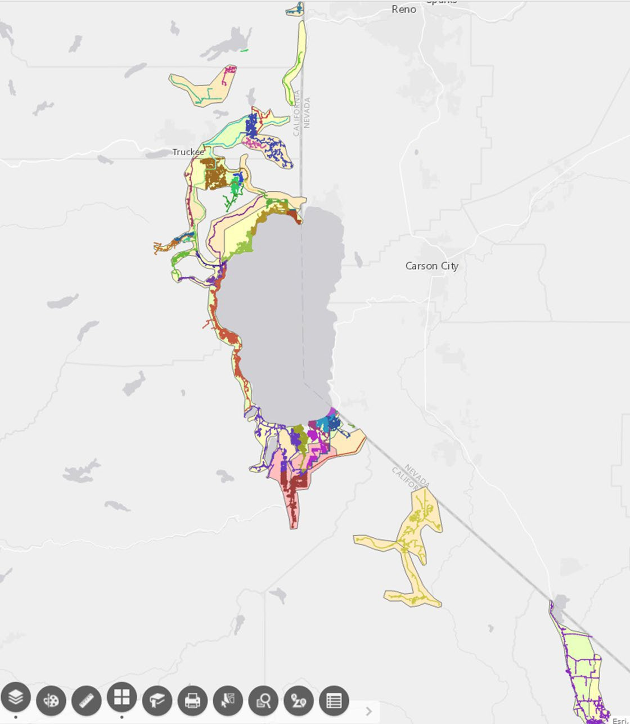
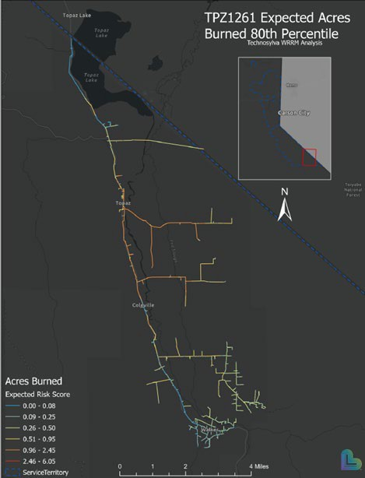

Risk Assessment and Mapping
Accomplishments in 2022
Liberty Wildfire Risk Maps
Used historic outages to model outage rates and ignition probability
Identified new high wildfire circuit segments based on the results
Fire propagation model consequences are summarized by circuit and statistically arranged from 95th percentile to 99th percentile
Ignition and fire model outputs are visually displayed
Reax Risk Zones for Liberty Service Territory
Technosylva’s WRRM results for Liberty’s expected risk (and consequences) for the Topaz and Muller circuits
3

Slide 24

2023 Planned Improvements
Risk Assessment and Mapping
Refine analysis at the circuit segment level
Adjust for annual improvements – vegetation clearances, CEMA tree removals, pole replacements, and other grid hardening efforts
Map pilot detection device installations and coverage areas, automatic reclosers (grids), Sensitive Relay Profile, and overlay with PSPS risk zones
Continue to enhance modeling capabilities for risk-based decision making and reduce wildfire risk
4

Slide 25
LUNCH BREAK
Back at 1:00pm

Slide 26
Grid Operation, Design, & Maintenance

Slide 27
Grid Operation, Design, & Maintenance
PANEL MEMBER or UTILITY REPRESENTATIVE | ORGANIZATION / TITLE
Andie Biggs (Moderator) | Energy Safety/Subject Matter Expert
Tom Chou | BVES/Utility Engineer & Wildfire Mitigation Supervisor
Amy McCluskey | PacifiCorp/VP of Wildfire Safety and Asset Management
Blaine Ladd | Liberty/Director, Operations
Holly Wehrman | Cal Advocates/Senior Utilities Engineer

Slide 28
BVES

Slide 29
SMJU WMP Workshop
BVES Grid Operation, Design & Maintenance
Tom Chou, Utility Engineer and Wildfire Mitigation Supervisor
June 16, 2023
Powering The Mountain Since 1929

Slide 30
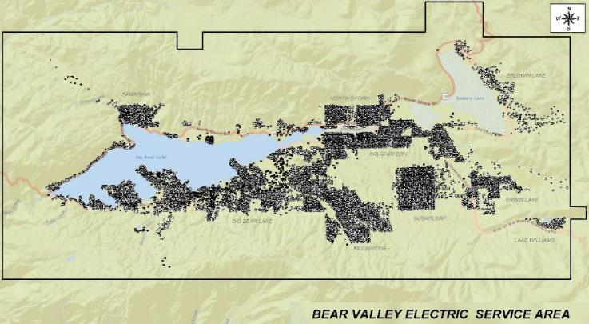
Service Area Overview
Location: 32 square miles of rural and mountainous terrain at approximately 7,000 ft. in San Bernardino Mountains (80 miles East of Los Angeles).
Entire Service Area is > 3,000 ft. elevation requiring more resilient construction standards.
98% of BVES service territory are in HFTD Tier 2 and 2% are in HFTD Tier 3
Customers: 24,725 total [23,222 residential and 1,503 commercial].
Electrical System:
Transmission – BVES does not own or operate any transmission systems (66 kV or greater).
Sub-transmission (34.5 kV)
  16.0 circuit miles bare overhead conductor
  12.9 circuit miles covered overhead conductor
  2.1 circuit miles underground
Distribution (4 kV)
  160 circuit miles bare overhead conductor
  22 circuit miles covered overhead conductor
  53.2 circuit miles underground
Substations: 13
Supply Lines: 39 MW total
Bear Valley Power Plant: 8.4 MW
In the event of a wildfire (due to any cause) in the BVES service territory, the damage would not be as significant due to the availability of lake water from Big Bear Lake to fight the fire and contain it early.
Baldwin Lake
Fawnskin
North Shore
Big Bear City
Erwin Lake
Boulder Bay
Sugarloaf
Big Bear Lake
Village
Lake Williams
Moonridge

Slide 31
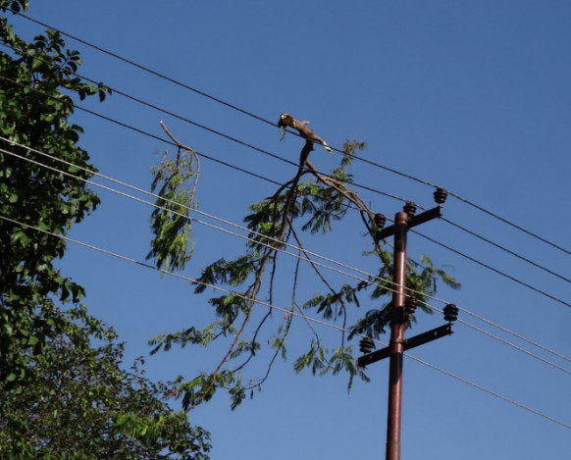
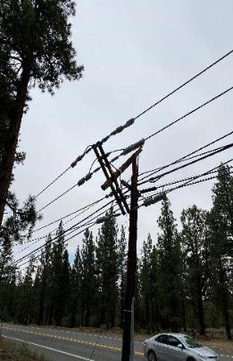
Covered Wire Program
Bare wires were historically used because they provided a reliable, cost-effective solution for delivering energy to customers.
  When vegetation or other objects make contact with bare wire, the potential for ignition is significant.
  With climate change driving near continuous dry and drought conditions, especially in the High Fire Threat Districts as defined by the CPUC, these ignitions have a much greater potential to cause wildfires with catastrophic loss of life and enormous loss of property than ever before.
Covered conductors are any conductors (wires) covered by layers of insulation.
  Vendors designed these wires to withstand abrasive contact with vegetation or other debris and objects.
Priority Wire 394.5 AAAC Priority Wire
  Covered Conductor XLP/FRXLP 90°C Flame Resistant 3 Layer insulations:
  Conductors: ACSR or AAAC aluminum conductor, concentric or compressed stranded.
  Strand Shield: semi-conducting cross-linked polyethylene (XLP)
  Inner Covering: cross-linked polyethylene (XLP)
  Outer Covering: sunlight & flame resistant cross-linked polyethylene (FR-XLP)

Slide 32
WMP Project Completed
20 weather station installed in a 32 square miles of Service Area
15 HD Cameras across BVES Service Territory
Completed technical and safety updates to 2 substations.
Installed a fiber optic network in BVES service area
Installed Fault Localization Isolation and Service Restoration (FLISR) system (Sub-transmission)
Utilizing fiber network to connect FLISR, (3) substations onto Supervisory Control and Data Acquisition (SCADA)
Expulsion Fuse replacement program - Dec 31, 2021 completed

Slide 33
Major WMP Projects
Covered Wire 34.5 kV (4.3 circuit miles) & 4 kV (8.6 circuit miles): Continuation of current WMP covered wire project.
Evacuation Route Hardening Project - 500 poles per year: Installs wire mesh wrap on major secondary roads.
Tree Attachment Removal Project (removes 100 per year): Continues effort to eliminate all tree attachments in the BVES system.
Switch and Field Device Automation: Connects and automates (28) 34 kV and (20) 4 kV switches to SCADA network over 4 years.
Capacitor Bank Upgrade Project: Replaces (24) 4kV capacitor banks with automated capacitors connected to SCADA network over 4 years.
Substation Automation: Connects and automates 9 substations to SCADA network over 3 years.

Slide 34
Major WMP Projects Cont.
Install Fault Indicators: Project aims to install an additional 129 fault indicators (FIs) at 43 locations in Bear Valley’s sub-transmission and distribution system. FIs are devices installed in electric power distribution systems to detect and indicate the occurrence of faults.
Online Diagnostic System: Project installs continuous monitor sensors to provide usable grid insight information that is measured, reported, and documented. Analytics enable the ability to identify and correct current and future irregularities before a problem arises.
Partial Safety and Technical Upgrades Maltby and Village Substations
Safety and Technical Upgrades to Lake Substation
Bear Valley Solar Energy Project: Project constructs a 5 MW alternating current single-axis tracker solar generation facility, to be constructed on a 21-acre site within the BVES service territory. This system will directly feed the distribution system.
Energy Storage Project: Project constructs an energy storage project of approximately 5 MW/20 MWh (four-hour) Lithium-Ion NMC utility-grade battery located in the BVES main yard. This project will complement the Bear Valley Solar Energy Project.

Slide 35
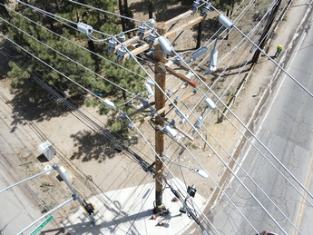
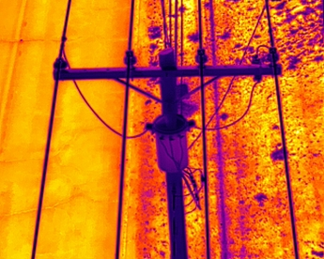
Major WMP Inspection
Patrol Inspections
Detailed Inspections
Intrusive Pole Inspections
UAV Thermography
UAV HD Photography/Videography
LiDAR Inspection
3rd Party Ground Patrol
Substation inspections
Asset management, vegetation management, and inspection enterprise system(s)
Asset Quality assurance/quality control

Slide 36
Questions
Slide 36
Powering The Mountain Since 1929

Slide 37
Pacificorp

Slide 38
2023 Wildfire Mitigation Plan Update
Grid Design, Operations and Maintenance
Amy McCluskey, VP of Wildfire Safety and Asset Management
June 16, 2023

Slide 39
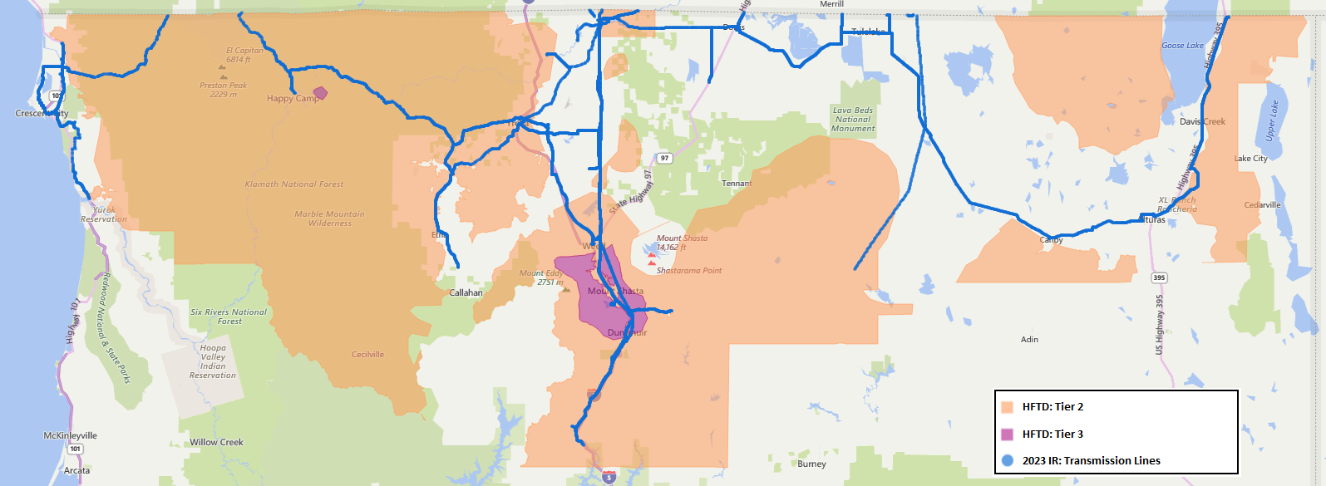
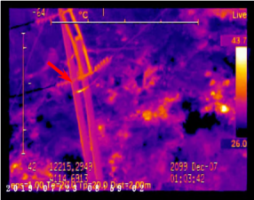



  2022 Inspections
  Infrared Inspections
PacifiCorp completed asset management work as per GO95 and GO165 within the 2022 year.
Completed detailed and patrol asset inspections:
Approximately 74,000 inspections completed
Identified, through inspections, for correction:
Approximately 12,000 conditions
Corrected (found in all years)
Fire Threat / Non Fire Threat:
Approximately 400 conditions / 10,000 Conditions
Corrected Priority A Conditions
Fire Threat / Non Fire Threat:
Approximately 70 conditions / 300 Conditions
Corrected Priority B Conditions
Fire Threat / Non Fire Threat:
Approximately 330 conditions / 6,600 Conditions
Completed enhanced IR inspections on:
Approximately 700 line miles
  2023 Inspections
Continued best practice asset inspections and corrections
Continued prioritization of HFTD areas
Continued development of the Distribution Handheld IR pilot

Slide 40
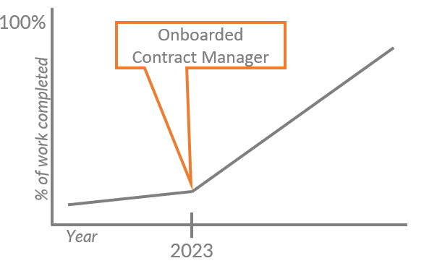
Grid Hardening
Reclosers and Relays allow for rapid power switching, reducing the fire potential.
Expulsion fuse replacement to prevents the initiation of ignition due to expulsion material..
Updated Contract Management Strategy
Covered conductor physically prevents the initiation of flash-over due to contact with object or vegetation
2022
3 fully dedicated FTEs, 2 Partial FTEs and Support Functions are Shared
Covered Conductor
Reclosers and Relays
Expulsion Fuses
PacifiCorp has strategically rebuilt
83 line miles with covered conductor from 2019-2022
Plans to increase the number of covered conductor miles by
130 line miles in 2023
PacifiCorp has strategically installed
113 recloser and relays from 2019-2022
Plans to install an additional
40 reclosers and relays in 2023
PacifiCorp has strategically replaced
2,116 expulsion fuses from 2019-2022
Plans to replace an additional
5,000 expulsion fuses in 2023
2023
Externally Contracted, Fully Dedicated Teams of Contractors

Slide 42
Liberty

Slide 43
Grid Operation, Design, and Maintenance
Blaine Ladd, Director, Operations
5

Slide 44

Grid Design and System Hardening
System Hardening Initiatives
In 2022, Liberty advanced system hardening efforts by:
  Completing three planned covered conductor projects
  Completing pole replacements, as part of:
    G.O. 165 Level 2 pole replacements
    Test and Treat pole replacements
    Storm damage pole replacements
    Covered conductor projects
  Systematically replacing equipment that creates ignition risk, such as expulsion fuses and tree attachments
  Improving substation infrastructure by installing substation animal guards and replacing oil circuit breakers
  Explore and pilot new technologies to improve system resiliency
44

Slide 45
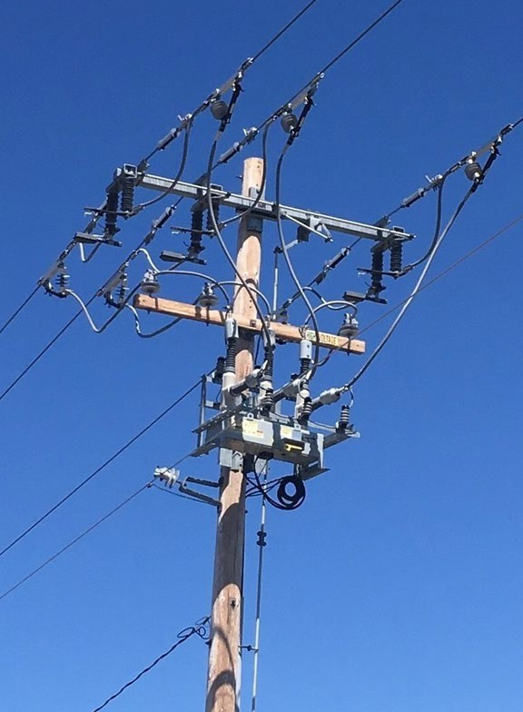

Sensitive Relay Profile Program
Sensitive Relay Profile (SRP)
Piloting 2 circuits starting in 2022
Adding 10 additional circuits in 2023
Fast trip settings used on breakers and reclosers
Adding fault indicators to better determine fault location
Collaborative research with the Electrical Engineering Dept at the University of Nevada, Reno
May lead to reduced use of PSPS depending on pilot results
45

Slide 46
1o minute break
Back at 2:30pm

Slide 47
Vegetation Management

Slide 48
Vegetation Management
PANEL MEMBER or UTILITY REPRESENTATIVE | ORGANIZATION / TITLE
Colin Lang (Moderator) | Energy Safety/Subject Matter Expert
Peter Stoltman | Liberty/Manager, Vegetation Management
Jared Hennen | BVES/Wildfire Mitigation & Reliability Engineer
Brian King | PacifiCorp/Dir. of Environmental and Veg Management
Henry Sweat | CPUC/Senior Utilities Engineer
Gregg Morris | GPI/Director

Slide 49
Liberty

Slide 50
Vegetation Management
Peter Stoltman, Manager, Vegetation Management
8

Slide 51

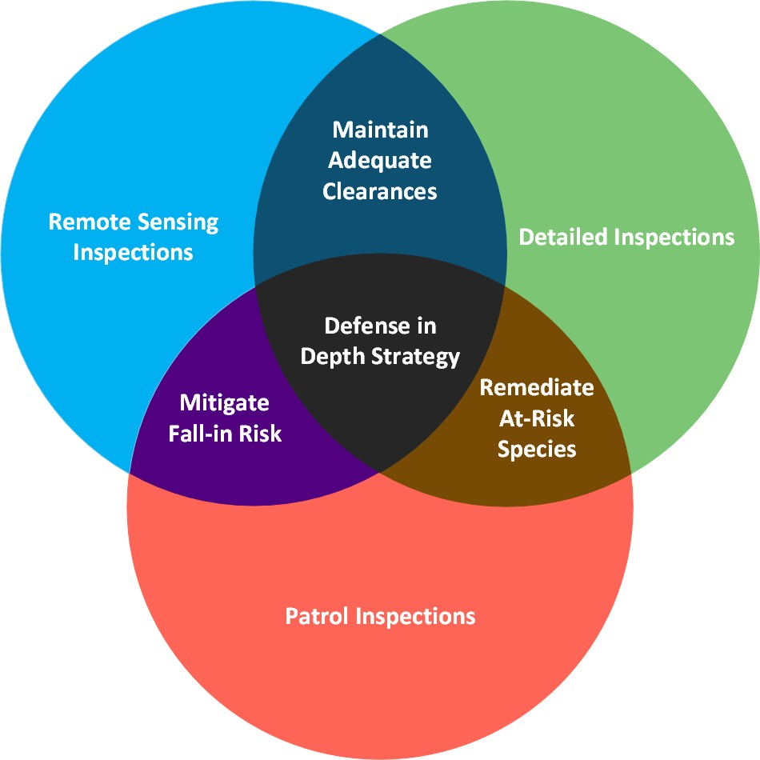

Vegetation Management
Program Overview
Manage vegetation threats using a multi- faceted approach
Three inspection protocols with corresponding maintenance activities
Post work verification and Quality Control Inspections
Environmental & Cultural Resource Protection
Community outreach

Slide 52

Vegetation Management
Accomplishments
6 Year Tree Work History
 | Trees Removed Trees Pruned |  |  | 13,642 | 14,357 | 18,262 | 35% Volume (avg. per year)
 |  |  |  |  |  |  | 58% Duration
 | Total Trees
 |  |  | 11,056
 |  | 6,610 |  |  |  |  | 100% Labor
 | 4,472
3,176
 |  |  |  |  |  |  | 4X Removed
2016 | 2017 | 2018 | 2019 | 2020 | 2021 | 2022 | 8X Pruned

Slide 53

Vegetation Management
2023 -2025 Initiatives
WMP Subcategory | Initiative Activity | 2023 Target & Unit | 2024 Target & Unit | 2025 Target & Unit
Vegetation Inspections | Detailed | 220 circuit miles inspected | 220 circuit miles inspected | 220 circuit miles inspected
Vegetation Inspections | LiDAR | 700 circuit miles inspected | 700 circuit miles inspected | 700 circuit miles inspected
Vegetation & Fuels Management | Fall-In Mitigation | 220 circuit miles | 220 circuit miles | 220 circuit miles
Vegetation & Fuels Management | Wood & Slash Management | 280 acres | 280 acres | 280 acres
Vegetation & Fuels Management | Pole Clearing | 4,960 subject poles | 4,960 subject poles | 4,960 subject poles
Quality Control | Quality Assurance & Quality Control | 229 circuit miles inspected | 229 circuit miles inspected | 229 circuit miles inspected

Slide 54

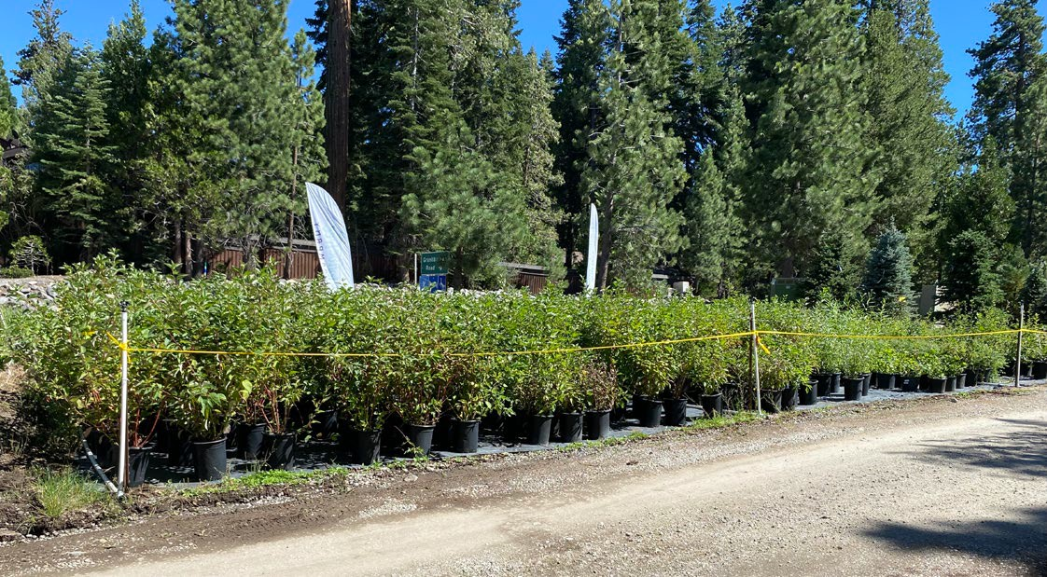

Vegetation Management
Program Outlook
Quality Assurance Inspections
Vegetation Risk Modeling
  Fall-in risk score pilot
Training of Inspectors
  Arborist training to specific to Liberty
  Compatible plant and land cover type identification and management
Integrated Vegetation Management
  Post VM monitoring of plant communities in right-of-way
  Compatible plant give-away
Partnerships
  National Forest Foundation & Forest Service

Slide 55

Thank you
13

Slide 56
BVES

Slide 57
SMJU WMP Workshop
BVES Vegetation Management
Jared Hennen, Wildfire Mitigation and Reliability Engineer
June 16, 2023
Powering The Mountain Since 1929

Slide 58
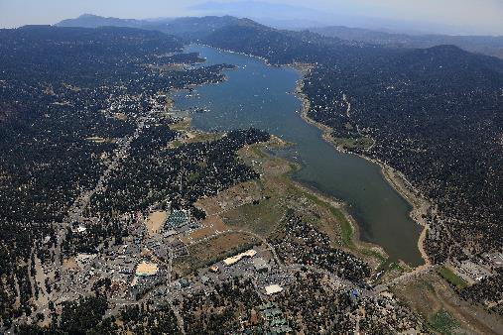
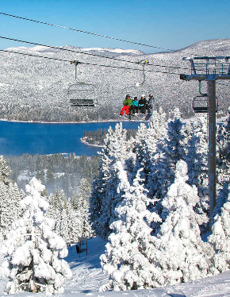
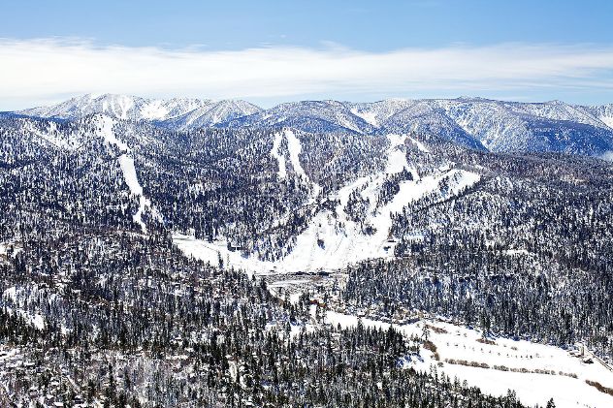
Vegetation Management - Accomplishments
2022 Accomplishments
Zero tree-related ignitions
Trimmed over 6,000 Trees
Removed 147 at risk trees
Completed LiDAR and UAV inspections on all BVES service territory
Brought on a pre-inspector
Implemented a new tree inventory system
  Fully customizable for future regulatory needs
  stores extensive data for every tree (Species, height, condition, Geolocation, etc.)
Slide 58

Slide 59
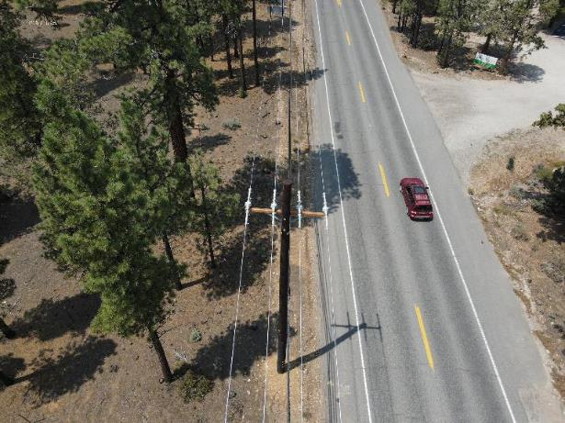
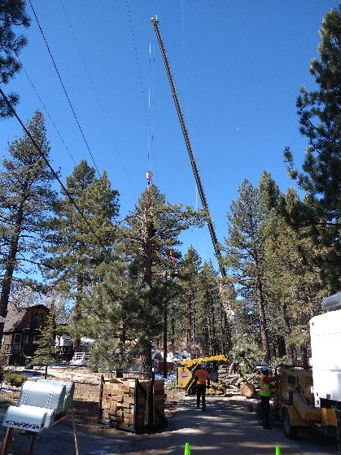
Vegetation Management – 2023 Goals
Complete at least 72 circuit miles of EVM work
Remove 88 trees with strike potential on lines
Continue UAV and LiDAR inspections on entire service territory
Complete at least 72 VM QCs
Further update tree inventory system to meet BVES needs
Slide 59

Slide 60
Questions
Slide 60
Powering The Mountain Since 1929

Slide 61
Pacificorp

Slide 62
2023 Wildfire Mitigation Plan Update
Vegetation Management
Brian King, Director of Environmental and Vegetation Management
June 16, 2023

Slide 63
  2022 Vegetation Management
  2023 Vegetation Management
PacifiCorp completed vegetation management work as per Public Resources Code § 4292 and Public Resources Code § 4293
Continued best practice vegetation management work
Continued improvement of the field mobile software tool
Kicked off enhanced overhang reduction pilot work
Increasing QA/QC resources
Completed inspection of 1,174 line miles beyond routine maintenance and 1,531 miles of routine maintenance
Completed pole clearing on 3080 poles
Completed overhang reduction planning

Slide 64
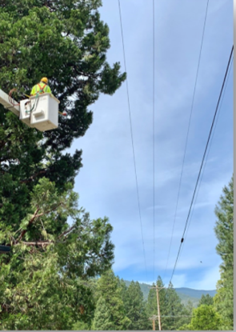

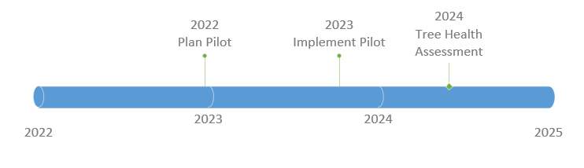

Enhanced Overhang Reduction
Clear overhanging vegetation to sky
Located in HFTD Tier 2 and/or Tier 3 where there is a variety of coniferous and hardwood species
Collect data on tree species, location, date pruned

Slide 66
OPEN QUESTIONS
AND ANSWERS
Reminder to raise hand, use Q&A function in Zoom.

Slide 67
NEXT STEPS
Slides and workshop recording will be made available.
Written comments due by June 29, 2023.

Slide 68
PUBLIC PARTICIPATION
Docket 2023-2025-WMPs is your primary source of information regarding WMP evaluations: https://efiling.energysafety.ca.gov/EFiling/DocketInformation.aspx?docketnumber=2023-2025-WMPs
Data Request (DR) responses are available at each electrical corporation’s website and summaries of DRs received by the utilities are available at: https://efiling.energysafety.ca.gov/EFiling/DocketInformation.aspx?docketnumber=2023-2025-WMP-DRs

